Slide 1
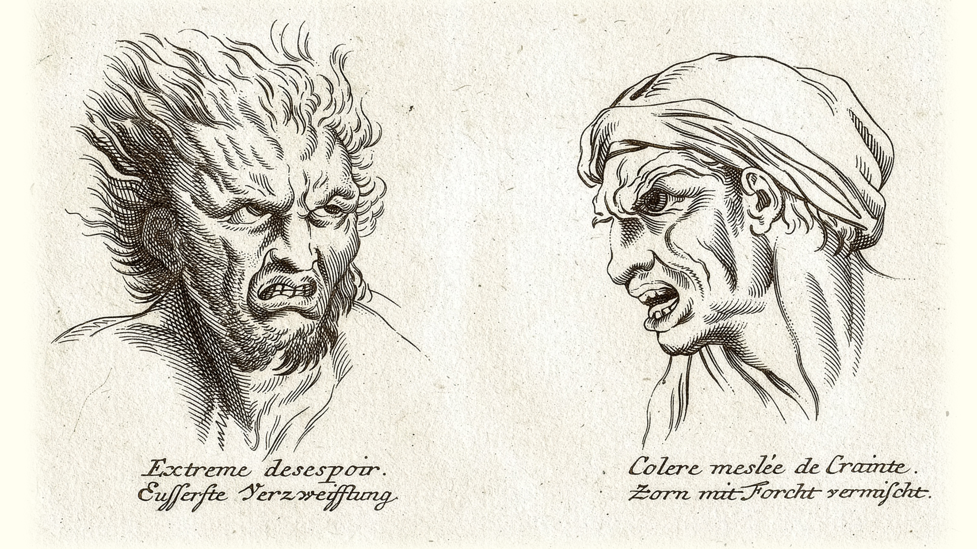
Know Your Other, Protect Yourself
Polemon’s Physiognomy

Slide 2

Security with Google smarts with the new Nest Doorbell
Notes:
So, why is it important to know if it’s a zombie, werewolf, or ghost?

Slide 3
Bar Hebraeus, Cream of Knowledge
“Regarding women Polemon said in relation to Menelaus, whose wife Helen was seized by Alexander Paris, that truly had God granted Menelaus to know the natural [= physiognomic] signs, he would have realized Alexander was an adulterer, and he would not have introduced him into his house and would not have shown his wife to him.”
(Trans. Swain, from Bar Hebraeus Cream of Knowledge)
Notes:
Regarding women Polemon said in relation to Menelaus, whose wife Helen was seized by Alexander Paris, that truly had God granted Menelaus to know the natural [= physiognomic] signs, he would have realized Alexander was an adulterer, and he would not have introduced him into his house and would not have shown his wife to him. And the hard war and the slaughter of the heroes, the destruction of the famous city of Ilion, the dissolution of the seven guiding stars [= Pleiades], and the many miseries that happened to the Greeks would not have occurred. And again, if Agamemnon had noticed the look of his wife Clytemnestra, he would have understood the deceit she had prepared for him and he would not have been killed in his house on a table like a bull in its manger. (Trans. Swain, from Bar Hebraeus Cream of Knowledge)
Polemon cites the obscure myth of Electra, progenitor of the Trojans, quitting her spot in the firmament out of grief for her descendants. Scholia vetera (D scholia) in Iliadem 18.486. φασὶ δὲ Ἠλέκτραν οὐ βουλομένην τὴν Ἰλίου πόρθησιν θεάσασθαι, τῷ τὸ κτίσμα εἶναι τῶν ἀπογόνων, καταλιπεῖν τὸν τόπον ἔνθα κατηστέριστο, διόπερ οὔσας πρότερον ἑπτὰ, γενέσθαι ἕξ. ἡ ἱστορία παρὰ τοῖς Κυκλικοῖς. ... ὡς μὲν Ἄρατος ἐν τῷ πρὸς Θεόπροπον ἐπικηδείῳ φησὶ, Τροίας πορθουμένης τὴν Δαρδάνου μητέρα Ἠλέκτραν μίαν οὖσαν τῶν Πληϊάδων, φυγεῖν τε τὴν τῶν ἀδελφῶν συνοδίαν, καὶ τὰς κόμας λύσασαν, ἐνίοτε κομήτην ἀστέρα φαίνεσθαι.

Slide 4
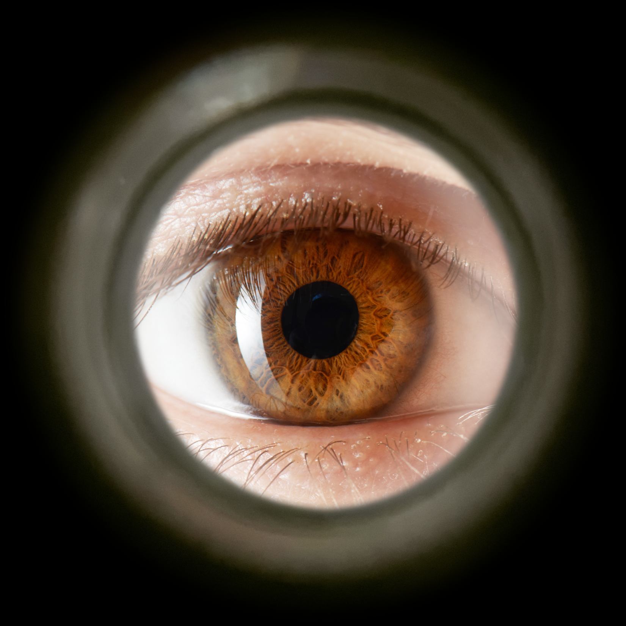
Peephole
Notes:
doors protect us, but we can’t always see through them.
if we could leave the door in place, yet have a view of what’s on the other side, we’d know whether to let those others in.
the body is like a door, blocking our view of the inner being.
yet its features — especially the eyes — offer a window into what lies within. who wouldn’t want some of that?
I suspect that Polemon’s Physiognomy was intended, first and foremost, as a kind of personal security app.
Yet the “scientific” principles around which this bit of tech are organized, as well the uses for which it is intended, could well prove culturally revealing

Slide 5
Agenda
Discussion
  Where are we now? Is All Life agōn?
Polemon and His Physiognomy
  A Quick and Dirty Introduction
Case Studies
  Your Thoughts…

Slide 6
Discussion
Where are we now? Is All Life agōn?

Slide 7
SWA Prompts
How does the assigned reading validate / challenge ideas that you bring to the assignment?
Do we all need early warning systems?
  Is all life agōn, potential threat?

Slide 8
Polemon and His Physiognomy
A Quick and Dirty Introduction

Slide 9
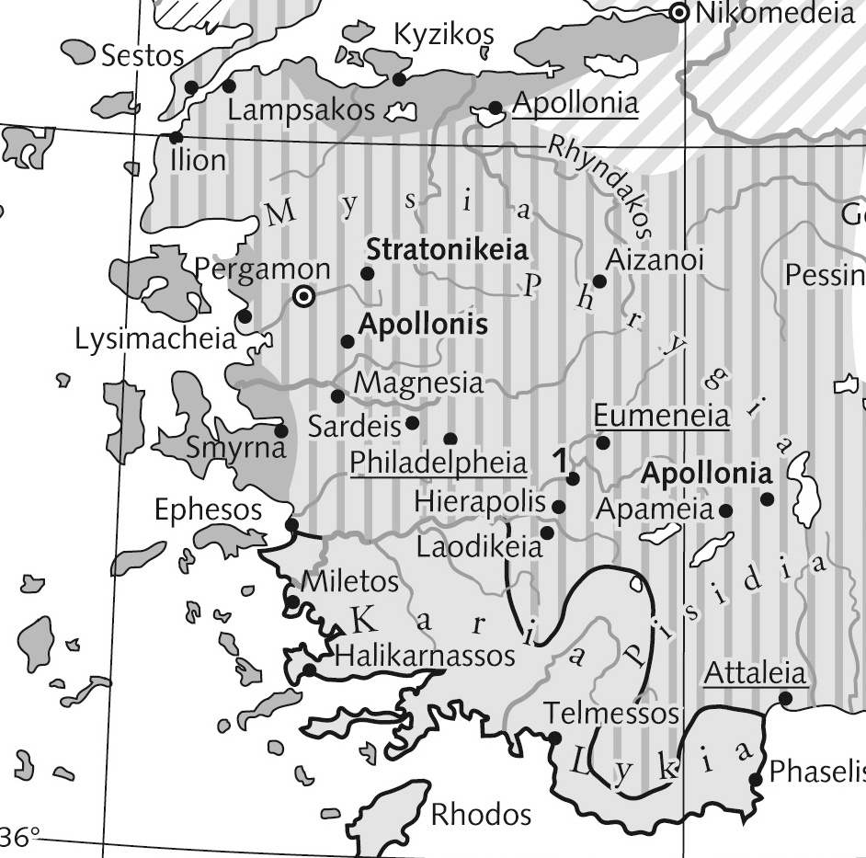
Antonius Polemon (ca. 90–146 CE)
Royal ancestry
  Laodicea on the Lycus
Sophist, statseman
  Smyrna
Imperial “friend”
  Hadrian (r. 117–138 CE)
Map, western Anatolia

Slide 10
Physiognomy: Etymology, Definition
Greek phusiognōmōnia
  phusis, “nature,” “character”
  gnōmōn, “one who knows, interprets”
Oxford English Dictionary
  “The study of the features of the face, or of the form of the body generally, as … indicative of character….”
Notes:
“[t]he study of the features of the face, or of the form of the body generally, as being supposedly indicative of character; the art of judging character from such study”

Slide 11
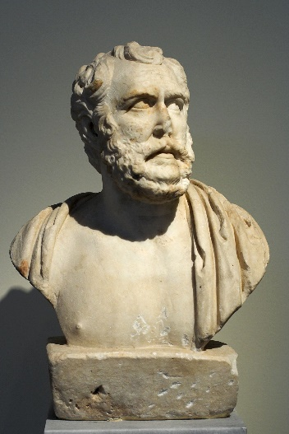
Sources: P’s Physiognomy (ca. 130 CE?)
Greek: Adamantius Physiognomy (4th ce)
Latin: Anonymus Latinus (late 4th ce)
Arabic: Leiden Polemon (9th/10th?),
Istanbul Polemon (pre-mid 10th)
Syriac: Bar Hebraeus Cream of Knowledge (13th cent)
Polemon?

Slide 12
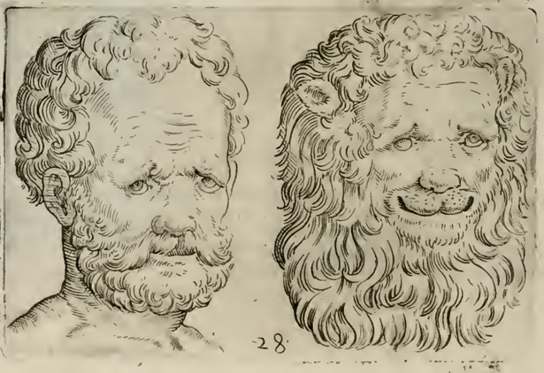
Science
Detailed observation
Rhetorical reasoning
Analogical reasoning
Character = habitual emotion
From della Porta's Physiognomy
Notes:
Method: integrative, summative reading of signs: Leiden 369, 381, 383; cf. Ad 1.3
Context: culture of mutual inspection, elite competition.
Physiognomy relies on rhetorical proof (abduction, enthymemes: Aristotle Prior Analytics 70b6–25; Barton 104–107; Sassi 69–81). It appeals, in Sassi’s phrase, “[to] collective patterns of thought and per-sonal intuitions” ( 81)
How do the passions figure in? For physiognomy deals mainly not with the passions per se but with ēthos, “character,” of which passion forms a part. Still, for no less an authority than Aristo-tle, stable correlations between pathos (emotion/passion), whether momentary or dispositional, and physical traits like khroia (complexion) underpin physiognomy’s scientific rigor (Categories 9b1–33; Sassi 70–73). And so do they in Polemon, certain of whose case studies clearly il-lustrate his interest in detecting transitory passion that has yet to break out into the open. Nor does one detect a strict demarcation between passion and character trait in any of our physiognomists.

Slide 13
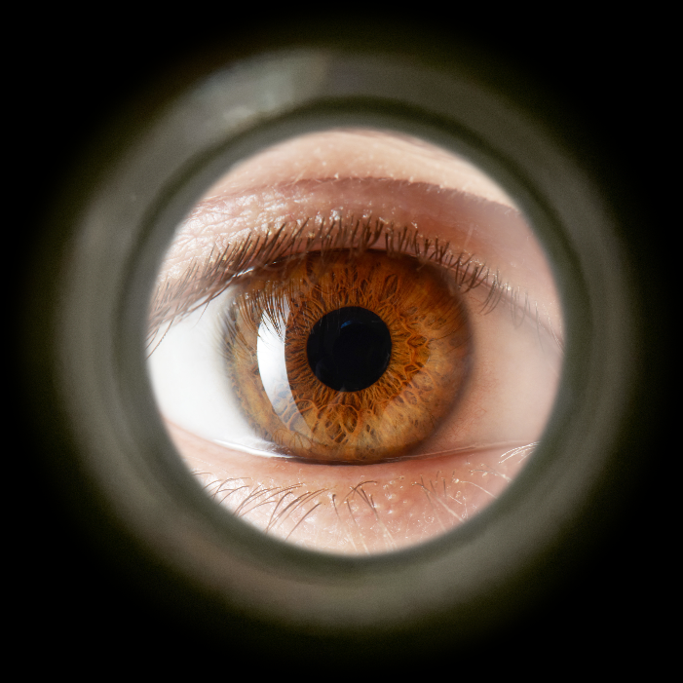
Technology
“Technology is Society Made Durable”
  Bruno Latour
Physiognomy as tekhnē (Adamantius
1.2–3)
  Copious memorization
Physiognomy as security system
  Bar Hebraeus Cream of Knowledge
Notes:
Polemon offers further insight in a passage where he decries the physiognomic ignorance of the sons of Atreus. Had they but known how to read the signs, they could have detected the guile that lay hid in the breasts of their respective rivals and adversaries. Indeed, they could have avoided the whole, sorry business of the Trojan War and its attendant calamities (Swain 178, from Bar Hebraeus). We can, then, think of physiognomy as a kind of security system. Like a peephole, it allows us to stand safe and sound on our side of the door, yet also allows us to peer into what lies beyond the divide, protecting not just ourselves but entire households and cities from the catastrophic effects of ill-considered associations — a means “of holding society together as a durable whole” by determining if the intentions of one’s “other” align with one’s own.

Slide 14
Sociology? (Boys-Stones 2007)
“Second-sophistic society was full of rules…. This need produced a culture of mutual inspection and evaluation”
  Swain’s “Introduction” to the Leiden Polemon, p. 131
“Afterwards I heard the people saying that it had been with her approval”
  Leiden Polemon p. 459, on bride abduction
Is “second-sophistic society” the right word?

Slide 15
Case Studies
Your Thoughts…
Notes:
the case studies = research, though often are merely anecdotal. validate the physiognomy and physiognomist’s skill

Slide 16
The Man from Lydia
“He had an effeminate mouth, was boastful in his speech, with a long nose, and chin and cheeks far from his eyes. … He often honed his teeth like a wild pig when it attacks the huntsman to kill him. He presented to [neighbors] a basket .… On top of it were saucers of oyster-shells, and underneath them was the head of a man!” (p. 355)
Notes:
"I have not seen the like of this type, though I did see one man, and he was from Lydia. He was going down to the land of Ionia and travelling about there. He had eyes like those I have described to you [bluish-black-red plus red, yellow, or green dots?]. As for his colour, it was black turning towards redness, as if he had drunk wine or were angry. He had an effeminate mouth, was boastful in his speech, with a long nose, and chin and cheeks far from his eyes. He had much flesh, a thick short neck, and his stomach was large, protruding, even, and fleshy. He was strong, his ankles were thick, the digits of his hands and feet were short, the flesh of his hands was fatty, and in his voice was an ugly hoarseness. His glance was the glance of a grieving and bilious man, and he seemed like one bearing threats towards all people. He often honed his teeth like a wild pig when it attacks the huntsman to kill him. He laughed in a high voice, and his spirit seemed ablaze. So I knew that this individual was full of evil, and he was always interested in and thinking about plotting and learning vile deeds. He was full of tyranny and enmity, often threatening evil; a killer, and shedder of blood. He would often speak of fornication, of young men and women, and that he desired no trappings but bastard children. To his friend he was more evil than to his enemy, desirous in harming friend and foe, freedman and slave. He would invent innumerable kinds of evil. Among the astonishing calamities which no one was aware of was that he was once neighbour to some good people, on a feast day of theirs on which they were giving out invitations. He presented to them therefore a basket, the contents of which were not known. When the messenger had set it down and left, the people said to each other ‘he has sent this to us with much food’. They gave orders for the food to be brought to them, and the basket was put among the offerings, and was opened. On top of it were saucers of oyster-shells, and underneath them was the head of a man!” (do we have any indication of the man’s class? perhaps affluent enough to arrange for this “gift.” that he was invited to a celebration does not have to mean he was of the same class as the hosts.)

Slide 17
On Nationalities, Races. North
“Know that the inhabitants of the northern parts are tall, white, red-haired, blueeyed, rough to the touch, with thick ankles, chubby bodies, good fatness, soft flesh, large bellies, and they are lacking in anger and investigation. They have forgetfulness, sincerity, and bad memory.” (pp. 423–425)

Slide 18
On Nationalities, Races. South
“Know that the inhabitants of the southern parts are black, curly-haired, with thin heels, dusky eyes, black hair, and little flesh. They are tolerant in their actions and have cleverness, memory, lightness, opulence, much thought, lying, desire, and stealing. Just as the north is the opposite of the south, likewise the judgement of its people is contrary to the judgements of the people of the south. Regarding whoever is in the middle of the two conditions, judge for them accordingly.” (p. 425)
Notes:
character conforms to geography

Slide 19
On Nationalities, Races. Greeks
“[The Greeks] are a people who share in their land. Others have become numerous among them, because people want them and their land, either for the pleasantness of their life and their moderate temperament and passion, or out of a desire for their knowledge, their good way of life and their laws.” (p. 427)
Notes:
“The pure Greek is of medium stature, between tall and short, broad and weak. He is of erect posture, beautiful in face and appearance, white in colour, mixed with red, medium in flesh, with medium palms and elbows, alert, quick to learn, neither small nor large of head, in his neck thickness and strength. His hair is soft and red, with some curliness and some waviness on account of its lankness. In his face there is squareness, in his lip slimness, and his nose is pointed and evenly proportioned. His eyes are moist, bluish-black, very mobile, and very luminous. This is the description of the pure Greek.” (p. 427)

Slide 20
“Woman’s Passion For Unknown Men”
“I looked at [the bride’s lover’s] face and he was smiling, with a keen gaze, and his eyes were flooded with water. I got near to him and I heard that he had heavy breath. I saw that sweat had soaked his clothes, and I saw that his nose quivered, and I saw his colour taking on different hues, yellow after red. This was because of the disquiet and fear of scandal in him. I looked at the bride, and her eyes were flooded with water and her gaze was keen. Dread was evident in her.” (p. 459)
Notes:
on bride abduction.
cf. abduction of a farmers wife in Alciphron. attempted and successful abduction of Chloe in D&C.
“Know that I was in a city called Dmsws,366 for I was invited with some of its people to a wedding. When they wanted to escort the bride to her husband, the family of the woman set off to the groom’s house, and they ate with him and drank, then they returned together. He was with them, and on his head was a coronet, and in their hands were sprigs of basil, and lamps were borne among them, and the singers were with them, until they brought the bride to the house of her husband. So I accompanied them. Then I said to those around me, to the exclusion of the rest of the gathering, that the bride would be abducted before reaching the house of her husband, and that a man would marry her that very night who was not the husband to whom she was being escorted. Then I remained awaiting the confirmation of what I said until we reached [48b] the door of the dwelling of her husband, when there rose up against us armed ambushers, who had been lying in wait around the door. They rushed to that bride and killed whom they could. The crowds dispersed, and I was among those who escaped on seeing their evil. They overpowered the bride and made off with her. Afterwards I heard the people saying that it had been with her approval. I will mention to you some of the signs by which I made the judgement. I saw the bride walking with people around her and I saw a young man among the companions of her husband and his friends who came with him, to the right of the maiden. I looked at his face and he was smiling, with a keen gaze, and his eyes were flooded with water. I got near to him and I heard that he had heavy breath. I saw that sweat had soaked his clothes, and I saw that his nose quivered, and I saw his colour taking on different hues, yellow after red. This was because of the disquiet and fear of scandal in him. I looked at the bride, and her eyes were flooded with water and her gaze was keen. Dread was evident in her. Thereupon I judged as I judged.” (pp. 457-459)

