Slide 1
Citizen-sponsored public works in the Roman East

Slide 2
Agenda
Discussion
Philanthropy as Dangerous?
Citizen-Sponsored Public Works
Types and Purpose
Euergatism: Case Studies
Herodes Atticus, Regilla
Eternal Fame
The Library of Celsus

Slide 3
Discussion
Philanthropy as Dangerous?

Slide 4
Euarestos Inscription (van Nijf 2004)
“... I pray to the immortals that my children, my city and my country will always celebrate these festivals, unharmed.... Many have put up fair prizes for cities, after they were dead, but, in his own life, no mortal man. I alone dared do this.... So, abating your criticism, all those who have dread Envy, look upon my statue with emulous eyes”

Slide 5
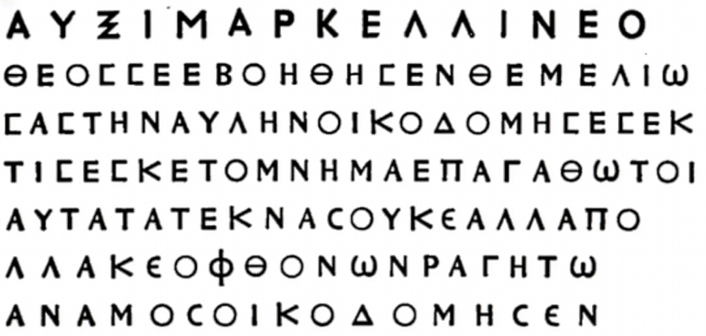
phthonōn ragētō, “Let him who envies burst!”
“In an inscription from Breiké (Syria), commemorating the building of the courtyard of a temple, the wish is expressed that the one who feels phthonos may burst.” (Dunbabin Invida 1983 p. 13 on cf. Waddington Inscriptions grecques et latines 1870 #2415)

Slide 6
SWA Prompt
What risk, if there is one, does philanthropy entail — is Euaristus over-dramatizing things (“celebrate … unharmed”)? Are risk and benefit connected in some way?

Slide 7
Citizen-Sponsored Public Works
Types and Purpose

Slide 8
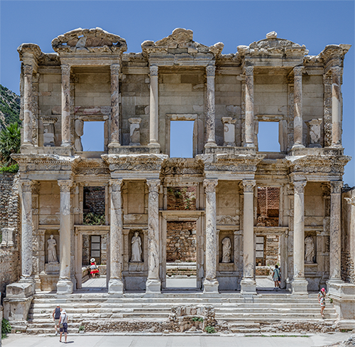
Types, Purpose (studied for today)
Euergetism
Liturgy
Funerary Monument
(Library of Celsus)
Library of Celsus
Notes:
how are these the same?
how are they different?

Slide 9
Euergatism: Case Studies
Herodes Atticus, Regilla

Slide 10
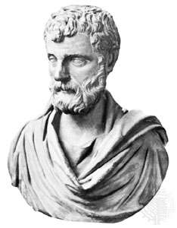
Herodes’ Projects Include…
Panathenaic stadium, Athens
Stadium, Delphi
Odeion, Athens
Odeion, Corinth (renovation)
Aqueduct: Canusium (Italy)
Aqueduct, baths: Alexandria Troas (Anatolia)

Slide 11
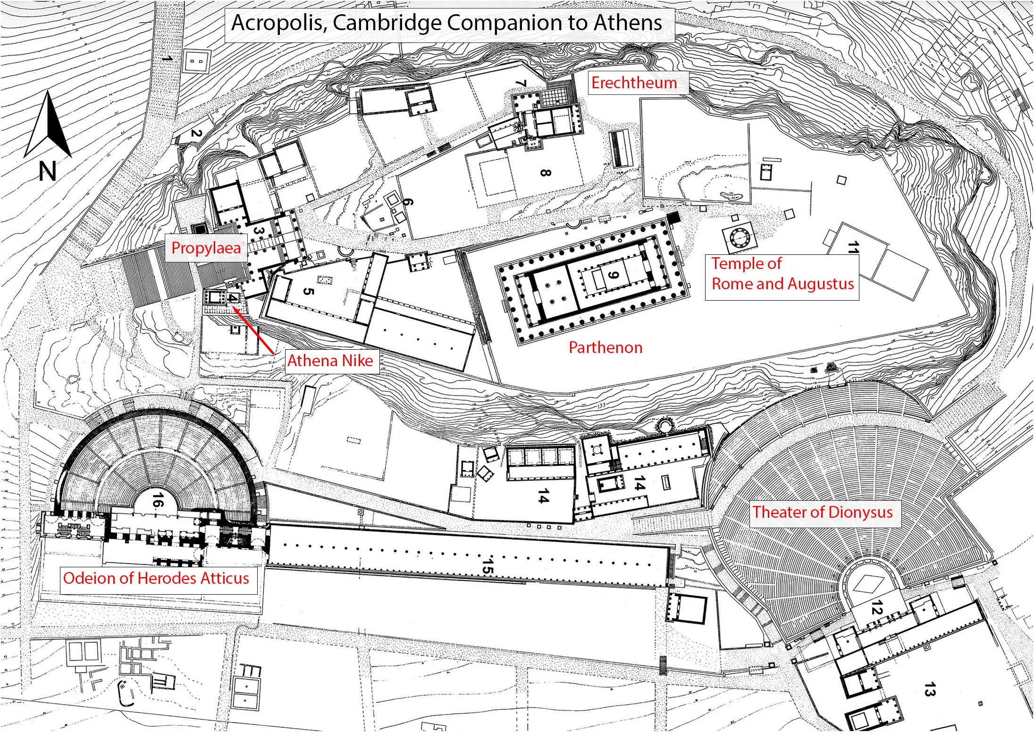
Plan, Acropolis, Cambridge Companion to Athens

Slide 12
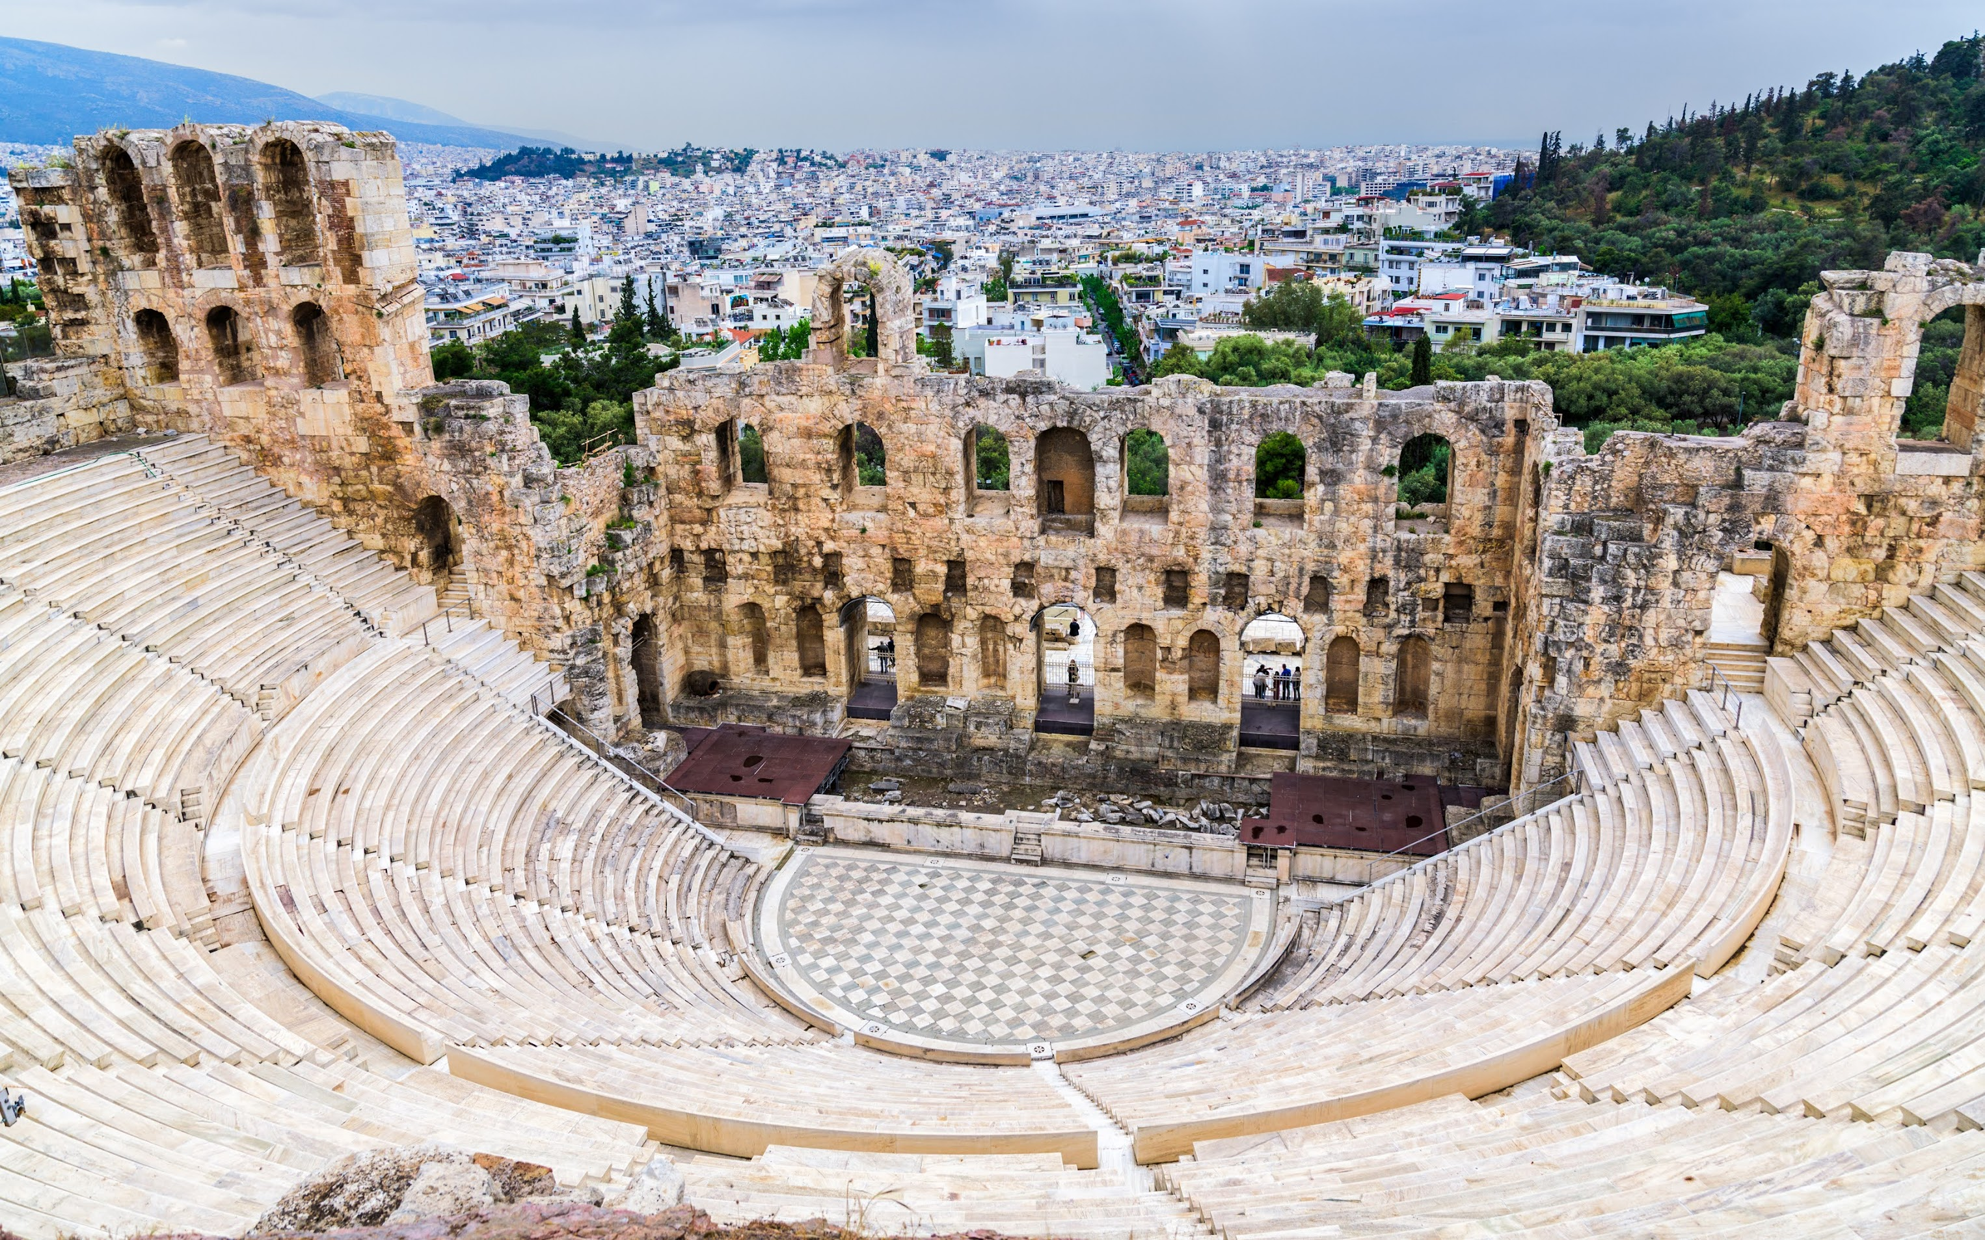
Odeion of Herodes Atticus, from south (161 CE)

Slide 13
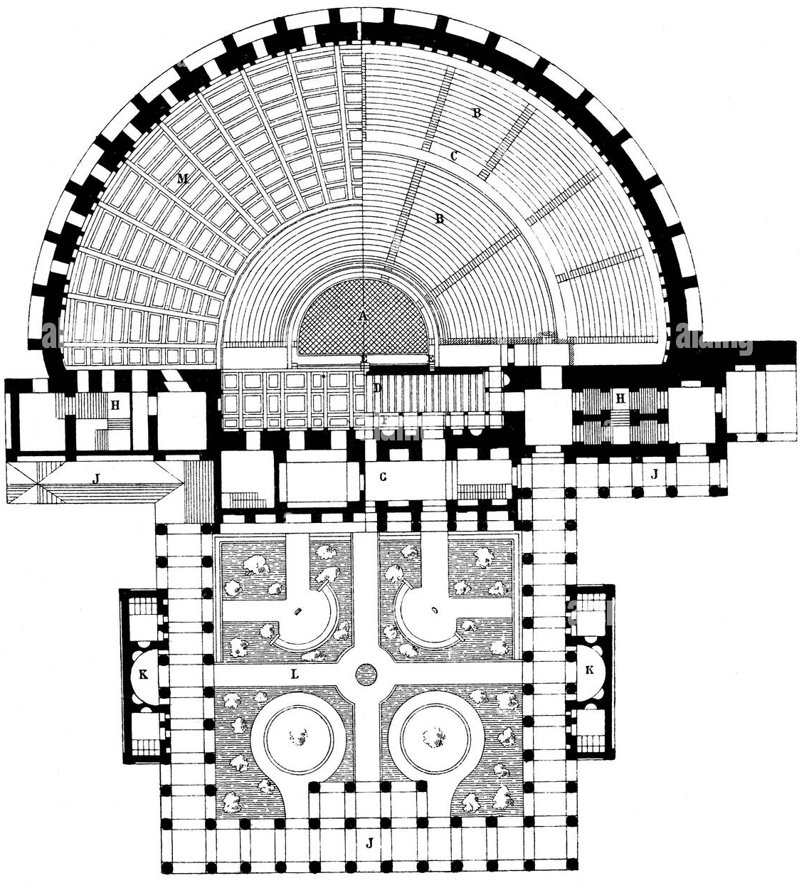
Plan, Odeion of Herodes Atticus (161 CE)

Slide 14
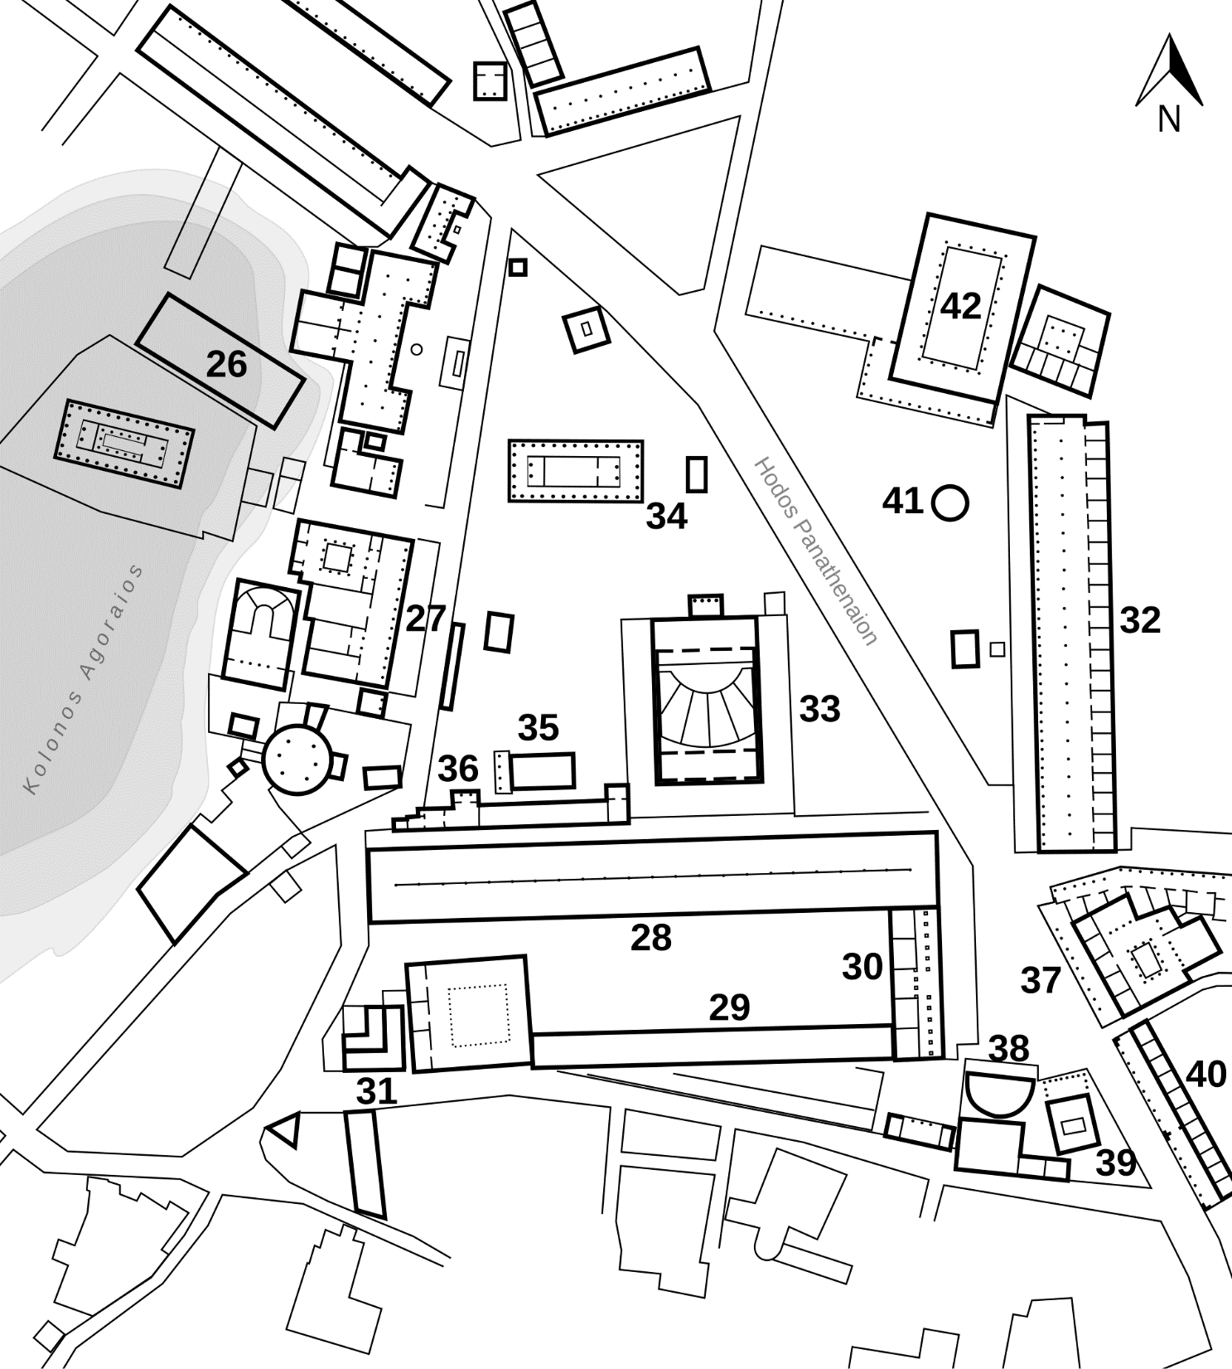
Athens Agora, Roman period, with Odeion of Agrippa (ca. 15 BCE), renovated ca. 150 CE (by Herodes Atticus?)
Odeion of Agrippa,

Slide 15
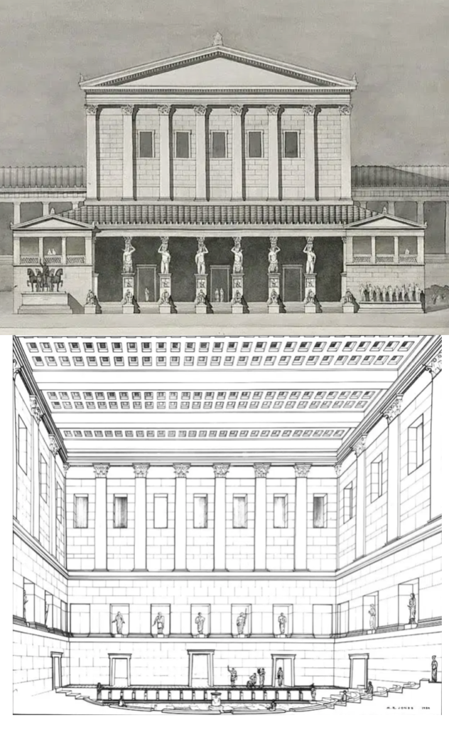
Odeion of Agrippa, renovated ca. 150 CE (by Herodes Atticus?)

Slide 16
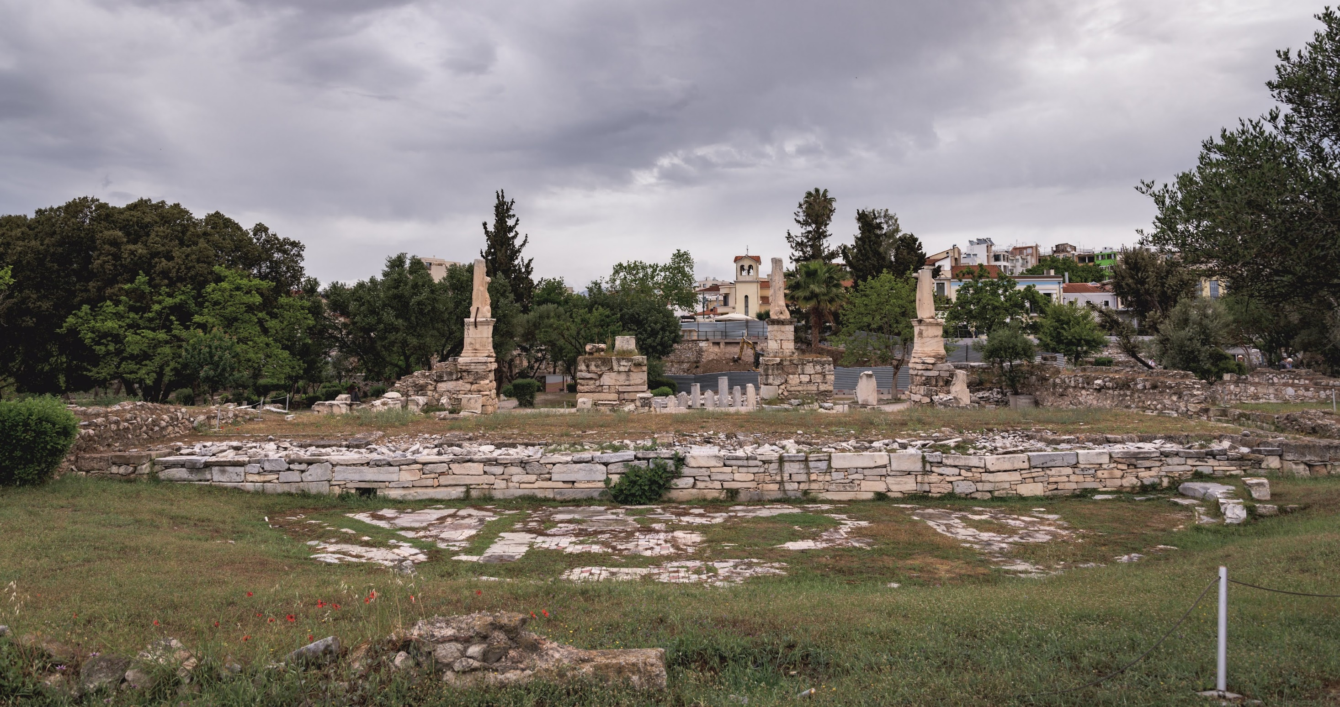
Odeion of Agrippa, from south, facing stage

Slide 17
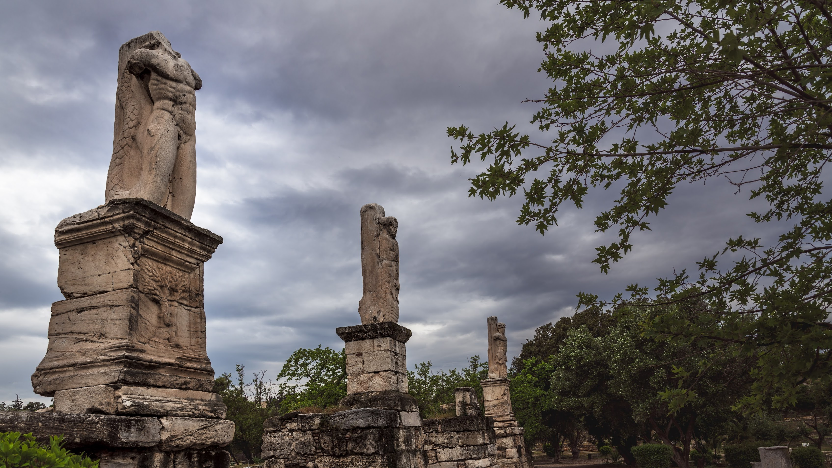
Odeion of Agrippa, giants from renovated north porch

Slide 18
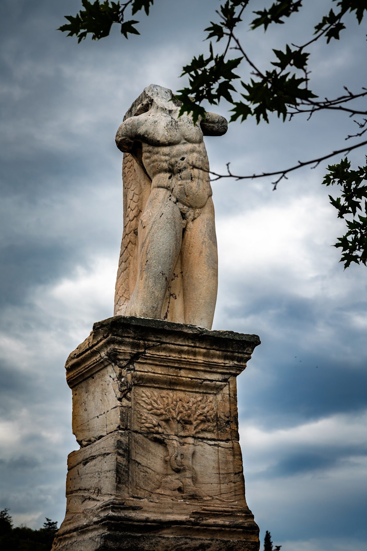
Odeion of Agrippa, giant with snake tail

Slide 19
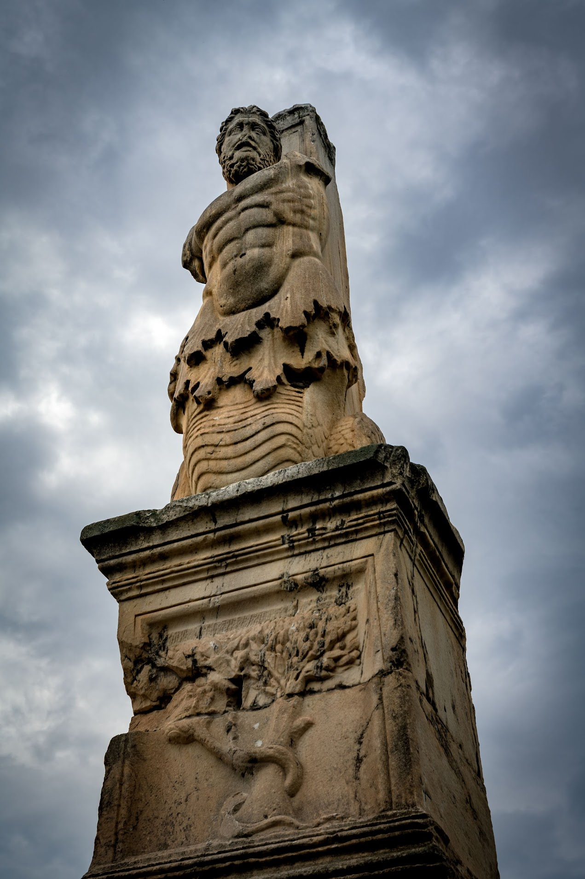
Odeion of Agrippa, giant with fish tale

Slide 20
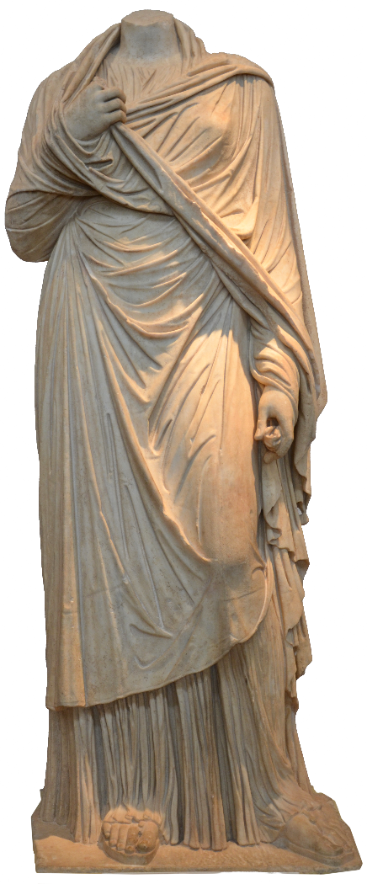
Regilla
Aula Regilla Atilia Caucidia Tertulla
ca. 125–ca. 159 CE
Wife, Herodes Atticus
Priestess of
Tyche (“Fortune”), Athens
Demeter Chamyne, Olympia (153)

Slide 21
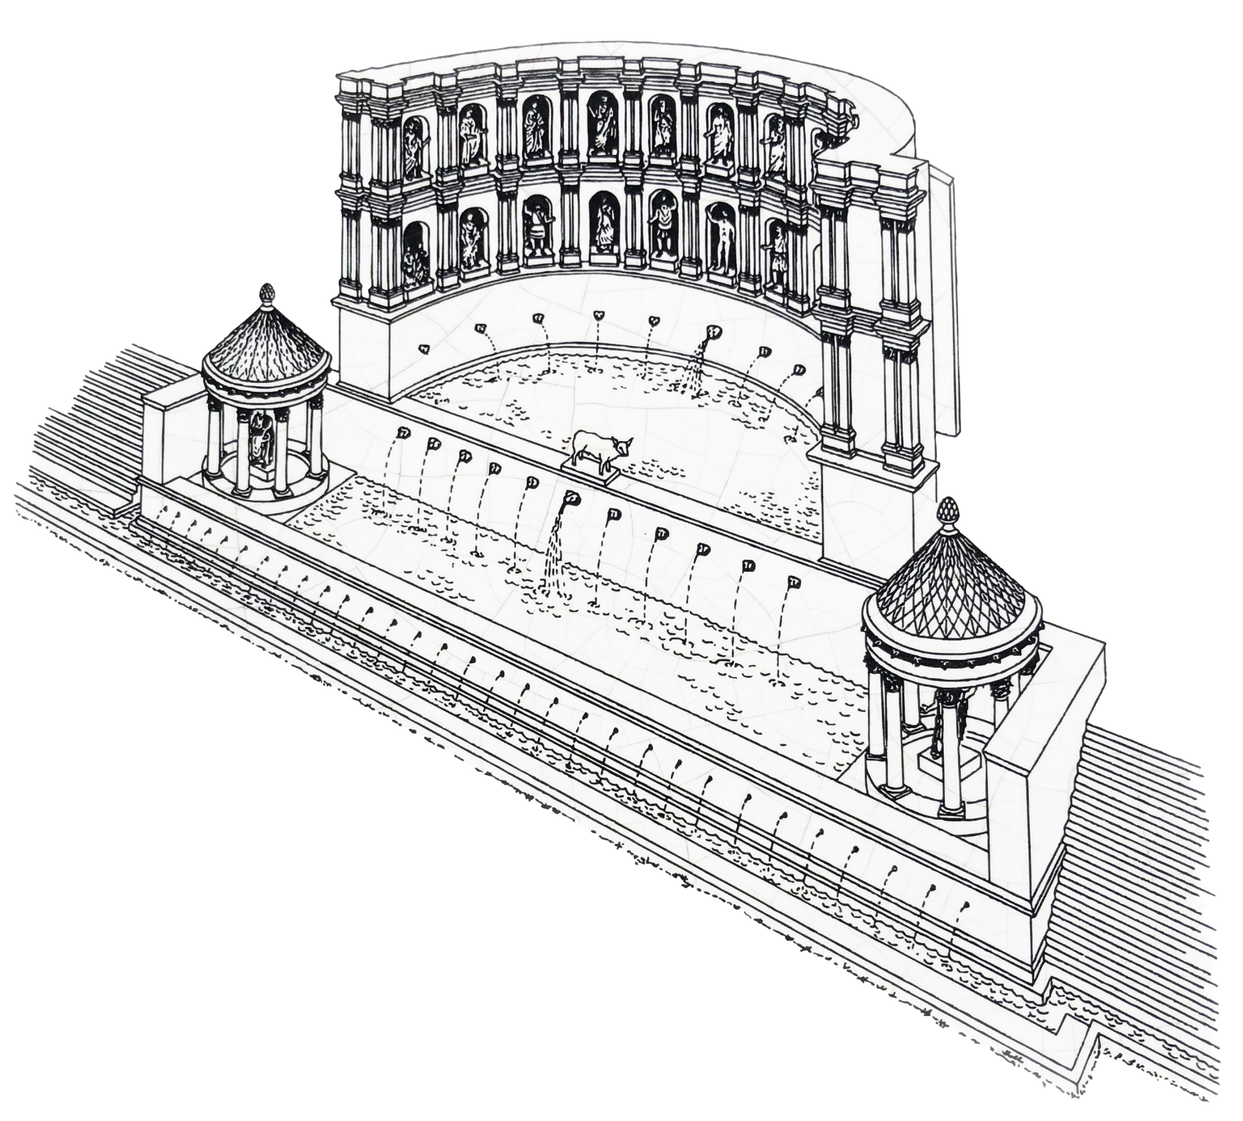
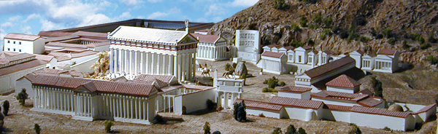
Nymphaeum (fountain) of Regilla, ca. 153 or later, Olympia

Slide 22
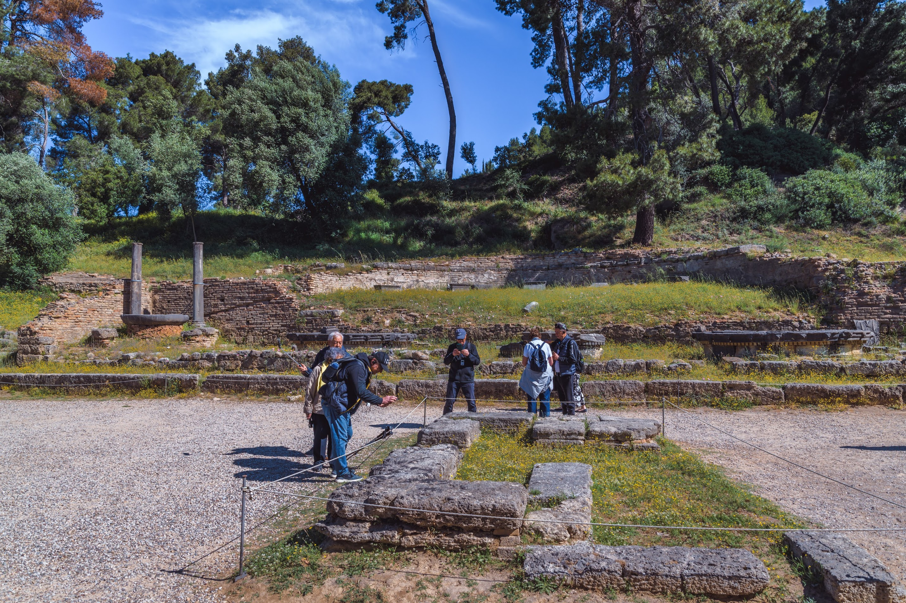
Nymphaeum of Regilla now (1)

Slide 23
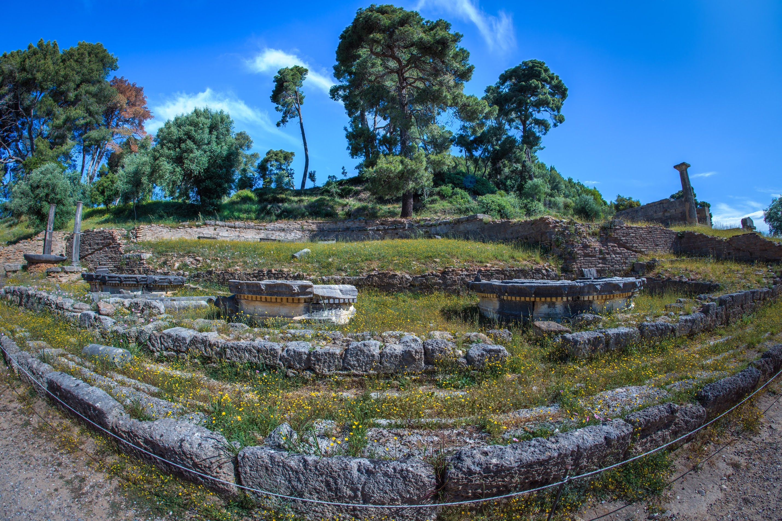
Nymphaeum of Regilla now (2)

Slide 24
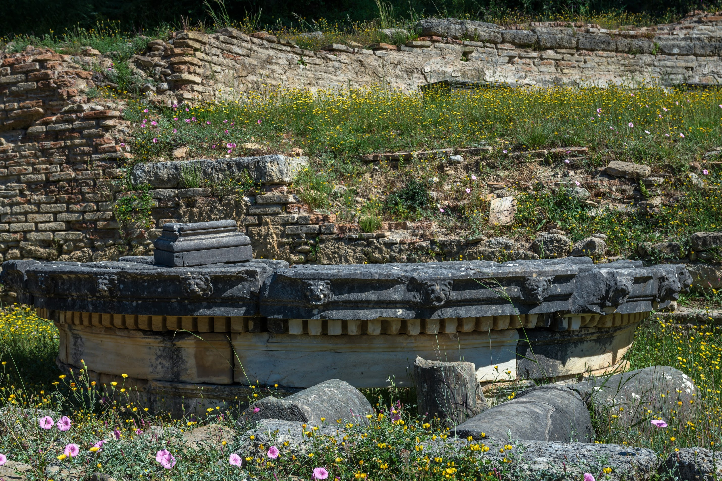
Nymphaeum of Regilla now (3)

Slide 25
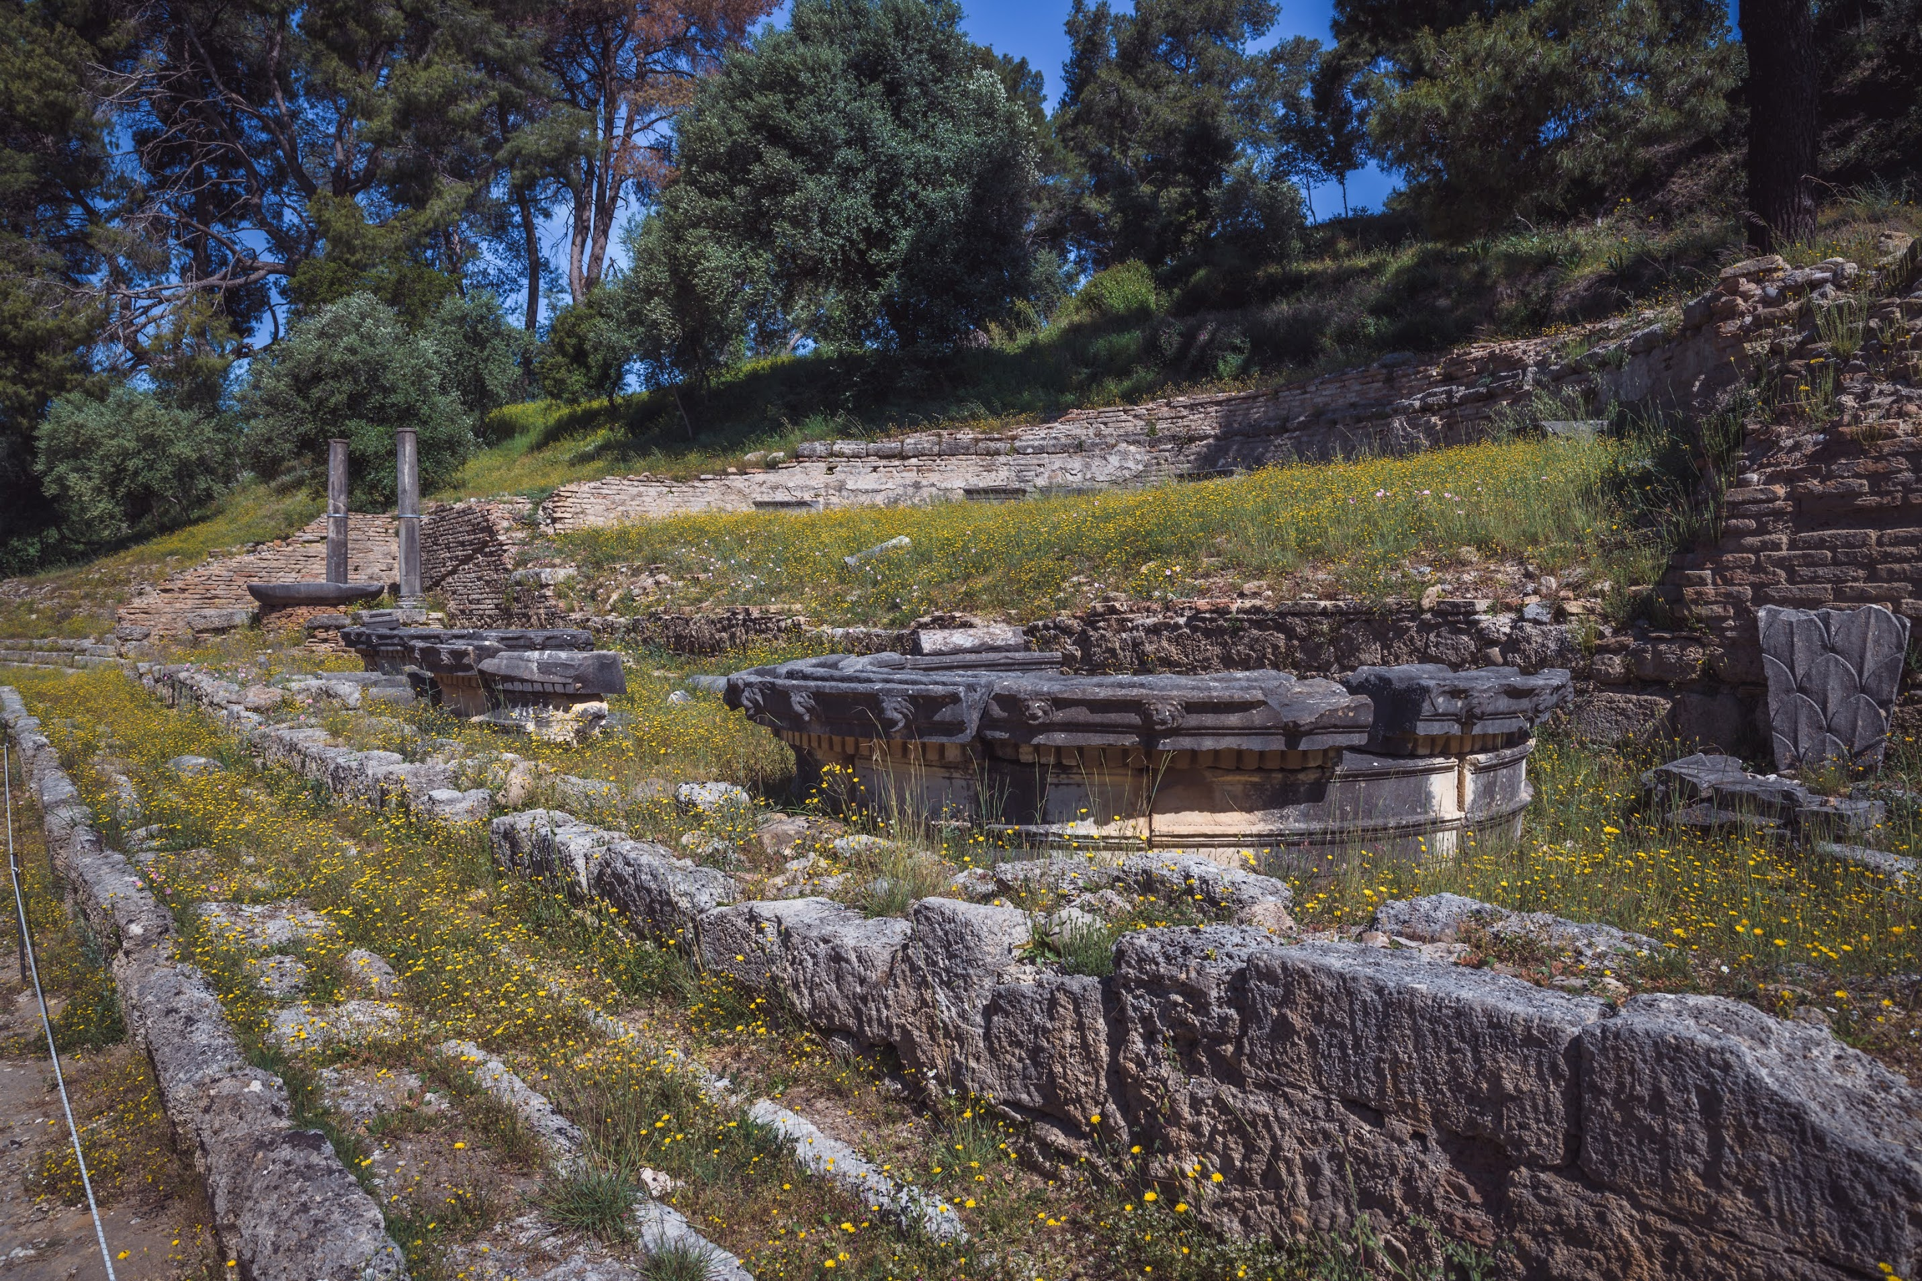
Nymphaeum of Regilla now (4)

Slide 26
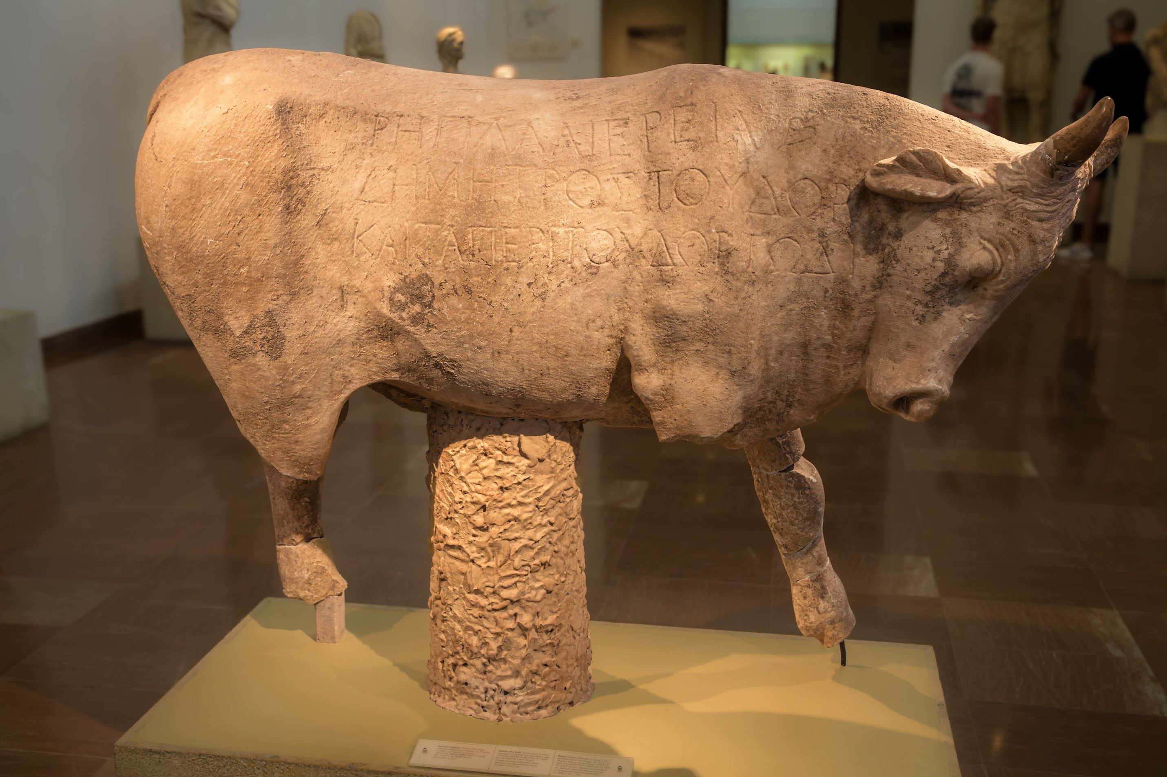
Nymphaeum of Regilla, bull sculpture with dedication
Notes:
Bull from the Fountain of Regilla. The inscription reads, "Regilla, priestess of Demeter, dedicated to Zeus the water (the fountain) and all that pertains to it." 2nd 1/2 2nd CE. Regilla was the wife, and reputed murder victim, of the sophist Herodes Atticus

Slide 27
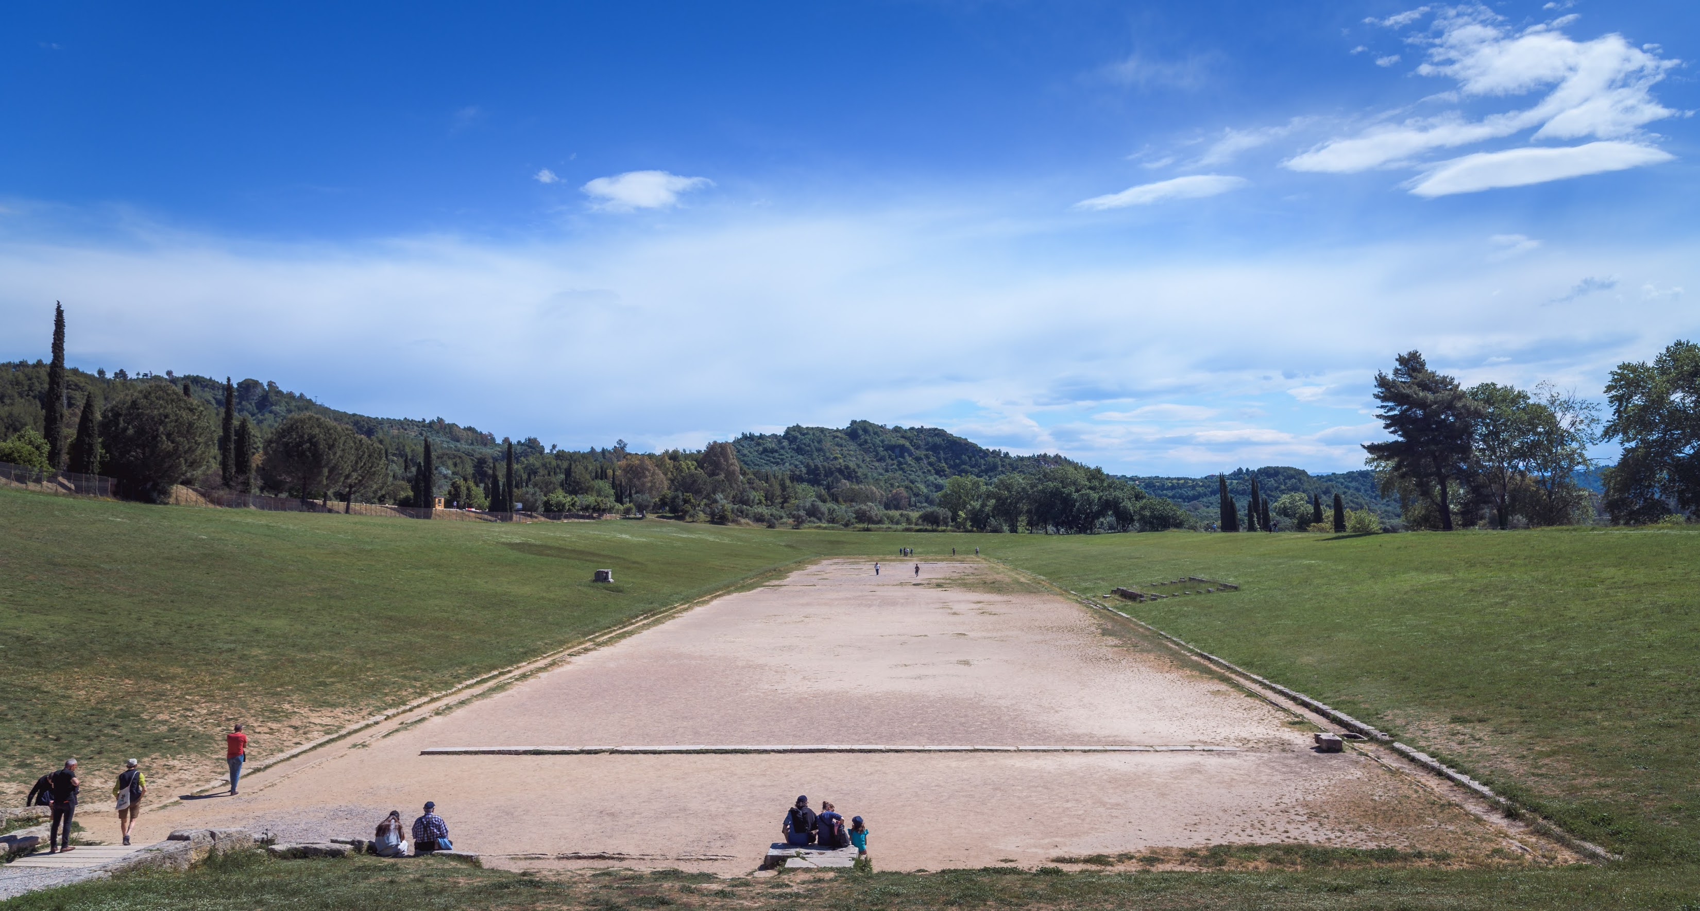
Olympia, stadium

Slide 28
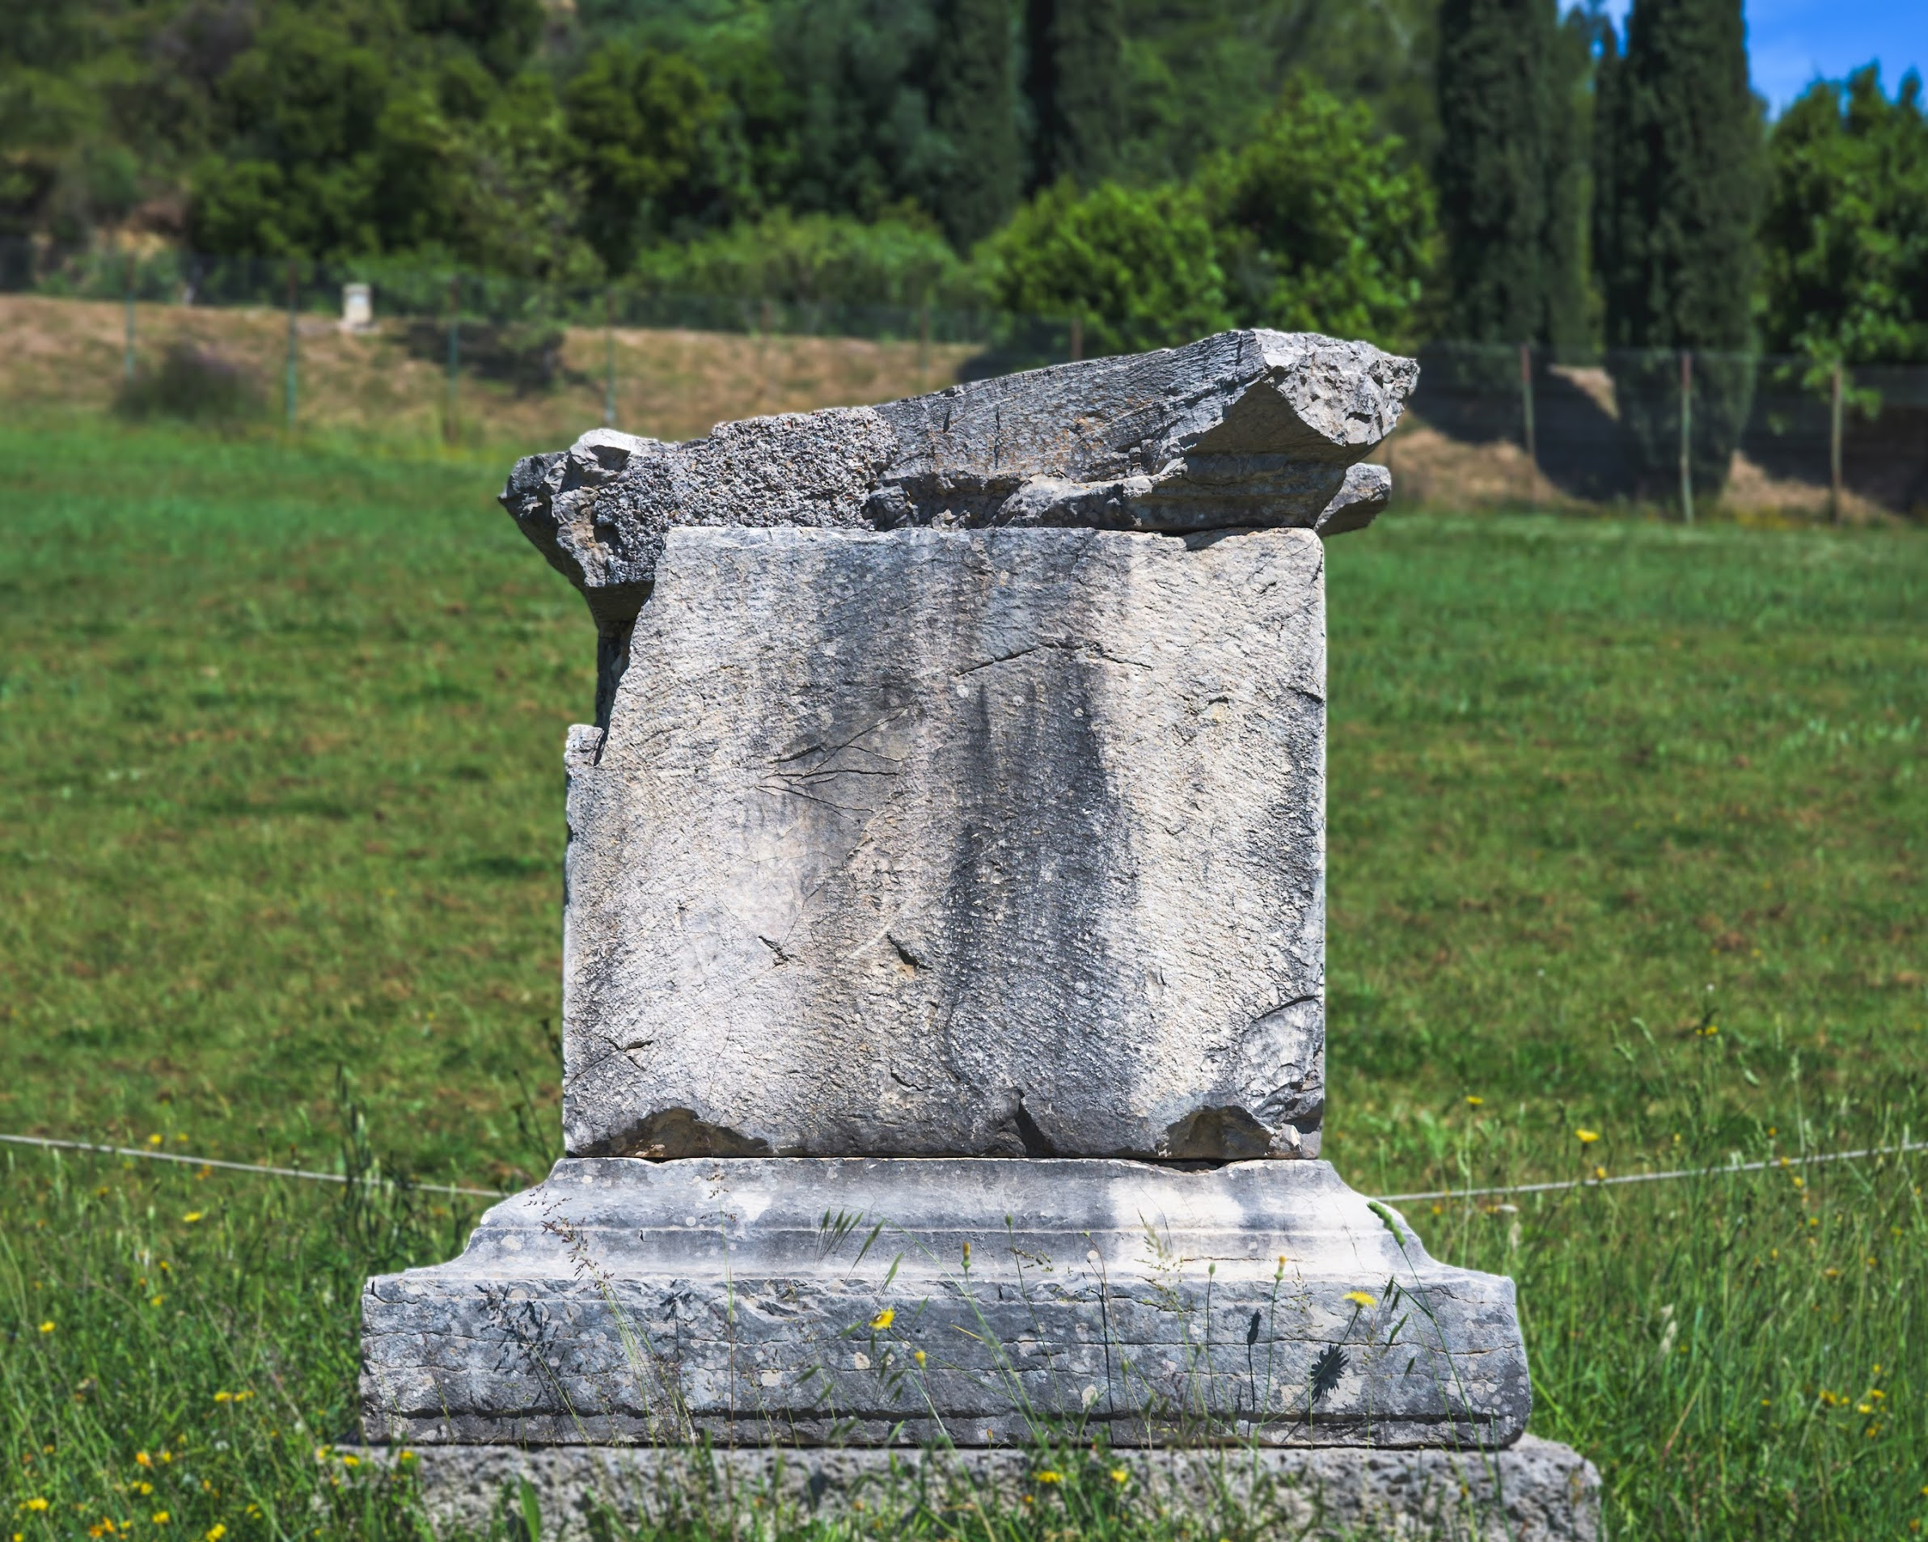
Altar of Demeter Chamyne

Slide 29
Eternal Fame
The Library of Celsus

Slide 30
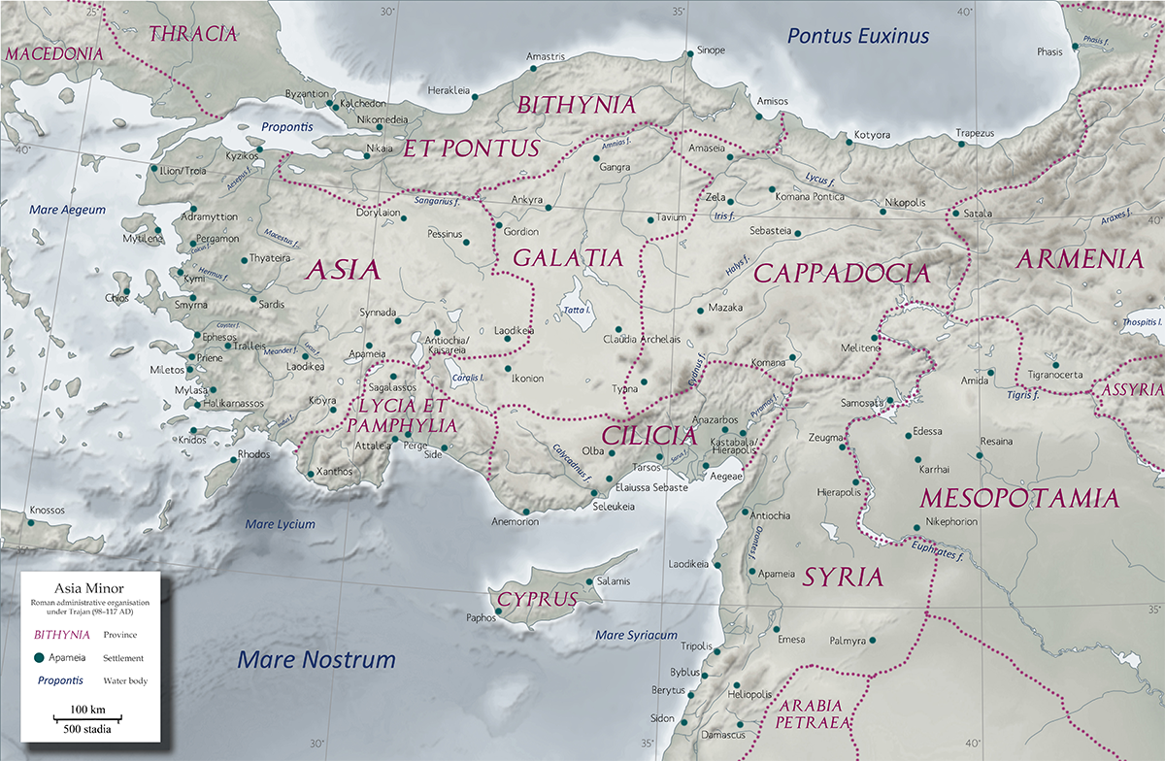
Map, Roman Asia, with Ephesus
Ephesus

Slide 31
Ephesus
Ionian foundation 1086/5 bce (trad.)
Temple of Artemis
7th Wonder of the World
Leading city, Roman Asia

Slide 32
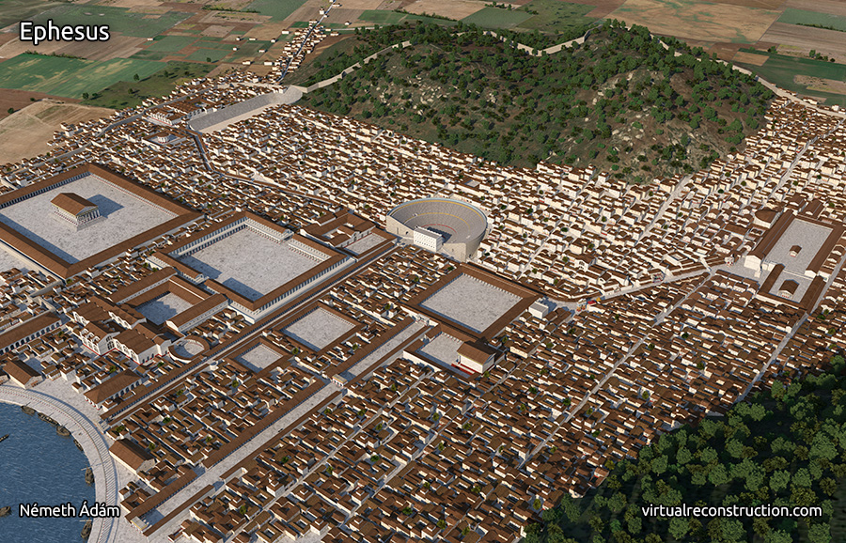
Roman Ephesus
Artemision
Library of Celsus

Slide 33
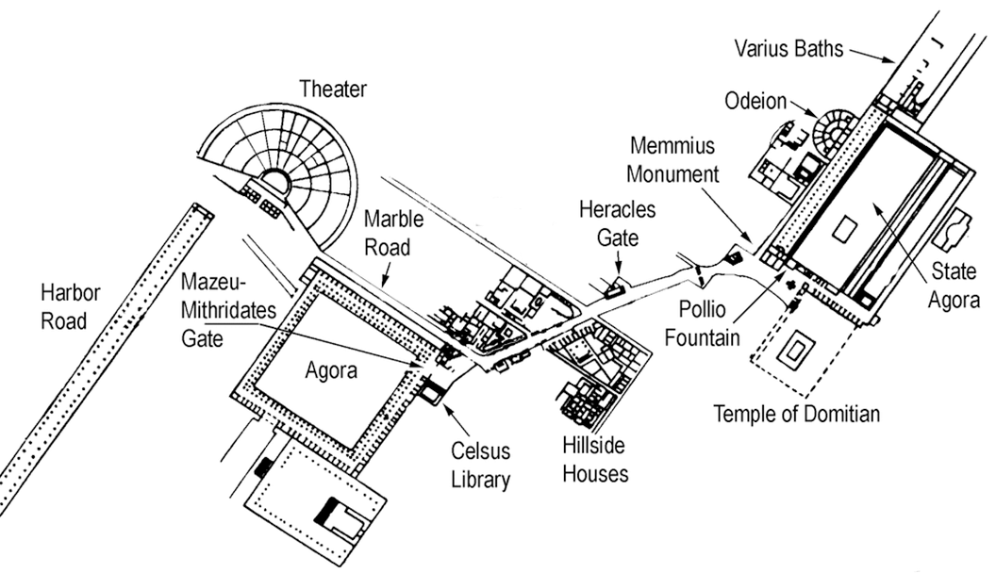
Map, Roman Ephesus, Library of Celsus and vicinity
North
Temple of Artemis
Curetes Street

Slide 34
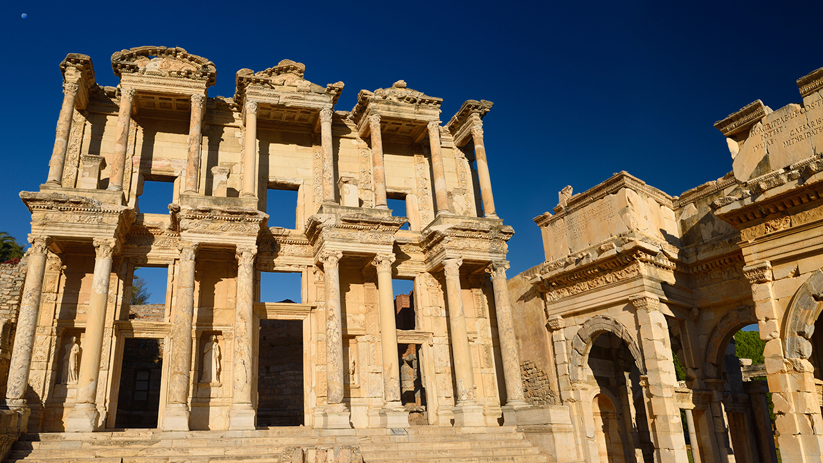
Library of Celsus. Completed 1st half 2nd cent. CE

Slide 35
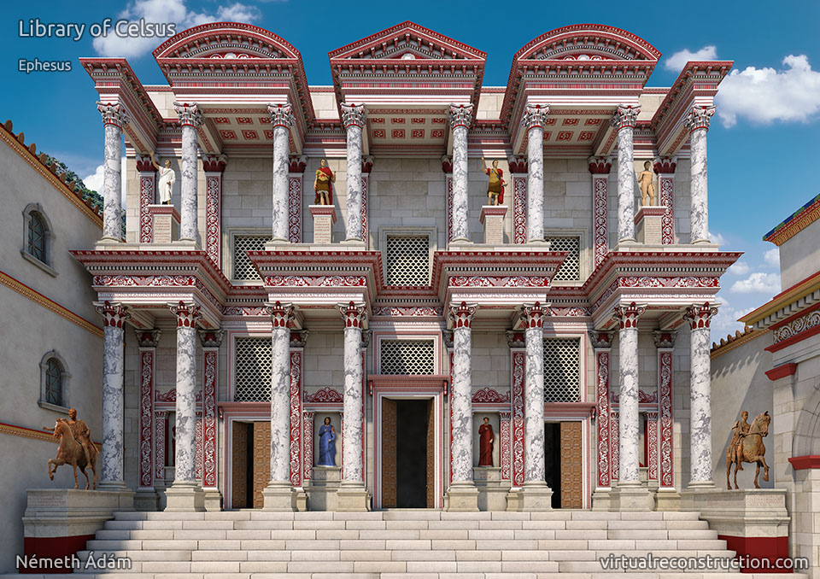
Library of Celsus. 2016 virtual reconstruction, Ádám Németh

Slide 36
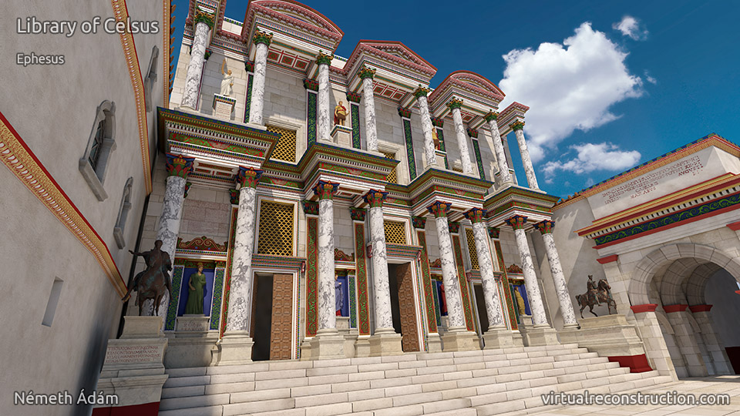
2018 virtual reconstruction, Ádám Németh (new color scheme)

Slide 37
History
Honoring
Tiberius Iulius Celsus Polemaeanus, general, senator, consul, and governor of Asia (died before 114 CE)
Commissioned by
Son Tiberius Julius Aquila, senator, consul AD 110
Library of Celsus
Notes:
brill’s [II 40] Ti. I. Celsus Polemaeanus From Sardeis, official end of 1st cent. AD
From Sardeis; later strong connections with Ephesus. He supported Vespasian in AD 69 as tribune of the legio III Cyrenaica. Entered the Senate; legatus iuridicus in Galatia-Cappadocia 79/80; after occupying several praetorian offices under Domitian cos. suff. in 92; curator aedium sacrarum; proconsul of Asia c. 105/6. On his death interred in a sarcophagus in the library in Ephesus, which had been erected by his son I. [II 17]. He and his virtutes are represented in images, including two equestrian statues. IEph VII 2, 5101-14; Halfmann, 111f.; PIR² J 260.

Slide 38
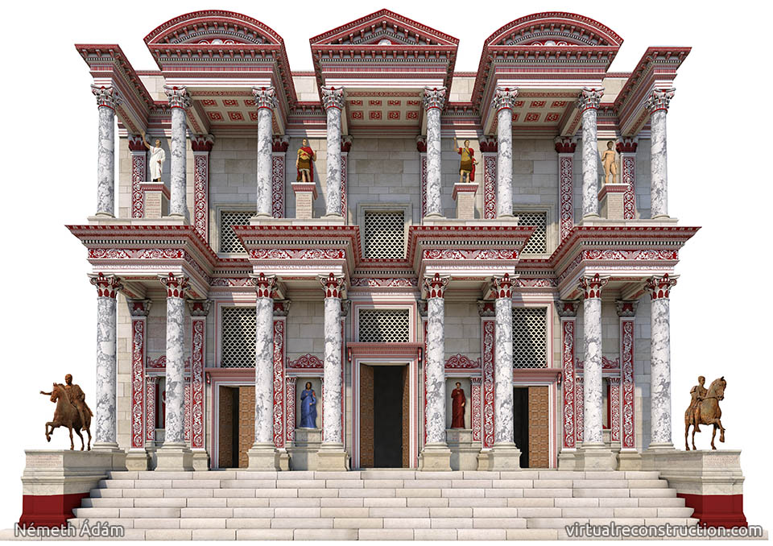
Library of Celsus, facade, reconstruction 1
(Probably) male figures
Celsus
Celsus
Greek bio
Latin bio

Slide 39
Library of Celsus, facade, reconstruction 2
Labeled personifications, Greek virtues (Celsus’)
Knowledge, Intelligence
Wisdom, Virtue
Notes:
sophia, arete, episteme, ennoia

Slide 40
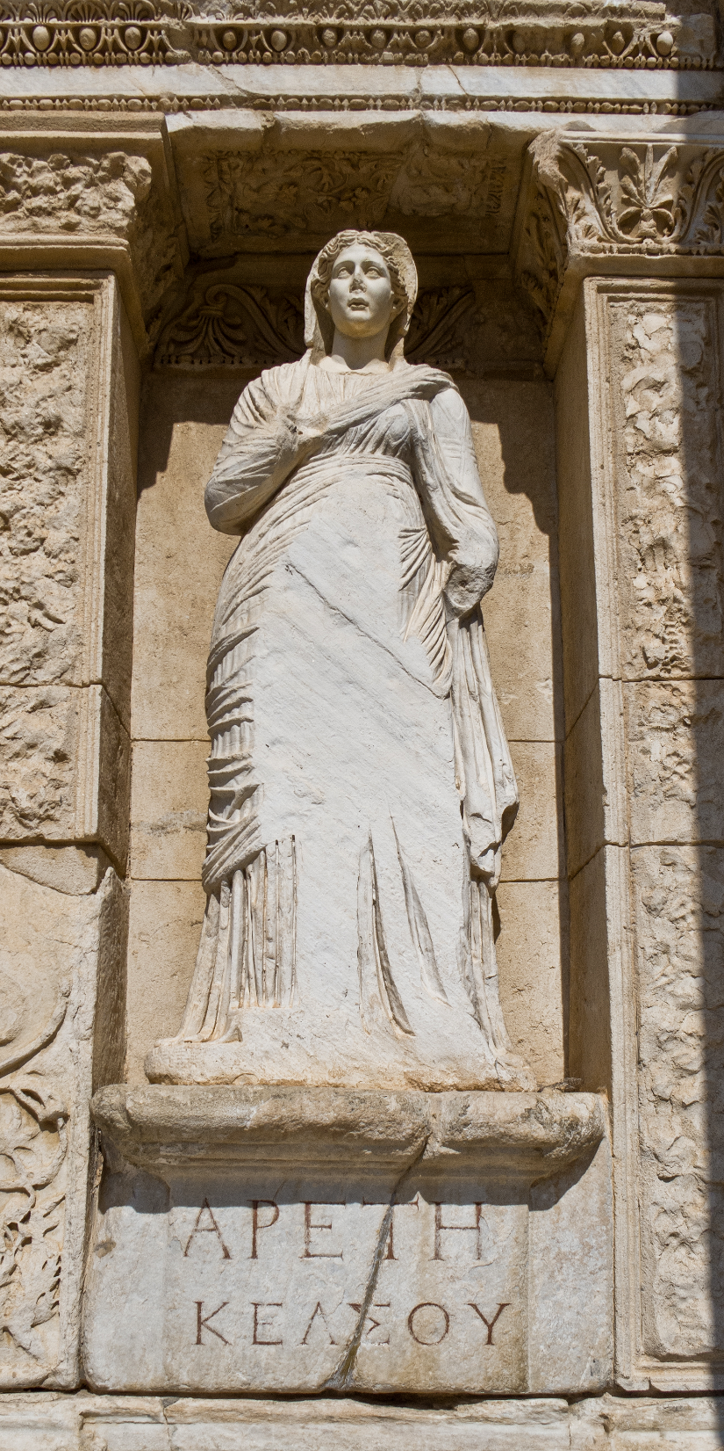
Aretē Kelsou, “The Virtue of Celsus”

Slide 41
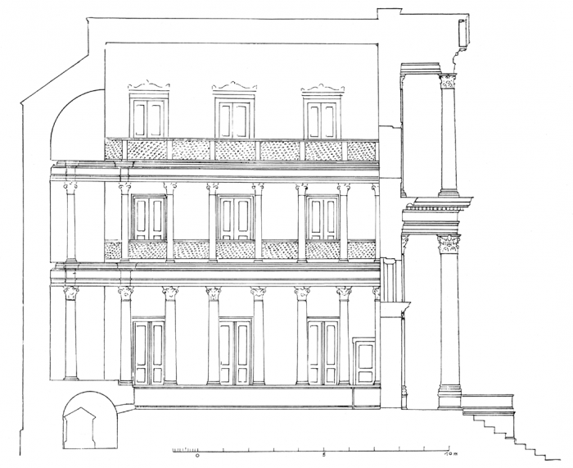
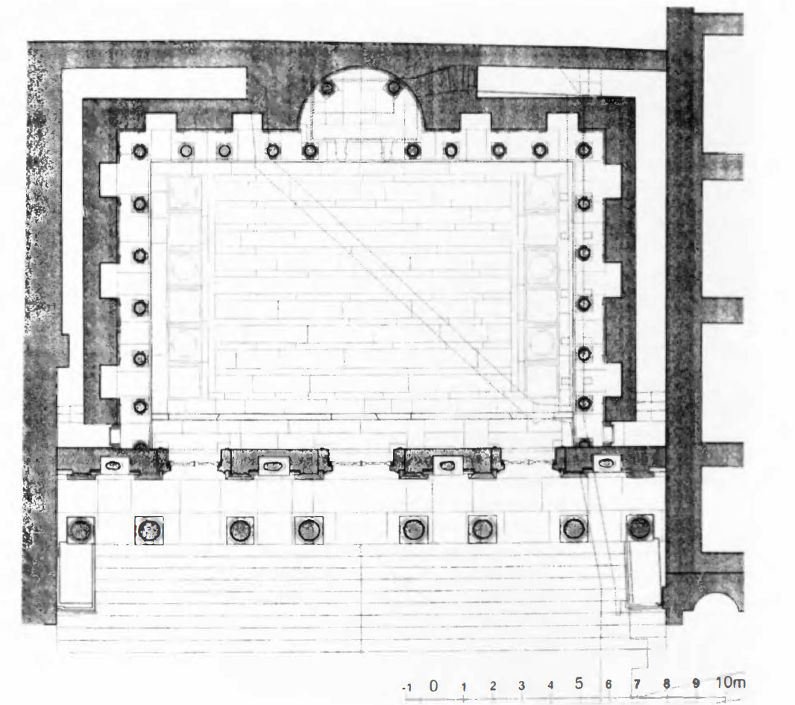
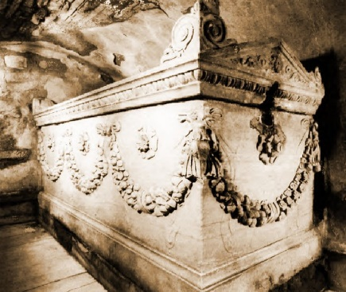
Library, interior plan
Statue (Athena? Apollo? Emperor?)
Tomb of Celsus

