Slide 1
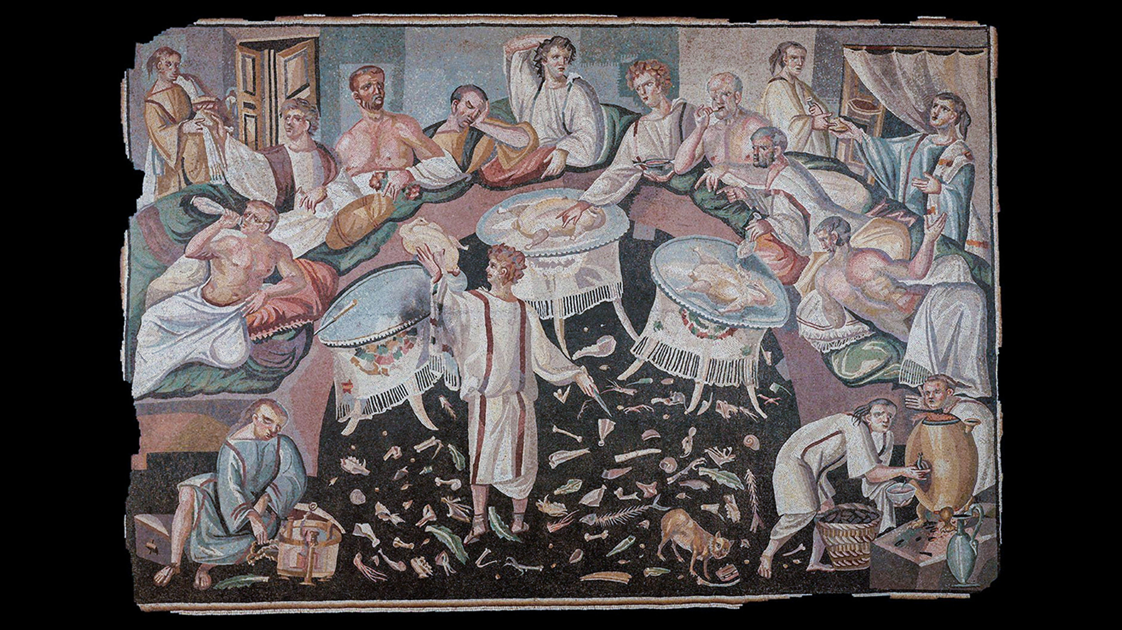
Commensality, Agonism, and Sociality in the Roman East
Notes:
What do you see?

Slide 2
Asarōtos oikos, “unswept banquet hall,” with semi-circular stibadium. Roman East, fifth cent. CE (?)
zxzxzxzzxzxz

Slide 3
Reminders…
Quiz 2
Wed 29-Apr
Paper 2 due
Tuesday, 12-May via Brightspace > “Assignments” upload portal
Evaluation portal open (Brightspace)
No class Wed, 6-May

Slide 4
Agenda
Discussion
Reflections on Today’s Reading
Quick and Dirty Overview
Hosting and “Guesting,” Greco-Roman Style
Getting in the Door
Agōn and pathos in a Greco-Roman Villa

Slide 5
Discussion
Reflections on Today’s Reading
Alcock, Susan E. "Power Lunches in the Eastern Roman Empire." Michigan Quarterly Review 42.4 (2003): 591-606.
Notes:
This SWA prompt has two, very important functions:
To prepare you for the next SWA, which will focus on Lucian's Symposium, a work narrating an eating-and-drinking party in the Roman East under the high Empire. Note that that SWA will refer you back to this assignment.
To prepare you for the paper 2 critical-thinking component, a very critical-thinking prompt. To respond properly, please re-read the critical-thinking document, this site.

Slide 6
Alcock on Hierarchies at Table 1
“A key to this hierarchy is the seating plan, with a very clear place of honor next to the host…. Every other place at table was graded lower in status, increasingly below the salt.”
“The ‘Place of honor’ certainly seems to have been adopted at least in some [Greek] contexts.” (“Power Lunches” 602)
Notes:
Alcock “Power Lunches”:
“A key to this hierarchy is the seating plan, with a very clear place of honor next to the host—thus creating a kind of "power corner" privileged with the best views over and out of the room. Every other place at table was graded lower in status, increasingly below the salt. Games of honor and humiliation were played out in conversation as well (with some people not spoken to, nor welcome to speak — the junior faculty phenomenon!); some were visibly given worse food, or less wine, than others. Lying on a couch huddled next to a neighbor, such inequities would be hard to miss—no one ever said the Romans were subtle! All in all, a convivium could be (for some) a pleasant, convivial occasion; for others, the dinner party from hell. In essence, this is all about dinner as hierarchy, as rule making, dinner as creating social alliance and distance, dinner as a diacritical feast.”
“How far does this behavior accompany the triclinium form to the east? The ‘Place of honor’ certainly seems to have been adopted at least in some contexts. We see this in the careful organization of views from power corners; a defined best place to lie and look emerges in some examples of eastern triclinia.” (602)

Slide 7
Alcock on Hierarchies at Table 2
“In imperial society, dinners served as a central way to meet and deal with peers (Roman and Greek) in an invite-only space, with a shared sense of status membership, of elite rules and understanding, of defined social competition.” (“Power Lunches” 603)
Notes:
Alcock “Power Lunches”:
“My suspicion is that dinner was simply too essential an arena for the Greek elite either to dodge or to do its own thing in too radical a fashion. In imperial society, dinners served as a central way to meet and deal with peers (Roman and Greek) in an invite-only space, with a shared sense of status membership, of elite rules and understanding, of defined social competition. And this wasn't only useful at home. Proper understanding of the rules of the triclinium provided you with a behavior set with which you could travel the length of the empire and never put a foot wrong.” (603)

Slide 8
SWA Prompt: Two Parts
What are Alcock’s main points?
Even if you're not an expert in the field, what kind of feedback for the author might you have with regard to argumentation, evidence, documentation?
Notes:
Eastern Roman Dining As...
Power-play, social maneuvering
Culture clash (1st BCE – 1st CE, Rome vs. Greece)
“In essence, this is all about dinner as hierarchy, as rule making, dinner as creating social alliance and distance, dinner as a diacritical feast.”
“Military analogies, which recur throughout the Table Talk, quietly suggest that ‘dining in good order’ was something Roman guests, and rulers, expected to happen.”
with regard to story from elder seneca about marcus cicero whipping smyrna sophist:
"We can hope that was not the norm, but there must have been an increasing presence of foreigners at Greek tables, and this need not have been instantly easy — anthropological studies of foodways warn that bad things can happen when different modes of power eating clash. One major disjuncture between Greek and Roman dining is similarly revealed through a misunderstanding: in this case about the gender of just who's coming to dinner. In one of Cicero's Verrine orations, we are told that Verres and his posse are invited to the house of a prominent citizen of the Greek city of Lampsacus, in northwest Asia Minor. The party goes well, so after a bit they decide to drink ‘in the Greek fashion.’ It is not exactly clear what this means, but it probably ratchets up the booze level (the big drinking cups come out). Eventually the Romans ask for the daughter of the house to come in, but her father says no (“it is not the custom of the Greeks that women should recline at the convivium of men”). The matter ends in a brawl, a dead Roman, and the ultimate execution of the Greek host and his son."

Slide 9
Quick and Dirty Overview
Hosting and “Guesting,” Greco-Roman Style

Slide 10
Greek Symposium (ca. 800-ca. 300 BCE)
Elite-male dinner-drinking-fellowship
Egalitarian ethos
Varied entertainment
Host and guests / outside performers
Imaginative escape
Notes:
why talk about the classical-archaic Greek symposium? because it sets a baseline for our focus today. The Greek symposium provided the model, the armature around which, multiple works of classical Greek literature were composed, notably, dialogues entitled Symposium by Plato and Xenophon. those works were treated as classics by Imperial Greek writers, notably, Plutarch, Lucian, and Athenaeus, themselves authors of symposiastic literature. so, too, the idea of well educated party guests engaging in sophisticated repartee, a kind of showing off of paideia was complelling for elite Greco-Romans of the imperial period.
why talk about the classical-archaic Greek symposium? because it sets a baseline for our focus today. The Greek symposium provided the model, the armature around which, multiple works of classical Greek literature were composed, notably, dialogues entitled Symposium by Plato and Xenophon. those works were treated as classics by Imperial Greek writers, notably, Plutarch, Lucian, and Athenaeus, themselves authors of symposiastic literature. so, too, the idea of well educated party guests engaging in sophisticated repartee, a kind of showing off of paideia was complelling for elite Greco-Romans of the imperial period.

Slide 11
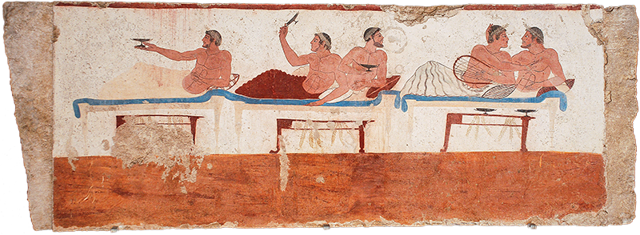
Greek Symposium (cont’d)
Paestum, Tomb of the Diver. Symposium scene, ca. 470 BCE
Notes:
why talk about the classical-archaic Greek symposium? because it sets a baseline for our focus today. The Greek symposium provided the model, the armature around which, multiple works of classical Greek literature were composed, notably, dialogues entitled Symposium by Plato and Xenophon. those works were treated as classics by Imperial Greek writers, notably, Plutarch, Lucian, and Athenaeus, themselves authors of symposiastic literature. so, too, the idea of well educated party guests engaging in sophisticated repartee, a kind of showing off of paideia was complelling for elite Greco-Romans of the imperial period.

Slide 12
Roman convivium
Mixed-gender
Hierarchical
Seating, serving, orderly dining
Social-political…
Networking, maneuvering, competing
Upward mobility
Notes:
from an article by John d’Arms (Echos du monde classique 1984):
“Though it would be easy to multiply examples of the negative impact of clientela on Roman convivial customs, we thereby run the risk of ignoring interesting countervailing evidence. We need to recall that upper class survival depended, especially in the Empire, upon considerable upward mobility.... In this respect one of the letters of Pliny, where the setting is a private dinner-party in Rome, deserves attention. PIiny reports that he reclined next to the distinguished consular Fadius Rufinus, who had on his other side a fellow municeps, who first set foot in Rome on that very day. When Rufinus described Pliny's studia in general terms (but had not yet introduced him), his neighbor, the vir municipalis, exclaimed: ‘Why, the man must be Pliny!’ ... If Pliny's acquaintance had political ambitions, the informal setting of this convivium will have been appropriate for furthering them.”

Slide 13
Socializing and Upward Mobility?
John D’Arms on Roman Imperial dinners (but basically valid for the East):
“Though it would be easy to multiply examples of the negative impact of [social inequality] on Roman convivial customs, we … need to recall that upper class survival depended, especially in the Empire, upon considerable upward mobility.” (Then, an anecdote in Pliny about mid-level elite at a super elite dinner party. Echos du monde classique 1984)
Notes:
from an article by John d’Arms (Echos du monde classique 1984):
“Though it would be easy to multiply examples of the negative impact of clientela on Roman convivial customs, we thereby run the risk of ignoring interesting countervailing evidence. We need to recall that upper class survival depended, especially in the Empire, upon considerable upward mobility.... In this respect one of the letters of Pliny, where the setting is a private dinner-party in Rome, deserves attention. PIiny reports that he reclined next to the distinguished consular Fadius Rufinus, who had on his other side a fellow municeps, who first set foot in Rome on that very day. When Rufinus described Pliny's studia in general terms (but had not yet introduced him), his neighbor, the vir municipalis, exclaimed: ‘Why, the man must be Pliny!’ ... If Pliny's acquaintance had political ambitions, the informal setting of this convivium will have been appropriate for furthering them.”

Slide 14
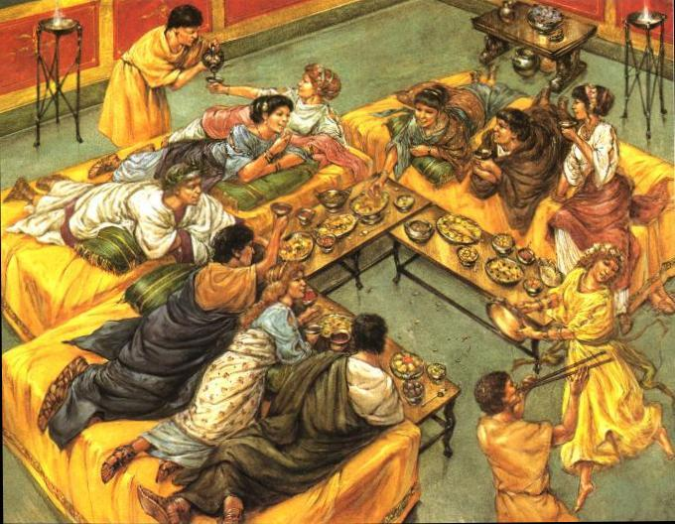
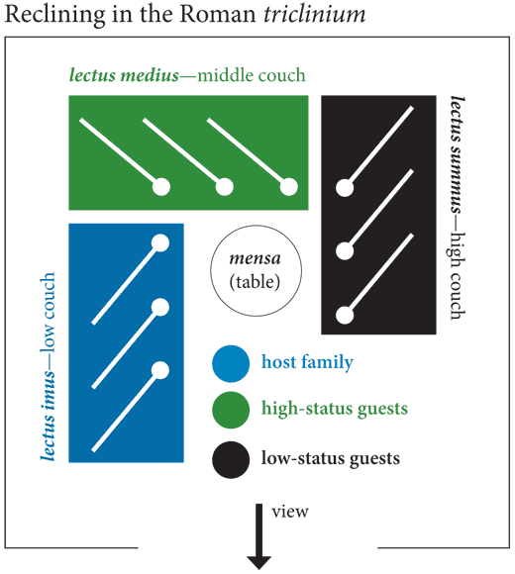
Roman convivium (cont’d)
Roman convivium in a triclinium
Seating, Roman triclinium
Notes:
what do we see that’s different from the preceding?
i’m not sure how much we know about social differentiation of host and guests at archaic-classical Greek symposia, but social differentiation clearly mattered at roman convivia.
[discuss couch arrangements]

Slide 15
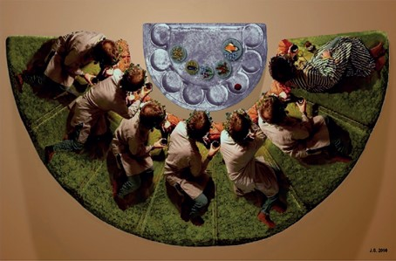
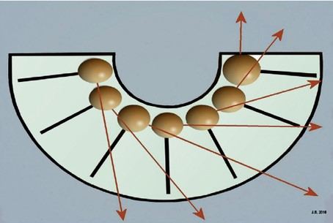
Imperial Banqueting, 2nd cent on
Stibadium reconstruction (Stephenson BICS 2016)
Stibadium diagram (Stephenson BICS 2016)
Notes:
little to add here, except that beginning maybe in the 2nd cent or so ce, Greek and Roman dining traditions began to mingle. in the roman east, respectable women start being invited to dinner, while the dinners themselves set the stage for social-political maneuvering.

Slide 16
Getting in the Door
Agōn and pathos in a Greco-Roman Villa

Slide 17
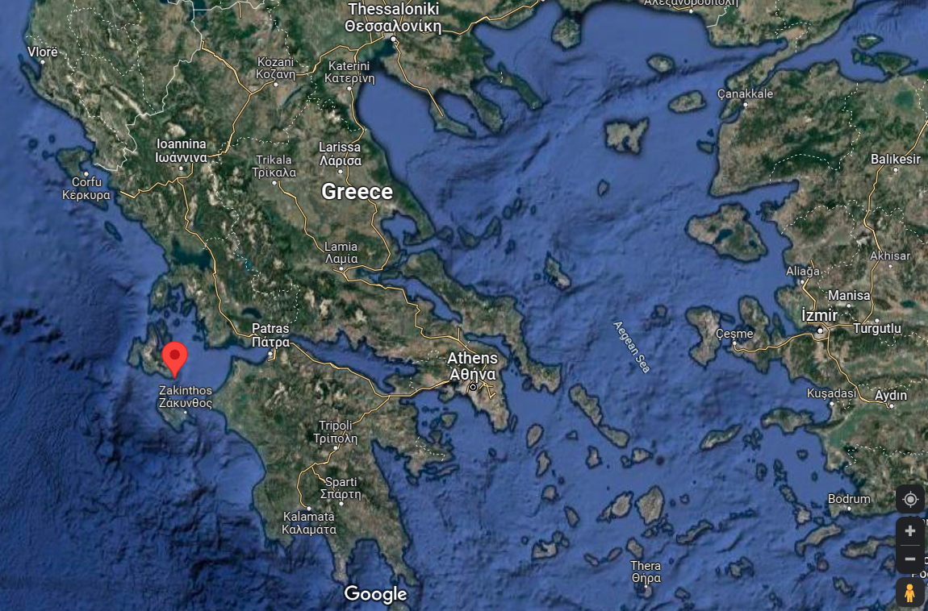
Map
Kefalonia
Skala

Slide 18
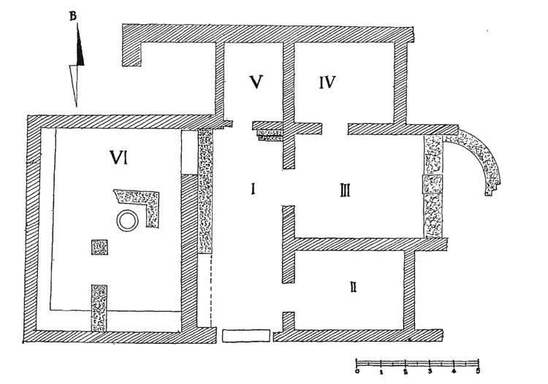
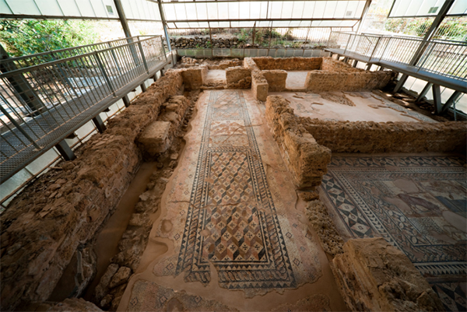
Skala villa, circa 200 CE
Skala Villa, plan
Skala Villa, photograph
Notes:
Roman, including Greco-Roman, private residences and houses served as venues to entertain guests and to show off — and to compete. "Kim Bowes, noting that 'the traditional locus of elite competition and distinction in the Roman world was the home,' describes domus [urban domestic residences] and villas as 'machines for competition,' 'physical sites of social rivalry.' " By late antiquity, these sorts of "Roman villas," as they're generally called, had spread all over the Empire.

Slide 19
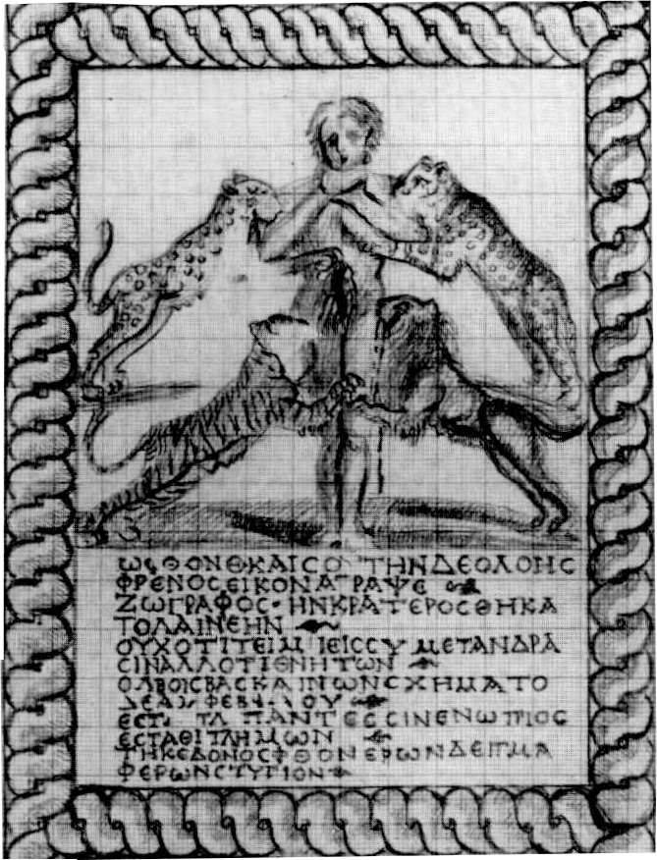
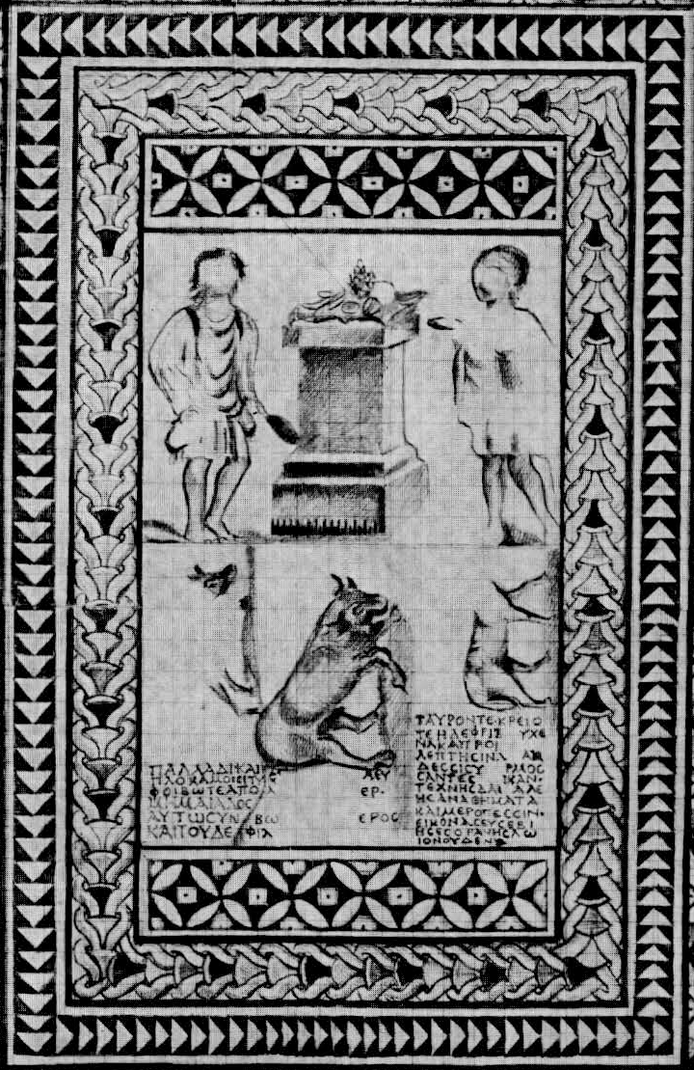
Skala Villa Mosaics
Sketch, Skala villa entry mosaic (early 3rd cent CE, see Scholtz TAPA 151 2021)
Sketch, Skala villa triclinium mosaic
Notes:
envy mosaic inscription, skala:
“O Envy, even yours, this image of baneful passion that a draftsman has sketched, and Krateros has set in stone, not because men honor you, but because you, who cast your evil eye on mortal bliss, have taken this form on yourself. Come stand before the gaze of all, stand, you wretch, bearing the vile mark of wasting that the envious bear!”

