Slide 1
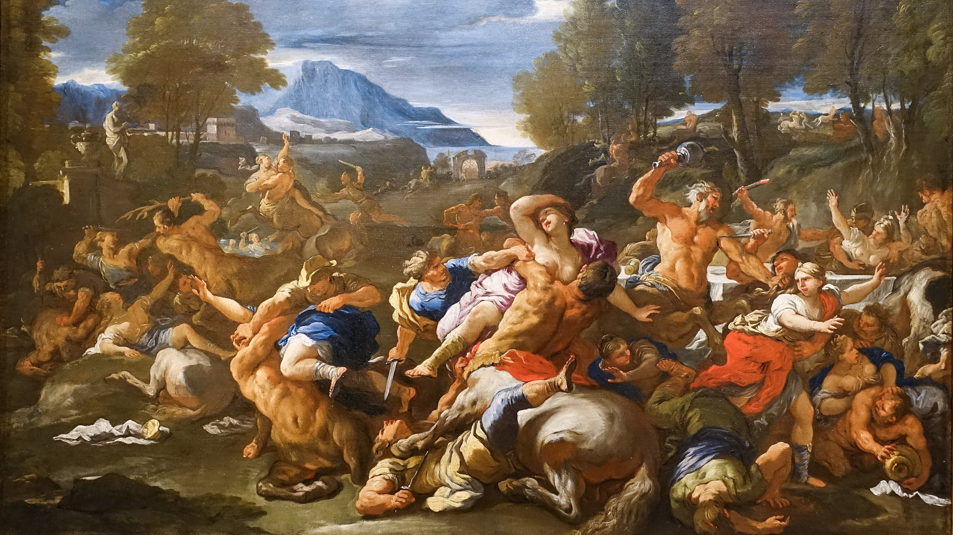
Agōn Gone Haywire in Lucian’s Symposium
Battle of the Lapiths and the Centaurs. Luca Giordano, 1682

Slide 2
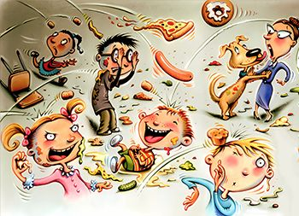
Warm-Up Question
What is Lucian’s Symposium About?
Notes:
is it really about a symposium?

Slide 3
Agenda
Discussion
Alcock as Lens? (Lucian’ Symposium)
Class Experiment
Let’s Write a Paper!

Slide 4
Discussion
Alcock as Lens? (Lucian’ Symposium)
Alcock, Susan E. "Power Lunches in the Eastern Roman Empire." Michigan Quarterly Review 42.4 (2003): 591-606.

Slide 5
Brief Review…
“Three questions: What would Damianus eat? With whom would Damianus eat? And how, in what setting, would Damianus eat? And how do these reflect, or react, to the fact of empire?” (p. 594)
Alcock, Susan E. "Power Lunches in the Eastern Roman Empire." Michigan Quarterly Review 42.4 (2003): 591-606.
Notes:
mostly question #4: “And how do these reflect, or react, to the fact of empire?”
on elite eastern dining as occasions featuring power displays and networking, but also as negotiating the rome/greece nexus. not simply a smoothly unproblematic adoption of roman customs; rather, a dialogue and dialectic establishing cultural distinctiveness within the rome/east power differential.
"power lunch" as "power plays around the table.“
food "invests, and creates, our social distinctions, our gender differentiations, our political alliances, our religious affiliations, our constructions of self and other"

Slide 6
SWA Prompt
How useful is Alcock’s “Power Lunches” as a guide to Lucian’s Symposium, especially in regard to themes of identity, status/class, and contest? What insights does the article yield in relation to the Lucian reading? Are there ways that Lucian poses challenges to Alcock’s argument?”
Notes:
the foods mentioned by alcock remind us of the menu for Aristaenetus’ dinner, also of the dinner mosaic with which we began last class — think of those big turkey-like fowls being served and wielded by hand in the mosaic and the “the so-called ‘complete dinner’ was brought in for us, a single bird for each guest, with boar’s flesh, hare meat, fish cooked in a tagine, sesame cakes, and various dessert nibbles“ (549).
515. seating arrangements:
“The women occupied the whole of the couch situated to the right of the entrance, since they were not few in number; among them was the bride, very carefully veiled, and surrounded by women; the rest of the company took the wall opposite the door, each according to his seniority (ὡς ἕκαστος ἀξίας εἶχε). grumbling over seating ranking.” possibly the most roman thing about this party?
the issue of order in the dining room acc to alcock was central to roman concerns.
529. "Alcidamas flew into a rage (and it had long been obvious that he envied the jester’s success and the way he was holding the symposium’s attention), threw off his cloak, and challenged him to a no-holds-barred wrestling match, and said that if not, he would strike him with his staff. So the unfortunate Satyrion (that was the jester’s name) got up and started wrestling with him. And the business was quite delightful, a philosopher squaring up against a jester and beating and being beaten in turn."
ἀγανακτήσας ἐκεῖνος—καὶ πάλαι δὲ δῆλος ἦν φθονῶν αὐτῷ εὐδοκιμοῦντι καὶ κατέχοντι τὸ συμπόσιον—ἀπορρίψας τὸν τρίβωνα προὐκαλεῖτό οἱ παγκρατιάζειν, εἰ δὲ μή, κατοίσειν αὐτοῦ ἔφη τὴν βακτηρίαν. οὕτω δὴ ὁ κακοδαίμων Σατυρίων—τοῦτο γὰρ ὁ γελωτοποιὸς ἐκαλεῖτο—συστὰς ἐπαγκρατίαζε. καὶ τὸ πρᾶγμα ὑπερήδιστον ἦν, φιλόσοφος ἀνὴρ γελωτοποιῷ ἀνταιρόμενος καὶ παίων καὶ παιόμενος ἐν τῷ μέρει.
but the issue of competition and discontents in the dining room, though not exclusively a Greek one, nevertheless connects with Greek concerns. alcock isn’t focused on that, though competition and social dining are mentioned.
Lucian’s main concern seems to be the hypocrisy of intellectuals claiming a special relation with virtue (aretē), one of the four cardinal qualities of the Celsus commemorated at Ephesus (along with wisdom, knowledge, and intelligence).
The parading of quotations gets at the theme of paideia.
543. “Then it occurred to me to wonder whether that popular saying might not be true after all, that education leads away from true reason those who keep their eyes fixed only on books and the ideas in them.”
these intellectuals remind us of parasites looking for handouts, especially Hetoemocles, who had yet better invites than this one. this kind of satire goes at least as far back as Eupolis’ kolakes, satirizing callias as cultivator of sophists; callias also hosts Xenophon’s symposium, to which Socrates as an intellectual brings cachet.
this is ultimately about paideia and Greek, not Greco-ɍoman, identity. philosophical discourse satirized not as agōn but as eris, “strife”

Slide 7

Class Experiment
Let’s Write a Paper!

Slide 8
“Agōn in Lucian’s Symposium”
Groups to write simultaneously…
Intro (topic, question, thesis, approach).
Body (argumentation, evidence, documentation).
Conclusion (recap findings, further reflection).
Share orally with class. Match-up results.
More @ bingdev papers page.

