Slide 1
Race for Glory, Final Summing Up:
What Have We Learned?

Slide 2
First, …
One Final Clip
https://youtu.be/OXZQ5DfSAAc?si=Hi4yTl3DkP-AZe88

Slide 3
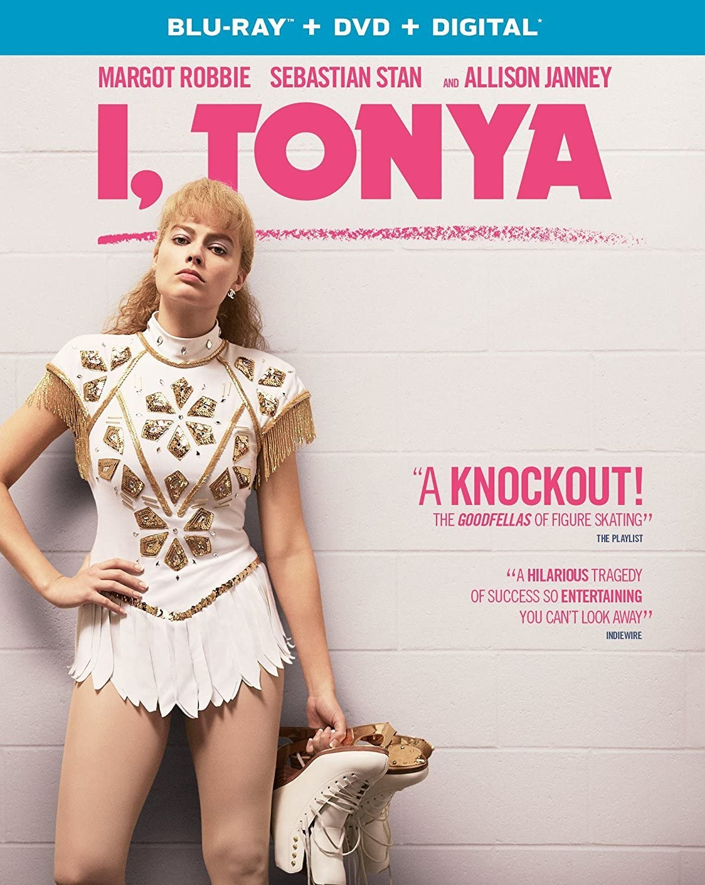
The Race for Glory
Are we, were Greeks under the Empire, naïve about…
  What it takes to win
  Who deserves to win?
  agōn’s downside?

Slide 4
Zero-Sum Competition
Zero-sum game:
  “… competitive interactions where one party's gain is directly offset by another party's loss” (Ebsco on “Zero Sum Game”)
Is all agōn zero-sum?
Is zero-sum agōn always a liability?
Chinoy, Sahil, et al. “Zero-Sum Thinking and the Roots of US Political Differences.” American Economic Review 116.3 (2026): 1052–1096.
Chun, J. S., H. Kakkar, and A. C. Kay. “How Watching Sports Shapes Zero-Sum Thinking: Correlational, Experimental, and Longitudinal Evidence.” Journal of Personality and Social Psychology (2026): forthcoming.

Slide 5
A Course Like This — Value Added?!
Two NYT Headlines
Notes:
Question: Which is more important? To get a good grade in this course? Or to leverage this course to get a good job (or any job)?

Slide 6
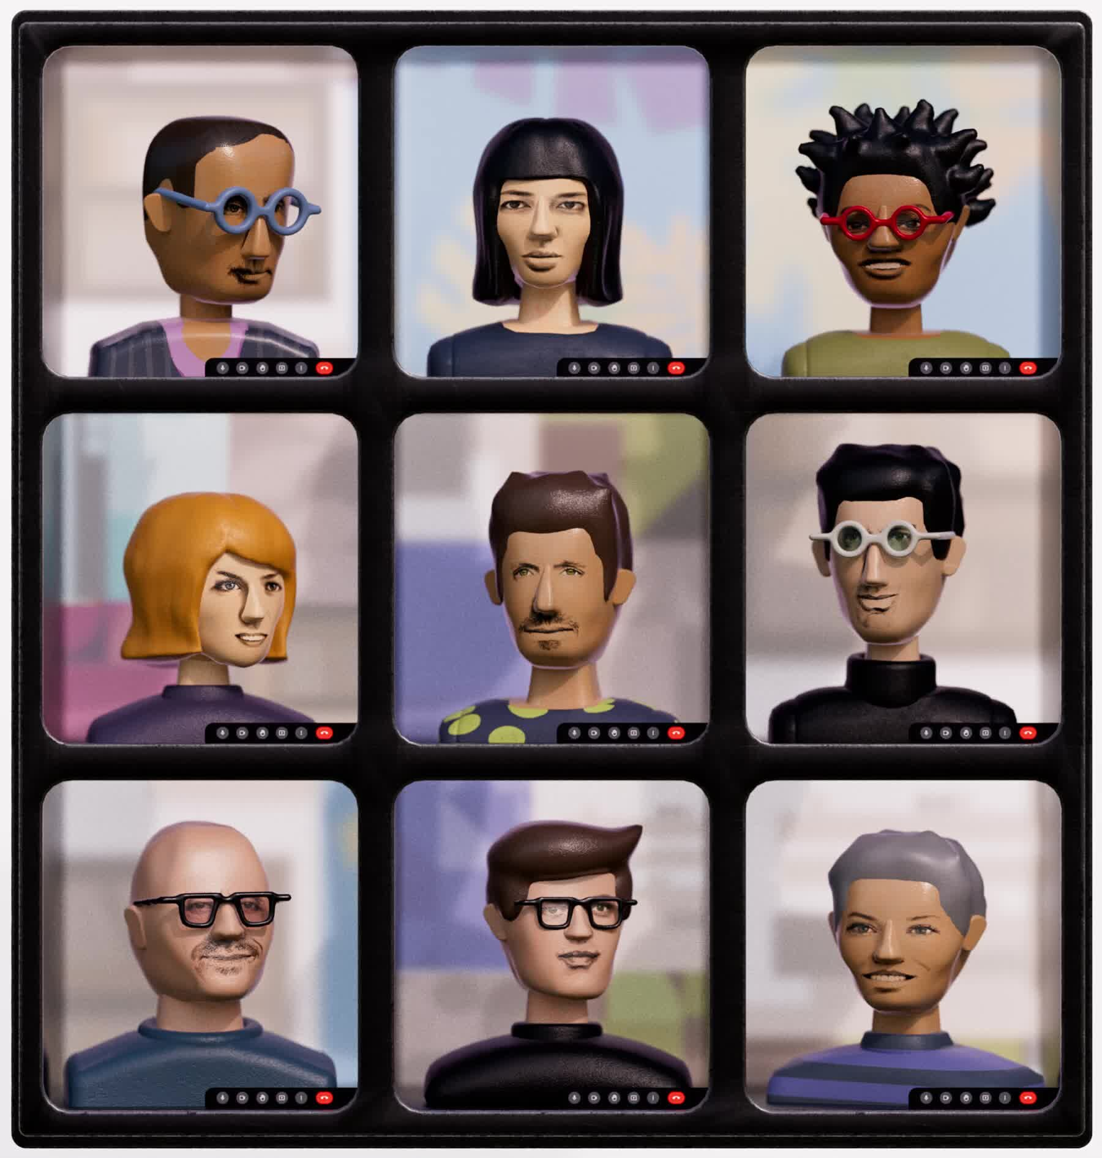
Rhetoric and Career
“That Meeting You Hate May Keep A.I. From Stealing Your Job”
  “As artificial intelligence makes many tasks easier, the human work of cajoling, arm-twisting and reassuring appears to be rising in importance” (NYT 14-Apr 2026)
Graphic, NYT 14-Apr 2026
Notes:
Whether you’re talking about the second-sophistic or our world, here and now, it’s all about self-presentation and interacting.

Slide 7

So Boring!
“The Key to Success in College Is So Simple, It’s Almost Never Mentioned”
  “The willingness to learn [is] a belief that every class offers something worthwhile, even if you don’t know in advance what that something is.” (NYT 3-Jan 2023)
Self-explanatory
Notes:
My experience with my senior undergrad music theory teacher.

Slide 8

Have an Awesome Summer!

