Slide 1
Sociality, Emotion, and agōn in the Roman East

Slide 2
Agenda
Discussion Topic
  Socializing: There and Then, Here and Now
Quick and Dirty Overview
  Hosting and “Guesting,” Greco-Roman Style
Alcock “Power Lunches”
  Chief Takeaways
Getting in the Door
  Agōn and pathos in a Greco-Roman Villa

Slide 3
Discussion Topic
Socializing: There and Then, Here and Now

Slide 4
How, in your experience, does the socializing of your here-and-now resemble what you encounter in readings for this assignment? How does it differ?

Slide 5
Quick and Dirty Overview
Hosting and “Guesting,” Greco-Roman Style

Slide 6
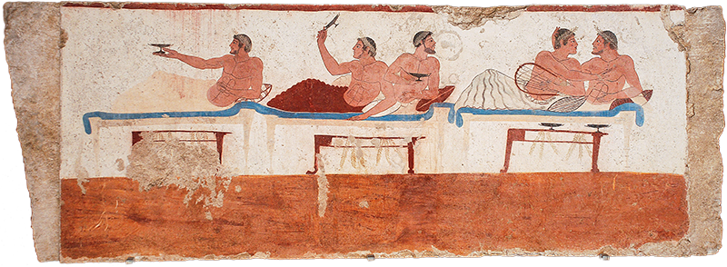
Greek Symposium (ca. 700-ca. 300 BCE)
Paestum, Tomb of the Diver. Symposium scene, ca. 470 BCE
Notes:
why talk about the classical-archaic Greek symposium? because it sets a baseline for our focus today. The Greek symposium provided the model, the armature around which, multiple works of classical Greek literature were composed, notably, dialogues entitled Symposium by Plato and Xenophon. those works were treated as classics by Imperial Greek writers, notably, Plutarch, Lucian, and Athenaeus, themselves authors of symposiastic literature. so, too, the idea of well educated party guests engaging in sophisticated repartee, a kind of showing off of paideia was complelling for elite Greco-Romans of the imperial period.

Slide 7
Greek Symposium (ca. 700-ca. 300 BCE)
Elite-male dinner-drinking-fellowship
Varied entertainment
  Host and guests / outside performers
Imaginative escape
Paestum, Tomb of the Diver. Symposium scene, ca. 470 BCE
Notes:
why talk about the classical-archaic Greek symposium? because it sets a baseline for our focus today. The Greek symposium provided the model, the armature around which, multiple works of classical Greek literature were composed, notably, dialogues entitled Symposium by Plato and Xenophon. those works were treated as classics by Imperial Greek writers, notably, Plutarch, Lucian, and Athenaeus, themselves authors of symposiastic literature. so, too, the idea of well educated party guests engaging in sophisticated repartee, a kind of showing off of paideia was complelling for elite Greco-Romans of the imperial period.

Slide 8
Greek Symposium (ca. 700-ca. 300 BCE)
≈ (tame) version of frat parties??
Paestum, Tomb of the Diver. Symposium scene, ca. 470 BCE
Notes:
why talk about the classical-archaic Greek symposium? because it sets a baseline for our focus today. The Greek symposium provided the model, the armature around which, multiple works of classical Greek literature were composed, notably, dialogues entitled Symposium by Plato and Xenophon. those works were treated as classics by Imperial Greek writers, notably, Plutarch, Lucian, and Athenaeus, themselves authors of symposiastic literature. so, too, the idea of well educated party guests engaging in sophisticated repartee, a kind of showing off of paideia was complelling for elite Greco-Romans of the imperial period.

Slide 9
Modern Reclining?
“When drinking the four cups of wine, and eating the matzot, the korech sandwich, and the afikoman, one is required to recline.... This is how royalty and nobility used to eat....” (chabad.org on the Passover Seder)
Paestum, Tomb of the Diver. Symposium scene, ca. 470 BCE

Slide 10
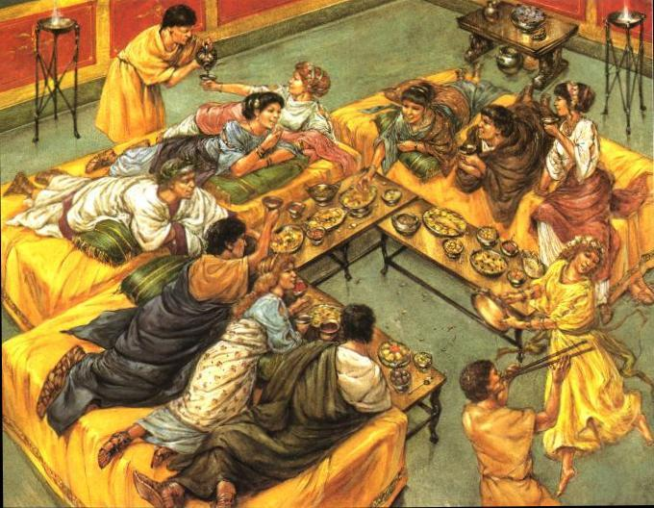
Roman convivium
Roman convivium in a triclinium
Notes:
what do we see that’s different from the preceding?
i’m not sure how much we know about social differentiation of host and guests at archaic-classical Greek symposia, but social differentiation clearly mattered at roman convivia.
[discuss couch arrangements]

Slide 11
Roman convivium
Mixed-gender
  Social mixing
Hierarchical
  Seating, serving, orderly dining
Social-political
  Networking, maneuvering, competing
Roman convivium in a triclinium
Notes:
what do we see that’s different from the preceding?
i’m not sure how much we know about social differentiation of host and guests at archaic-classical Greek symposia, but social differentiation clearly mattered at roman convivia.
[discuss couch arrangements]
from an article by John d’Arms (Echos du monde classique 1984):
“Though it would be easy to multiply examples of the negative impact of c1ientela on Roman convivial customs, we thereby run the risk of ignoring interesting countervailing evidence. We need to recall that upper class survival depended, especially in the Empire, upon considerable upward mobility.... In this respect one of the letters of Pliny, where the setting is a private dinner-party in Rome, deserves attention. PIiny reports that he reclined next to the distinguished consular Fadius Rufinus, who had on his other side a fellow municeps, who first set foot in Rome on that very day. When Rufinus described Pliny's studia in general terms (but had not yet introduced him), his neighbor, the vir municipalis, exclaimed: ‘Why, the man must be Pliny!’ ... If Pliny's acquaintance had political ambitions, the informal setting of this convivium will have been appropriate for furthering them.”

Slide 12
Roman convivium
≈ modern power lunch?
Roman convivium in a triclinium
Notes:
what do we see that’s different from the preceding?
i’m not sure how much we know about social differentiation of host and guests at archaic-classical Greek symposia, but social differentiation clearly mattered at roman convivia.
[discuss couch arrangements]

Slide 13
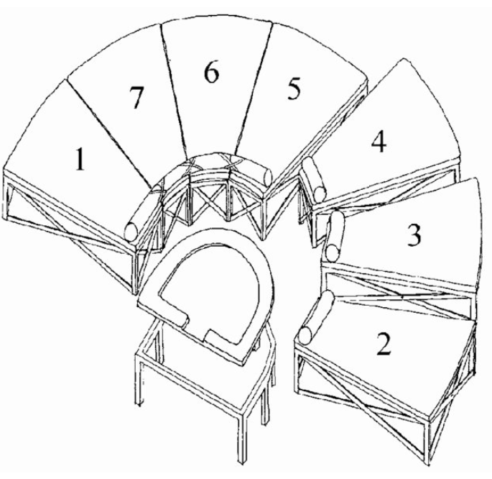
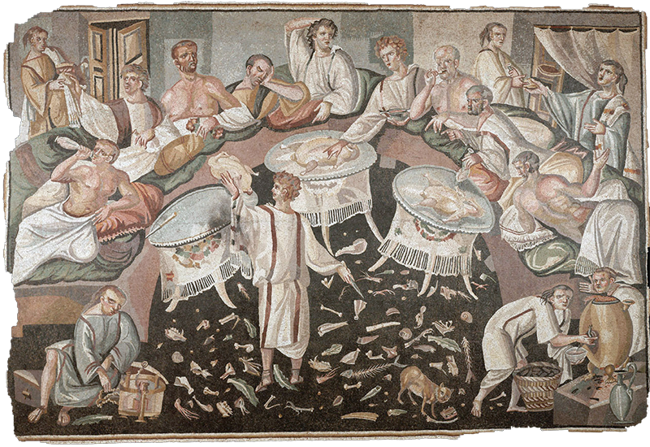
Imperial Banqueting (2nd cent on)
Stibadium diagram, with hierarchy
Late antique banquet
Notes:
little to add here, except that beginning maybe in the 2nd cent or so ce, Greek and Roman dining traditions began to mingle. in the roman east, respectable women start being invited to dinner, while the dinners themselves set the stage for social-political maneuvering.

Slide 14
Alcock “Power Lunches”
Chief Takeaways
Notes:
Alcock “Power Lunches in the Eastern Roman Empire”

Slide 15
Eastern Roman Dining As...
Power-play, social maneuvering
Culture clash (1st BCE – 1st CE, Rome vs. Greece)
“In essence, this is all about dinner as hierarchy, as rule making, dinner as creating social alliance and distance, dinner as a diacritical feast.”
Notes:
“Military analogies, which recur throughout the Table Talk, quietly suggest that ‘dining in good order’ was something Roman guests, and rulers, expected to happen.”
with regard to story from elder seneca about marcus cicero whipping smyrna sophist:
"We can hope that was not the norm, but there must have been an increasing presence of foreigners at Greek tables, and this need not have been instantly easy—anthropological studies of foodways warn that bad things can happen when different modes of power eating clash. One major disjuncture between Greek and Roman dining is similarly revealed through a misunderstanding: in this case about the gender of just who's coming to dinner. In one of Cicero's Verrine orations, we are told that Verres and his posse are invited to the house of a prominent citizen of the Greek city of Lampsacus, in northwest Asia Minor. The party goes well, so after a bit they decide to drink ‘in the Greek fashion.’ It is not exactly clear what this means, but it probably ratchets up the booze level (the big drinking cups come out). Eventually the Romans ask for the daughter of the house to come in, but her father says no (“it is not the custom of the Greeks that women should recline at the convivium of men”). The matter ends in a brawl, a dead Roman, and the ultimate execution of the Greek host and his son."

Slide 16
Getting in the Door
Agōn and pathos in a Greco-Roman Villa

Slide 17
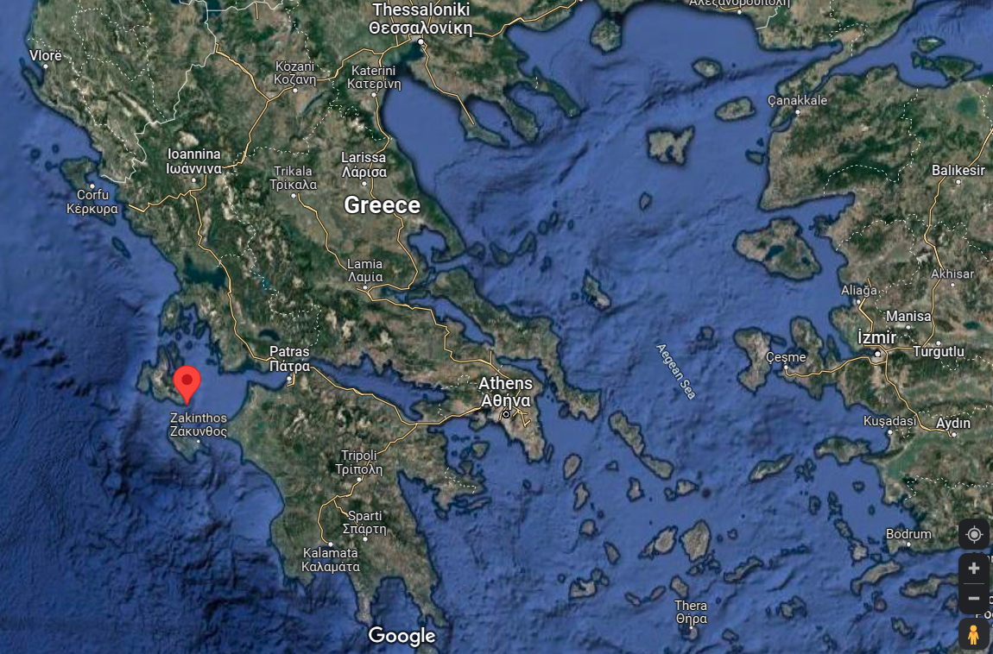
Kephalonia
Skala

Slide 18
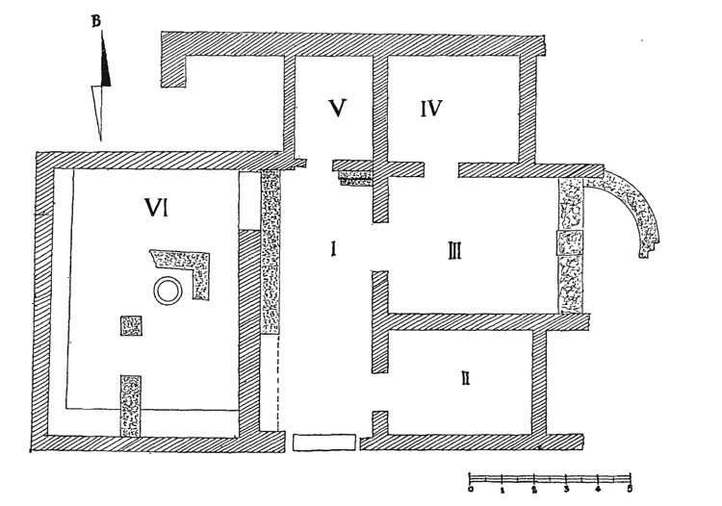
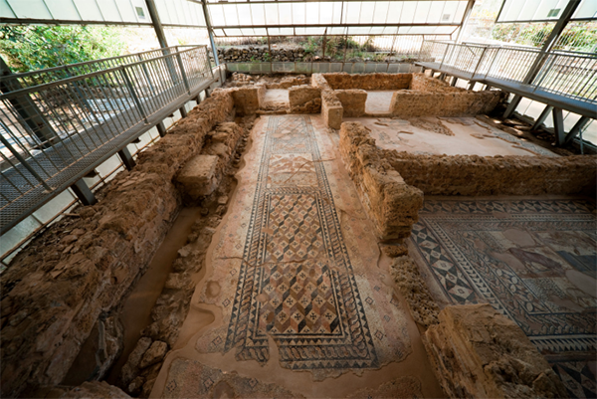
Skala villa, circa 200 CE. Plan and entry hall
Notes:
Roman, including Greco-Roman, private residences and houses served as venues to entertain guests and to show off — and to compete. "Kim Bowes, noting that 'the traditional locus of elite competition and distinction in the Roman world was the home,' describes domus [urban domestic residences] and villas as 'machines for competition,' 'physical sites of social rivalry.' " By late antiquity, these sorts of "Roman villas," as they're generally called, had spread all over the Empire.

Slide 19
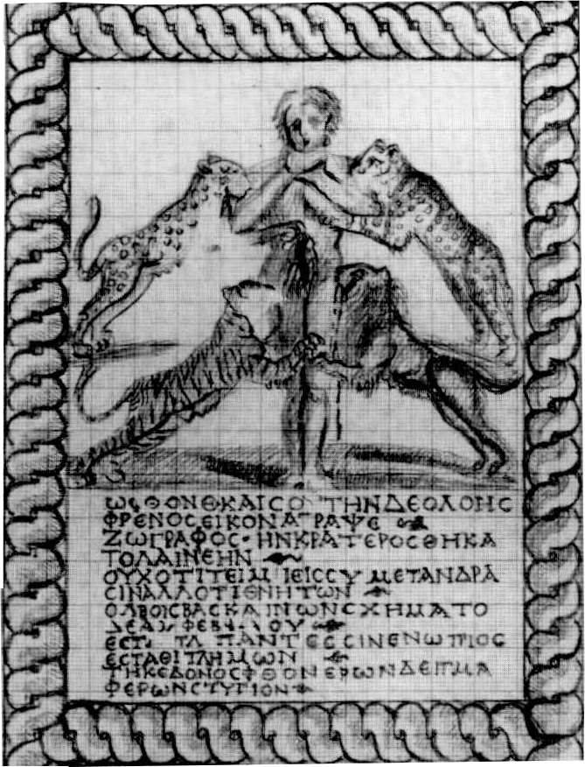
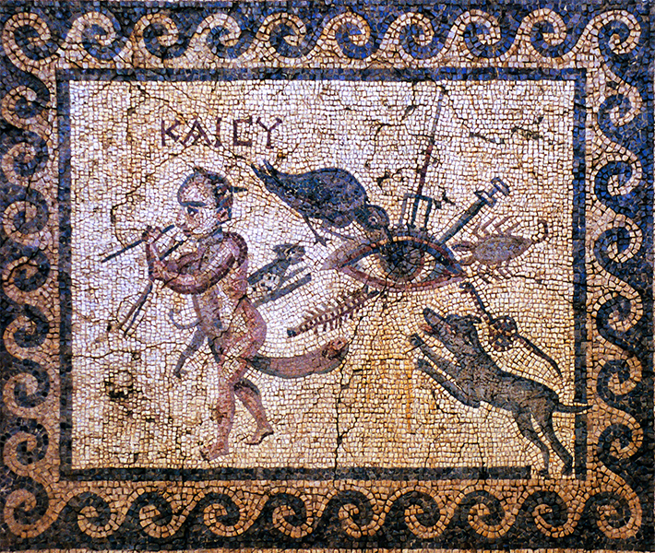
Sketch, Skala entry mosaic emblēma
Mosaic, House of the Evil Eye, Antioch
Notes:
envy mosaic inscription, skala:
“O Envy, even yours, this image of baneful passion that a draftsman has sketched, and Krateros has set in stone, not because men honor you, but because you, who cast your evil eye on mortal bliss, have taken this form on yourself. Come stand before the gaze of all, stand, you wretch, bearing the vile mark of wasting that the envious bear!”

Slide 20
How might Eastern Imperial socializing and the evil eye relate to the midterm essay question:
From what you have seen, how, if at all, does competition in the Roman Imperial East resemble a “zero-sum game”?

