Slide 1
Of Praise and Blame:
Epideictic Rhetoric in the Imperial East
Notes:
what did that opening exercise suggest?
to a certain extent, praise can be a one-size-fits-if-not-all-then-many. it can be generic.
capturing what is distinctive to the object of praise can be tricky, if praise tends to be generically generated.
generic rhetoric as tricky from the perspective of the sophist. paradoxically, the rhetor risks getting lost in the speech which is for Aristotle and Isocrates to be a way to display prowess to spectators, as in a show.
but maybe isn’t the real audience the emperor – or the imperial power? at least in the case of the imperial encomium, could this be for the rhetor a kind of survival rhetoric? for the rhetor’s city, a bid to win the good will of a one empowered to benefit/harm that city? in other words, high-stakes rhetoric of the most fraught kind?

Slide 2
Agenda
Recap and Update
  Zero-Sum Competition?
Figured encomium
  Useful Takeaways
Behavior Modification?
  Figured Encomium of Libanius’ Parasite

Slide 3
Recap and Update
Zero-Sum Competition?

Slide 4
East-Imperial agōn as Zero-Sum?
Zero-sum competition is...
East-Imperial forms of agōn are...
Competitive emotions
  Are...
  Matter because...
Other?

Slide 5
Figured encomium
Useful Takeaways

Slide 6
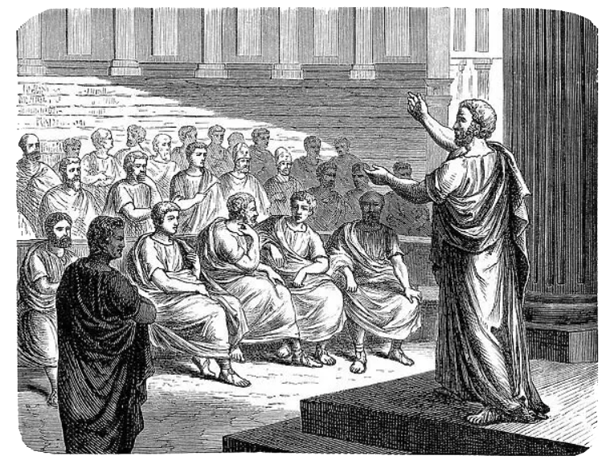
Epideictic (“show”) Rhetoric
Topics
  Praise
  Blame
Audience
  Spectators: orator’s skill

Slide 7
Pseudo-Dionysius on “Addresses”
Curry goodwill
  For self
  For city
Adapt topics
  To addressee
  To situation
Sell yourself!
  “I think that the most compelling opening would be to speak of oneself and one’s purpose, explaining why one has been chosen from all others to deliver this speech, and what makes its subject personally compelling” (p. 409)
Notes:
“Treat illustrious features in greater detail by saying, for example, that if he is like this at a young age, what must we expect to see in time to come? Or else that although young, he is wise beyond his years. If he is old, say that after proving his excellence in many situations, he has rightly been entrusted with this office, and that one aspect of his good fortune is his being at full bloom in old age.” (p. 411)
must we do all of this or only this? above all, use your judgment!

Slide 8
Demetrius on Figured Rhetoric
Avoid “obtrusive explicitness”
Use tact
For the powerful, be oblique
  Allude, imply, insinuate
to eskhēmatismenon en logōi (“verbal innuendo,” i.e., figured rhetoric)
Notes:
addressing tyrants: praise/censure qualities in others:
“Innuendo may be used in yet another way, as in this case: since powerful men and women dislike hearing their own faults mentioned, we will not speak openly, if we are advising them against a fault, but we will either blame others who have acted in a similar way, for example, in addressing the tyrant Dionysius, we will attack the tyrant Phalaris and the cruelty of Phalaris; or we will praise people who have acted in the opposite way to Dionysius, and say that Gelo or Hiero, for example, are like fathers and teachers of Sicily. Dionysius is receiving advice as he listens, but he does not feel insulted; he is envious of Gelo the subject of this praise, and wants to be praised himself.” (p. 513)

Slide 9
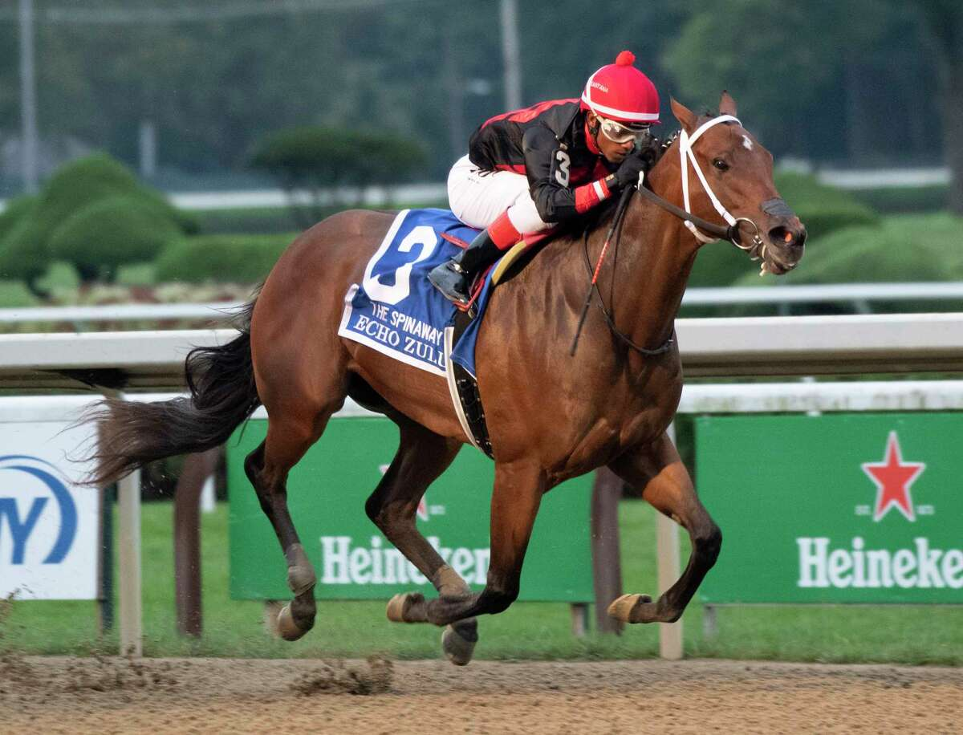
Libanius Declamation 28 as Figured Rhetoric
Notes:
the rhetoric of bluff: prosangelia as figured rhetoric:
I’ve had it and am ready to die — not!
I’m to blame, punish me — not!
Of, woe is me (i.e., pity me: kill me, or at least feed me)
Hosts will never forgive me, i’m bereft of all family, friends (and sustenance – pity me)
and anyway, i’m half dead already, and will be fully so by the time i’m invited back
show of learning in the blame-of-horses section. (i’m the victim!)
so at least feed me after i’m dead. (or how about now?)

Slide 10
Behavior Modification?
Figured Encomium of Libanius’ Parasite

Slide 11
Issues, Questions, Topics
In plain language: Your advice.
Praise topics: What’s plausible?
Figured rhetoric: Thoughts on strategy?
Epilogue: A stirring finish.
Notes:
this is how you always start, whatever the speech, whatever the occasion.
this will be just a preliminary sketch.

Slide 12
Exordium (“introduction”)
Address addressee
Announce purpose
Establish credentials
Curry favor
Grab attention!

