Slide 1
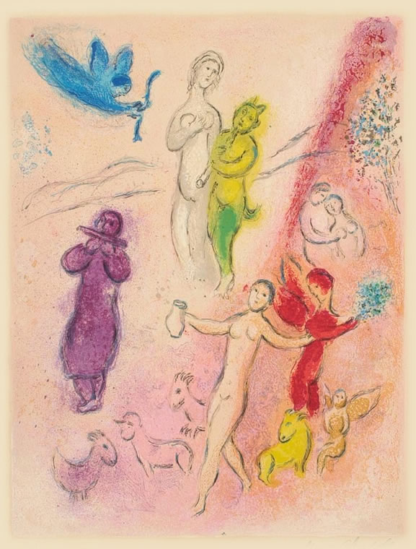
What’s Love Got to Do with It?
Longus Daphnis & Chloe
Daphnis & Chloe, Marc Chagall

Slide 2
Agenda
Discussion: Daphnis and Chloe
  Beyond RFG
Daphnis and Chloe as 2nd Sophistic
  Allusions and Evocations

Slide 3
Discussion: Daphnis and Chloe
Beyond RFG

Slide 4
What insights become possible when we switch out the RFG lens for something else?

Slide 5
Daphnis and Chloe as 2nd Sophistic
Allusions and Evocations

Slide 6
Gnatho sophistēs (pages 168-173)
Comic-suicidal entreaty
  Prosangelia (self-indictment)
  Figured rhetoric
Refutation of Astylus
  Mastery of argument from mythic analogy
Notes:
mini-meletai:
“Your Gnatho’s done for, master,” he said. “I’m the one one who until now loved only your table, who used to swear that nothing has a more youthful bloom than old wine, who said that your chefs are choicer than any boys in Mytilene, but now I think Daphnis is finer than anything. I have no taste for expensive food, even though there’s so much meat, fish, honey cakes prepared every day. I would gladly become a she-goat and eat grass and leaves so long as I could listen to Daphnis’ syrinx and have him take me to pasture. Please rescue your own Gnatho, and defeat invincible Love! Otherwise, I swear by you, my own god, that I will take a dagger, cram my belly with food, and kill myself on Daphnis’ doorstep, and no more will you be calling me Gnathipoo, as you always did when you were kidding.”
Wanting to steer him toward having his own second thoughts, he asked with a smile whether he felt no shame to be in love with a son of Lamo and indeed eager to bed down with a young man who herded goats; as he said this he burlesqued disgust at the reek of goats.
But Gnatho, a veteran of debauched drinking parties, was well schooled in the whole of erotic mythology and did not miss the mark in defending both himself and Daphnis
(mastery of mythological allusion)

Slide 7
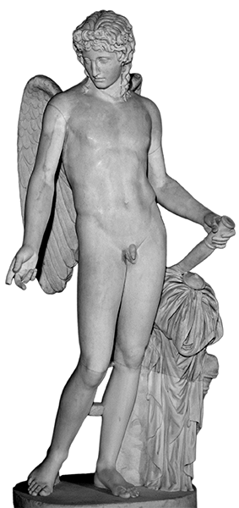
“Astylus ... said that Love (Erōs) makes great rhetoricians (sophistas).” (D&C page 173)
"Erōs, mischievous sophist” (Xenophon Education of Cyrus 6.1.41, ca. 400 BCE)
“Erōs is a teacher more powerful than any tricky sophist” (Anaxandrides, ca. 350 BCE)
Notes:
“Astylus laughed gaily, particularly at this last remark, and said that Love (Erōs) makes great rhetoricians (sophistas).”
Ἡδὺ γελάσας ὁ Ἄστυλος ἐπὶ τούτῳ μάλιστα τῷ λεχθέντι καὶ ὡς μεγάλους ὁ Ἔρως ποιεῖ σοφιστὰς εἰπὼν ἐπετήρει καιρὸν ἐν ᾧ τῷ πατρὶ περὶ Δάφνιδος διαλέξεται.
but this sophistry, which deploys tricky sleight of hand, like 1st sophistic, seeks a negative outcome

Slide 8
Ekphrasis set-pieces in D&C
Preface (pp. 13-15)
  And the novel as a whole?
Dionysiodorus’ “park” (pp. 151-155)
  Paradeisos, enclosed garden
Notes:
ekphrasis of the paradeisos plus shrine, where lamo and family live, over which he is overseer. in effect, a planned garden. combination of nature and art. "At the very center of the park’s length and breadth was a shrine and altar of Dionysus; ivy covered the altar, vine shoots the temple. Inside, the temple had paintings with Dionysiac themes: Semele in childbirth, Ariadne asleep, Lycurgus in chains, Pentheus being torn asunder; there were also Indians being conquered and Etruscans having their shapes changed; everywhere were satyrs <treading grapes>, everywhere maenads dancing. Nor was Pan neglected: he was there too, sitting on a rock and playing the syrinx as if providing the music for both the treaders and the dancers."
this evokes the elaborate villae rusticae of the roman period the master is Dionysiodorus, Lamon serves as slave overseer (vilicus-epitropos). Herodes Atticus had more than one such estate.
this is the taming of nature, the interpenetration of city and country.

Slide 9
Social Drama as 2nd-sophistical?
Daphnis’ maturation |  | Lampis as loose canon
Matrimony as prosocial erōs |  | Lampis’ attempted bride abduction
 | versus | Gnatho’s attempted Daphnis ravishing
Daphnis as inheritance insurance |  | Lampis’ vandalism
Physical-concrete tokens of class
Importance of property

Slide 10
Social Drama as 2nd-sophistical?
Daphnis’ maturation |  | Lampis as loose canon
Matrimony as prosocial erōs |  | Lampis’ attempted bride abduction
 | versus | Gnatho’s attempted Daphnis ravishing
Daphnis as inheritance insurance |  | Lampis’ vandalism
Physical-concrete tokens of class
Importance of property
Compare Polemon
Physiognomy
Notes:
bride abduction in Polemon and Alciphron
in Polemon, importance of keeping eros under control. of forestalling sexual violence, ungoverned eros. links between outward appearance an inward qualities. in d/c, classicist implications.

Slide 11
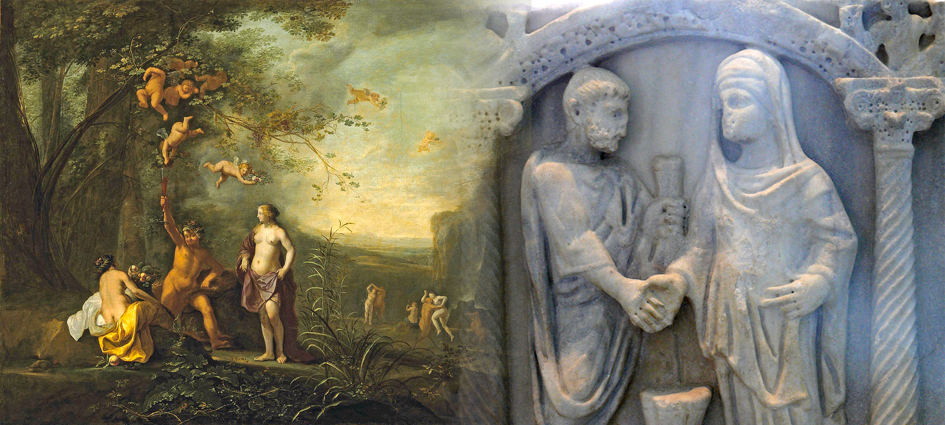
Happily-Ever-After
(a blending of worlds?)

