Slide 1
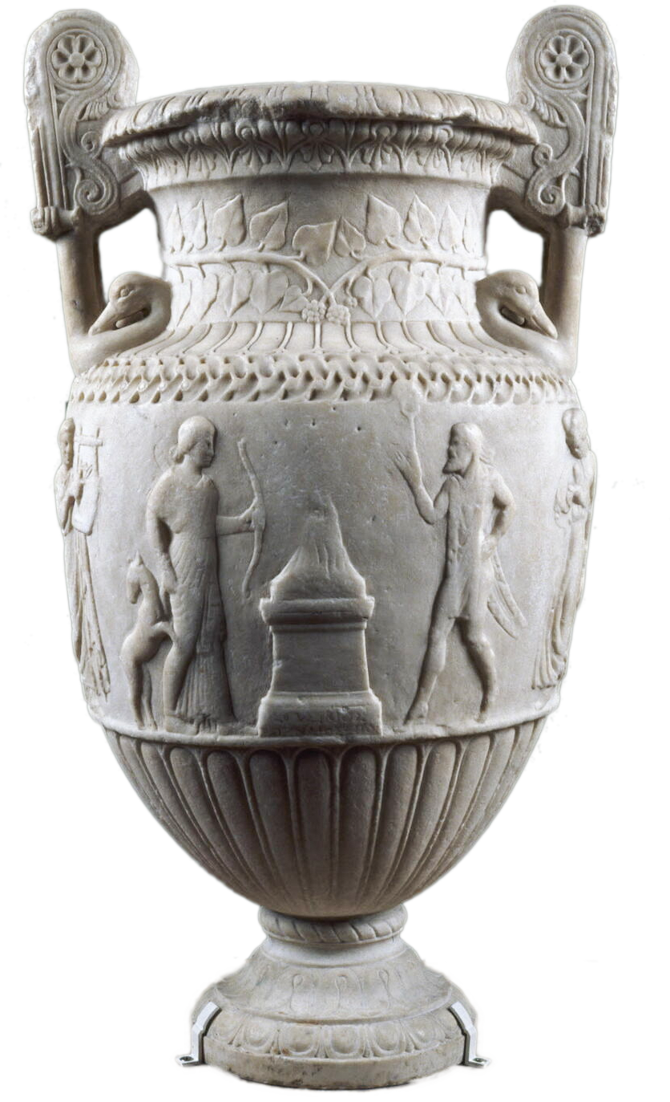
Picture This
The Art (and Rhetoric) of Ekphrasis
Sosibios Vase, Neo-Attic marble krater, ca. 50 BCE. Paris, Louvre Museum.

Slide 2
Keats’ Ode: What to Make of...
Sylvan historian, who canst thus express / A flowery tale more sweetly than our rhyme....
Heard melodies are sweet, but those unheard / Are sweeter....
“Beauty is truth, truth beauty,—that is all / Ye know on earth, and all ye need to know.”
https://youtu.be/a1AAKqh1BT8
Notes:
why is the vase a “cold pastoral”?
a lot of similarities with imperial-age rhetoric, specifically ekphrastic and otherwise, likely due to continuities in the western rhetoric-poetic tradition:
multiple first-person address: “Ah, happy” this and that, “O” etc. (the rhetorical figure of apostrophe, address directed at a non-human or absent addressee)
reflections on imitation (mimesis) and mimesis of mimesis, on discourse capable of bringing life to a static depiction of a scene
evocation of a there-and-then separate from the here and now, yet reflecting values embraced by the orator’s/poet’s here-and-now

Slide 3
Agenda
What is ...
Ekphrasis
Group Ekphrases
Leon the Lizzard (artwork)

Slide 4
What is ...
Ekphrasis

Slide 5
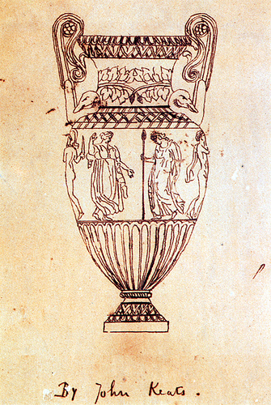
Ekphrasis Is ...
Expression
Greek ekphrasis
Description
Of things, places, details (enargeia)
Interpretation
Meditation
on themes of...
agōn
Keats, sketch of Sosibios vase

Slide 6
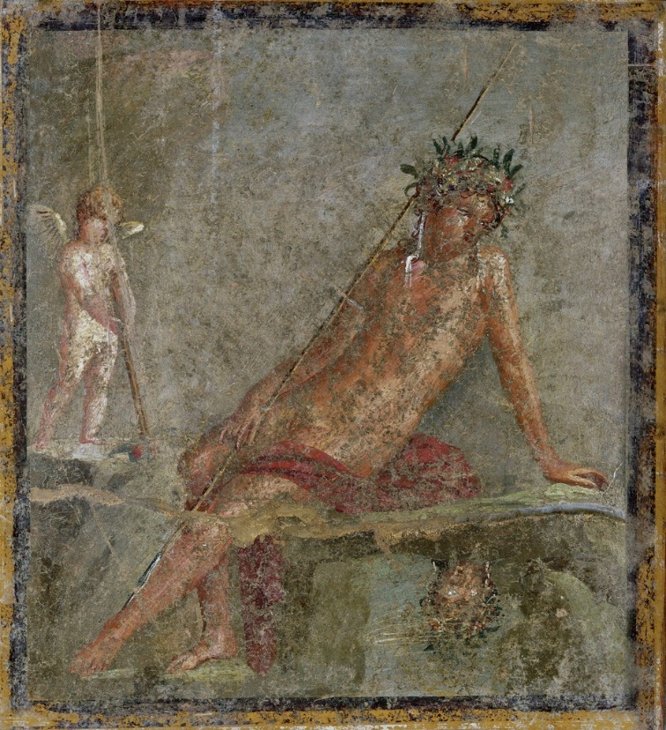
Philostratus Imagines 1.23
Cave (compare D&C)
Detail (of description)
Interpretation
Detachment (compare Keats)
Physiognomy (compare Polemon)
Narcissus, 1st-cent. fresco, Pompeii
Notes:
“The youth, standing erect, is at rest” – unlike what we see in Pompeiian painting. Phil’s is a different painting.
note the cave of Achelous (river god) and nymphs in Philostratus, like the cave of nymphs (with spring-fed stream) in D&C. (evidently not present in the fresco from Pompeii)
underscored realism of phil’s painting. the painting mirrors the imagined original scene, just as the pool mirrors narcissus. just as the ekphrasis mirrors the painting.
the importance of knowledgeable viewing. narcissus the naive viewer falls afoul of his refusal to love and of his naivete.
detachment of depicted figure from viewer: “Do you then expect the pool to enter into conversation with you? Nay, this youth does not hear anything we say, but he is immersed, eyes and ears alike, in the water and we must interpret the painting for ourselves.” ekphrasis as an exercise in interpretation of a visual object.
physiognomy: “The eye, surely, is that of a man deeply in love, for its natural brightness and intensity are softened by a longing that settles upon it, and he perhaps thinks that he is loved in return, since the reflection gazes at him in just the way that he looks at it.”

Slide 7
Group Ekphrases
Leon the Lizzard (artwork)

Slide 8

Group Tasks
A paragraph of ekphrasis
Focusing on one aspect
Doesn’t have to be pure description
Designate
Scribe
Orator

Slide 9
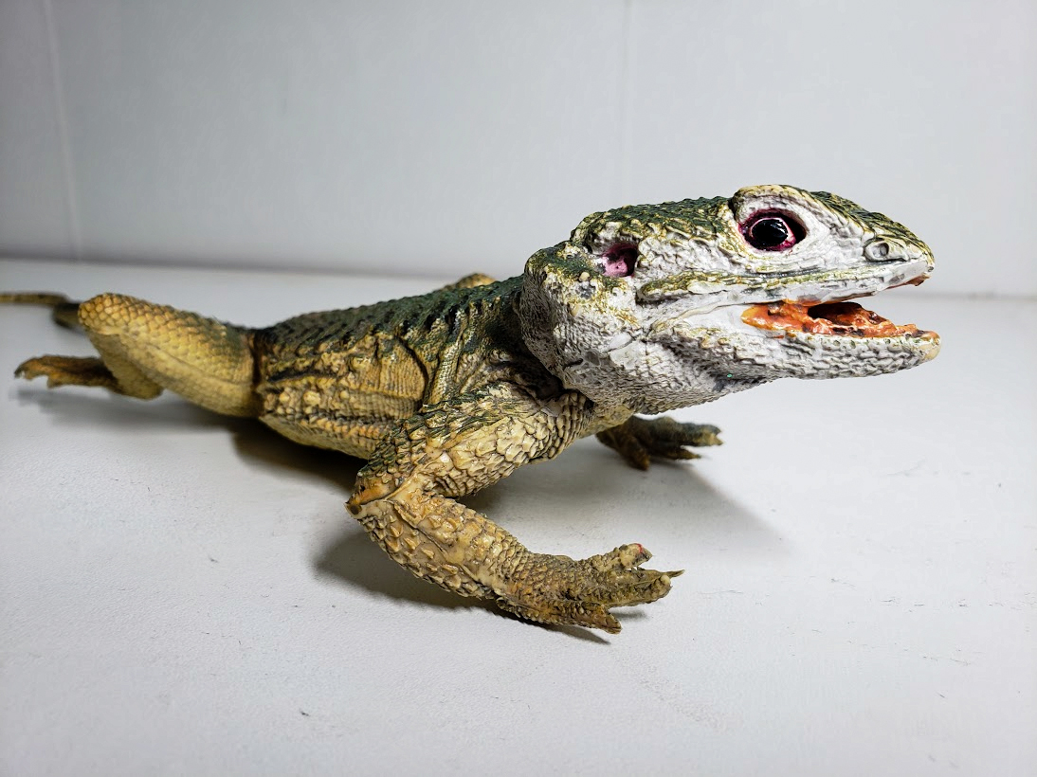
LEON the Lizzard

