Slide 1
Second Sophistic:
Introductory Readings

Slide 2
Agenda
Journal Entries Discussion 1
  Impressions of today’s Lucian readings?
Journal Entries Discussion 2
  What is a sophist?
Anti-Vade mecum (Lucian)
  Arguments contra
Lucian’s Tyrannicide
  Rhetorical Reasoning

Slide 3
Journal Entries Discussion 1
Impressions of today’s Lucian readings? (free discussion, 5 mins)
Notes:
10 mins max!

Slide 4
Journal Entries Discussion 2
What is a sophist? (breakout, 10 mins)
Notes:
Fill in following slide – breakout groups.

Slide 5
What is a sophist?
Not just rhetoricians, but teacher-practicioner-experts. Performers (like athletes).
Performer part. Less concerned about truth, doing rhetoric as spectacle.
Sophists as clever / deceptive. Specious values?

Slide 6
Rhetoric = Persuasion through
ēthos | character (speaker’s)
pathos | emotion (listener’s)
logos | language/reasoning

Slide 7
Sophistic: Concepts
Attic/Atticism
Genre
  (pro)lalia
  ekphrasis
  dialexis
genre (cont’d)
  meletē
    Forensic (for the law courts)
    Deliberative (political)
  Epideictic (occasional)
    Enkomion (praise)
    Psogos (blame)
    etc.

Slide 8
Anti-Vade mecum (Lucian)
Arguments contra (breakout, 30 mins)

Slide 9
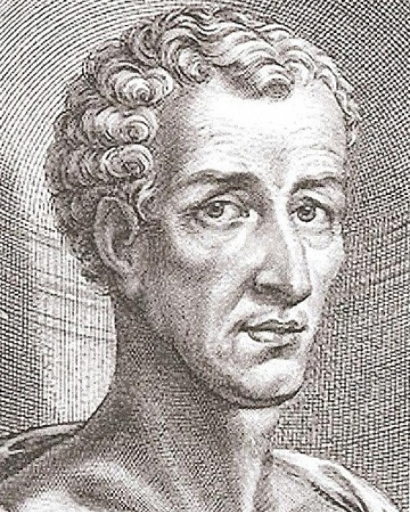
Directions for Each Group...
What is the thesis, the chief point, of the piece?
What is your antithesis, your “counter-point”?
How best to refute/disprove Lucian’s logic?
How best to support yours?

Slide 10
Vademecum, allusions
“Classical” Athens 400s-300s BCE
Lucian’s here-and-now
Aristophanes Clouds
  “Bad” logos (sophistry)
  “Good” logos (traditional education)
Aeschines Speech 1
  “Manly” public speakers
  Sexually compromised speakers
Vademecum
  “Bad” sophistic (shortcuts)
  “Good” sophistic (long road)
Vademecum
  “Manly” sophists
  Sexually compromised sophists

Slide 11
Lucian’s Tyrannicide
Rhetorical Reasoning (lecture)

Slide 12
Enthymeme, Epichireme
The tyrant would not have committed suicide had his son lived
I slew the tyrant
I slew the son
reward tyrant slayers
Reward me
I slew the tyrant
Notes:
“’But you did not kill the tyrant ; the law assigns the reward to him who kills the tyrant.’ And pray what is the difference between killing him and causing his death ? I see none.” (p. 177)
“'But you did not kill the tyrant ; the law assigns the reward to him who kills the tyrant.’ And pray what is the difference between killing him and causing his death ? I see none.” (177)

Slide 13
A fortiori reasoning
You reward those who slay one tyrant
And you’re not going to reward me?!
I slew two!

Slide 14
More...
Insinuation
Khrōma (Latin color), “spin”
It is surely from no patriotic motive ... that my adversary disputes my claim; rather it is from grief at the loss of the tyrants.
... we had not one tyranny, ... it was reserved for us to have two tyrants at once.... That of the old man was light by comparison.... The young man ... in all essentials ... was the real tyrant.

Slide 15
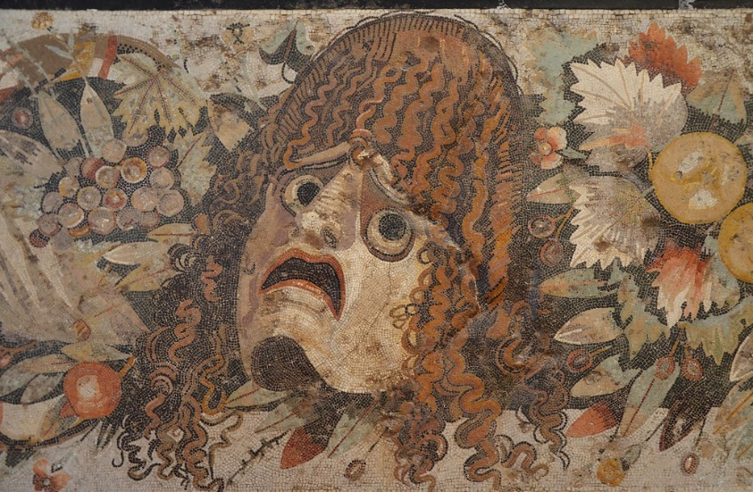
Enargeia (“vividness,” here, via dramatization)
“Now consider how the tyrant may be supposed to have acted and spoken as his end approached.... The closing scene you have all witnessed.” (pp. 182-183)
What does that get the speaker?

