Slide 1
Philostratus Lives of the Sophists:
A Sophist on Sophists

Slide 2
Agenda
Recap and Update 1
  Lucian’s The Rhetorician's Vade Mecum as Slander?
Recap and Update 2
  Rhetorical Reasoning in Lucian’s Tyrannicide
Introduction to Text
Discussion
  Race, Ethnicity, Gender, Class in Phil’s LOS
Philostratus on Sophistic as agōn
  The Good, The Bad, and the Ugly

Slide 3
Recap and Update 1
Lucian’s The Rhetorician's Vade Mecum as ... Slander?

Slide 4
Lucian’s Short-Cut Teacher:
“And in private you need draw the line at nothing, gambling, drink, fornication, nor adultery; the last you should boast of, whether truly or not. ... I was myself not without pretensions to beauty in my youth, which earned me a bare living from a miserly ill-conditioned admirer (erastēs, “lover”).” (p. 228)

Slide 5
Recap and Update 2
Rhetorical Reasoning in Lucian’s Tyrannicide

Slide 6
Enthymeme (Rhetorical Syllogism)
All Romans are freedom-loving
Marcus is freedom-loving
Marcus is a Roman

Slide 7
Epichireme (complex syllogism)
The tyrant would not have committed suicide had his son lived
I slew the tyrant
I slew the son
reward tyrant slayers
Reward me
I slew the tyrant
Notes:
“’But you did not kill the tyrant ; the law assigns the reward to him who kills the tyrant.’ And pray what is the difference between killing him and causing his death ? I see none.” (p. 177)
“'But you did not kill the tyrant ; the law assigns the reward to him who kills the tyrant.’ And pray what is the difference between killing him and causing his death ? I see none.” (177)

Slide 8
Introduction to Text

Slide 9
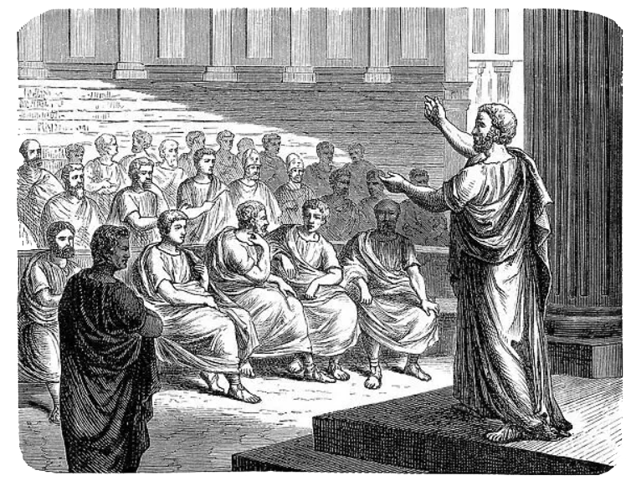
Philostratus of Athens
ca. 170–ca. 240 CE
Sophist
  Orator
  Teacher
  Socially-politically connected

Slide 10
Philostratus’ LOS: Issues, Themes
Defense of sophistic
Chronology
  “Older” (“philosophic”) sophistic
    Protagoras (mid-late 5th BCE)
    Gorgias (late 5th-early 4th BCE)
    Antiphon (late 5th BCE)
  “Second” sophistic, e.g.
    Aeschines of Athens (mid-late 4th BCE)
    Nicetes of Smyrna (1st cent. CE)
Notes:
Dedication to Proconsul (governor) Gordian (future emperor Gordian III, whose ancestor, Herodes Atticus, Phi points out. Greek rhetoric naturalized within Roman culture)
issues: plato's gorgias, and classical-grk distrust of rhetoric-sophistic. partly addressed/redressed by ari rhetoric and by plato phaedrus (second half) and others. but never wholly resolved. from the grk perspective, philosophy lends respectability to otherwise suspect rhetoric. but from the narrowly roman perspective, rhetoric historically-originally more respectable. quintilian founds his def of the orator (orator, latin for speaker) on cato the elder's (234-149 BCE), "vir bonus, dicendi peritus." that automatically stipulates that the public speaker will be a "good man" - not a person, a man (vir), and good both in the moral and social (aristocratic) sense. grk intellectual achievement generally, philosophy and rhetoric included, had a somewhat complicated history: phases of intense interest in, instances of official repression of, both. but the idea of their connection, which goes back to the athenian orator isocrates (436-338 BCE), is prominent in cicero. thus rhetoric could be seent to have a practical side, both in local municipal bodies and in the courts, and it could be seen as an important attribute of aristocratic status. in philostratus we see both the urge to lend rhetoric intellectual cachet via philosophy, and to address lingering distrust of it, especially in connection with doubts connected to "sophistry." [e.g., continuing use of derived words meaning "cleverly contrive" and the like.]
“Ancient” (arkhaia) sophistic versus “second” sophistic
Defense of sophistic: addresses its negative rap in the case of favorinus and of antiphon.
Older (philosophic)
Gorgias, Antiphon, etc. (400s–early 300s BCE)
Second
Aeschines (later 300s) to “present day”
declamation, systematic instruction

Slide 11
Phil’s LOS: Issues, Themes (cont’d)
“Second” sophistic (cont’d)
  “Sophistic” philosophy, e.g.,
    Dio (ca. 40/50-after 110 CE)
    Favorinus (ca. 85-155 CE)
  Pure sophistic
    Lollianus of Ephesus (2nd cent. CE), etc.
      Chair in rhetoric, overseer food supply, Athens
      ?? Educational policy, Antoninus Pius?? (r 138-161)
Sophistic had “arrived”!

Slide 12
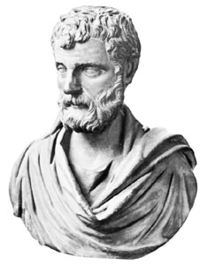
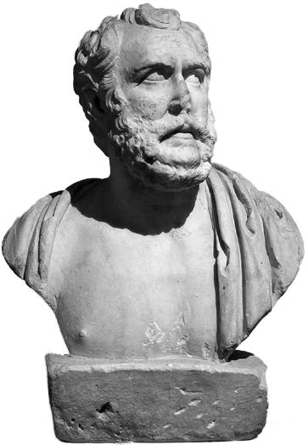
Phil’s Sophists Exemplify...
Wealth, Status
  Polemon
  Herodes
Roles
  Politician
  Ambassador
  Legal advocate
  Teacher
  Performer
Herodes Atticus
Polemon

Slide 13
Discussion
Race, Ethnicity, Gender, Class in Phil’s LOS

Slide 14
With regard to the lives of Favorinus, Polemon, and Herodes, really, with any of our sophists, what issues of race, gender, and/or class do you see? How might that relate to sophistic?

Slide 15
Relevant Quotations
Polemon’s students at Smyrna
  “... nor were they a dissolute and promiscuous rabble, but select and genuinely Hellenic” (p. 109)
“Heracles of Herodes,” his speech
  “The interior of Attica educated me, .... For the Athenians in the city admit as hirelings ... barbarian peoples, and their own speech deteriorates” (p. 155)

Slide 16
More Quotations
On Autolecythus:
  “... an Indian, entirely black, ... [who] used to divert [Herodes and Favorinus] by sprinkling his Indian dialect with Attic words and by speaking barbarous Greek with a tongue that stammered and faltered” (p. 27)
On Herodes’ murder trial:
  “For he never would have dedicated to [his wife’s] memory so fine a theatre nor would he have postponed for her sake the casting of lots for his second consulship, if he had not been innocent of the charge” (p. 161)

Slide 17
Philostratus on Sophistic as agōn
The Good, The Bad, and the Ugly

Slide 18
The Good: Emulation
On Scopelian’s reading and his rivalry with his teacher, Nicetes:
“He devoted himself to all kinds of poetry, but tragedies he devoured in his endeavour to rival (agōnizomenos, “competing with”) the grand style of his teacher; for in this branch Nicetes was greatly admired” (p. 228)

Slide 19
The Bad-Ugly
On rivalry between Favorinus and Polemon:
“The quarrel … became more bitter in Rome; for there consulars and sons of consulars by applauding either one or the other started between them a rivalry such as kindles the keenest envy (phthonos) and malice even in the hearts of wise men” (p. 27)

Slide 20
Rhetorical Envy-Attribution
On criticism of Scopelian:
“For they say that he is unworthy of the sophistic circle and call him dithyrambic, intemperate in his style, and thick-witted. Those who say this about him are quibblers and sluggish and are not inspired with extempore eloquence; for man is by nature a creature prone to envy” (p. 73)

