Slide 1
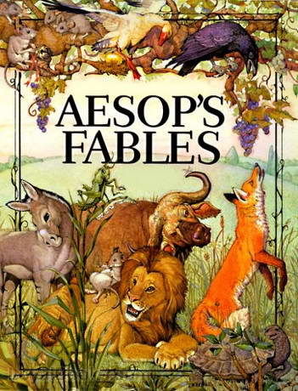

Fable As Exercise:
Hermogenes, Theon, Burton, Select RFG Pages

Slide 2
A question…

Slide 3
What’s the moral?
Which morals does Kubrick mention?
What do you think?
https://youtu.be/0YK8eYGplXo
Notes:
this is Stanley Kubrick accepting via pre-recorded video the D.W. Griffith Lifetime Achievement Award from the Director’s Guild of America.
Kubrick, who died just a year later, directed such films as 2001: A Space Odyssey and Dr. Strangelove. Griffith directed Birth of a Nation (1915) and Intolerance (1916).
After a brilliant career capped by the film Birth of a Nation in 1915, Griffith’s career went into decline. Kubrick is comparing his story to that of Icarus, the boy who flew too close to the sun, so that the wx of his wings melted; he says there are similar lessons to be learned from both the director’s and the boy’s respective stories.
so my questions:
so what is the moral? Note that Kubrick here tells a story about Griffith as if the latter were the mythological figure Icarus, who flew so close to the sun that the wax holding his wings together melted....

Slide 4
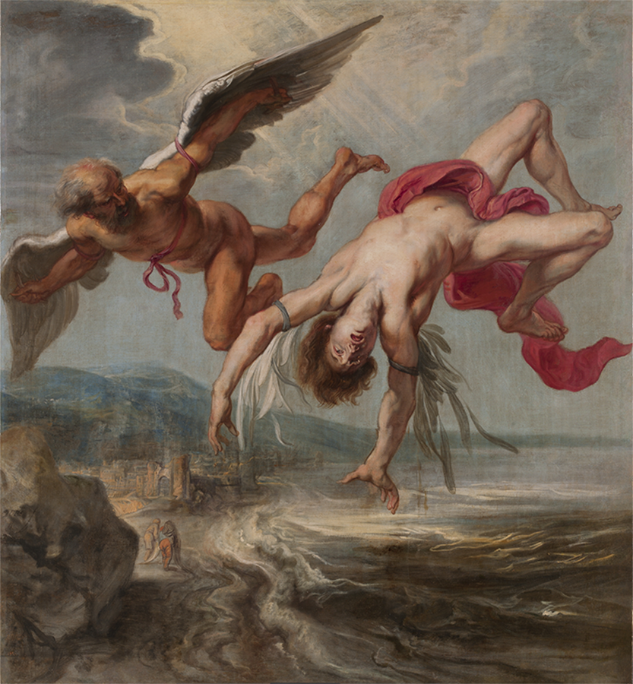
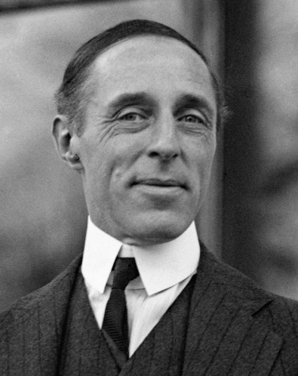
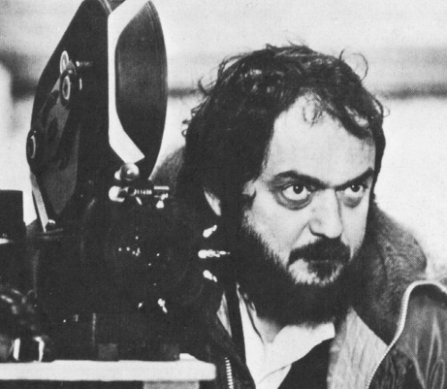
Kubrick
Griffiths
JP Gowy, “The Flight of Icarus” (1635–1637)
Notes:
Ok, what do you think? [what students think]
So Kubrick’s telling of this double fable (Icarus’, Griffith’s) is pretty elaborate – I’d call it rhetorically embellished. And I wonder if one of the embellishments is the very comparison of Griffith to Icarus, a comparison that seems to suppress a key fact about Griffith: that BOAN, a glorification of the KKK, was a racist film and damaged Griffith’s reputation. So I wonder if we can’t rewrite the fable a little, leaving out the (misleading?) Icarus and pointing toward another lesson to be learned, another moral.
that opening meant to preview key elements of today’s class, and even, to a degree, to address your journal comments.
some students found confusing the idea that you can produce an antirrhesis, a counter-argument for a fable, which we tend to assume are just too basic as stories to play around with. indeed, the idea that we should be messing with lessons taught by children’s stories is more than little disquieting.
but if you think about it, it’s the perfect bit of training in argumentation and self-expression, in rhetorical elaboration, precisely for the challenges it poses.
the those key facts of Griffith’s career, the psilos logos, the bare-bones version. In a way, isn’t it Kubrick who has rewritten the lessons to be learned from them, who challenges us to come up with a different set of narrative features with which to fill out the narrative, to drive home the point that we feel should be made.

Slide 5
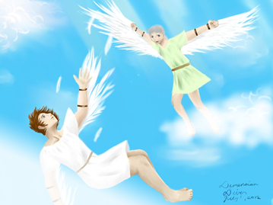
Why Daedalus & Icarus?
Spin (khrōma)
  Dodges race issue
Analogy
  wing designers : wings : : film directors : films
  Kubrick = new, improved Daedalus-Griffith

Slide 6
Agenda
Recap and Update
  Philostratus on Sophistic agōn
Journal Entries
  What to discuss? What’s the point?
Introduction to Progumnasmata
  Theon, Pseudo-Hermogenes
Can You Tweet It? (psilos logos)
  “The Frog Who Isn’t Talking to You”

Slide 7
Recap and Update
Philostratus on Sophistic agōn

Slide 8
Rhetorical Envy-Attribution
On criticism of Scopelian:
“For they say that he is unworthy of the sophistic circle and call him dithyrambic, intemperate in his style, and thick-witted. Those who say this about him are quibblers and sluggish and are not inspired with extempore eloquence; for man is by nature a creature prone to envy” (p. 73)
Notes:
Envy attribution is a way to make sense of “otherwise inexplicable events within communities” ({Eidinow, 2015 #244@8}).
Why envy attribution here?
According to Theophrastus, lies stemming from slander and envy lose force and fade away (fr. 153 Wimmer). Jump ahead in time, and we find Apsines commending envy attribution, the claim that so-and-so envies, or acts or speaks out of envy, as a way to sabotage an opponent’s claims (Ars rhetorica 93 Patillon). For it is, to quote a speaker in Sopater, “unseemly to pursue an envy-driven (phthonōi) prosecution, to put everything on the line for someone purely out of spite” (baskaniāi, 8.48 Waltz).

Slide 9
Constructive agōn
On Scopelian’s reading and his rivalry with his teacher, Nicetes:
“He devoted himself to all kinds of poetry, but tragedies he devoured in his endeavour to rival (agōnizomenos, “competing with”) the grand style of his teacher; for in this branch Nicetes was greatly admired” (p. 228)

Slide 10
Constructive agōn (cont’d)
zēlos
  Admiration, emulation, competitive spirit
mimēsis
  Imitation

Slide 11
Dysfunctional agōn
Favorinus versus Polemon:
“The quarrel … became more bitter in Rome; for there consulars and sons of consulars by applauding either one or the other started between them a rivalry such as kindles the keenest envy (phthonos) and malice even in the hearts of wise men” (p. 27)
Notes:
Scopelian versus Nicetes (student versus teacher) — was that real-time, synchronous rivalry?
when the stakes are high, can envy and its byproducts be avoided?
basically, Philostratus is saying that each sophist had his factional support at rome, and that that egged them on. descending to slandering one another and name-calling, they in effect brought dishonor to the practice of sophistic.
“The quarrel that arose between Polemon and Favorinus began in Ionia, where the Ephesians Favoured Favorinus, while Smyrna admired Polemon; and it became more bitter in Rome; for there consulars and sons of consulars by applauding either one or the other started between them a rivalry such as kindles the keenest envy and malice even in the hearts of wise men. However they may be forgiven for that rivalry, since human nature holds that the love of glory never grows old; but they are to be blamed for the speeches that they composed assailing one another; for personal abuse is brutal, and even if it be true, that does not acquit of disgrace even the man who speaks about such things. And so when people called Favorinus a sophist [as an insult], the mere fact that he had quarrelled with a sophist was evidence enough; for that spirit of rivalry of which I spoke is always directed against one’s competitors in the same craft.”

Slide 12
Journal Entries
What to discuss? What’s the point?

Slide 13
Journals: Some Concerns
These aren’t the kinds of fables I’m used to!
  (Cyprian, Libyan, Sybaritic, Aesopic?)
What’s the point of fables for us?
  (Why are we studying this topic?)
Elaboration, contradiction (auxēsis, antirrhēsis)
  (What’s that about — pros, cons, etc.?)
Notes:
These aren’t the kinds of fables I’m used to!
(Cyprian, Libyan, Sybaritic, Aesopic?)
What’s the point of fables for us?
(Why are we studying this topic?)
this the same as kid’s lit? (yes and no. not really a recipe for kid lit, but yes, intended to be morally instructive for students, as all education was intended to be. AT THE SAME TIME, rhetoric as something to weaponize is part of the bargain, and deemed a necessary skill for this period)
practical applications?
Stylistics: “"They want the expression to avoid to use of periods and to be close to sweetness“
not just simplification, but amplification, too
is this debating club, or something else?
Elaboration, contradiction (auxēsis, antirrhēsis)
(What’s that about — pros, cons, etc.?)

Slide 14
Introduction to Progumnasmata
Theon, Pseudo-Hermogenes

Slide 15
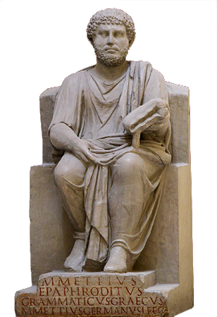
Two Rhetorical Treatises
Aelius Theon Progymnasmata
  1st cent. CE
Pseudo-Hermogenes Progymnasmata
  2nd, 3rd cent CE?
Marcus Mettius Epaphroditus, Greek grammatikos (lived 1st cent CE)
Notes:
Aelius Theon of Alexandria?
1st cent. CE (?)
Grammatikos (and rhētōr?)
Progumnasmata
Teacher’s handbook for…
“Preliminary exercises” (progumnasmata) in rhetoric
Practice in…
Grammatical inflection
Invention (heuresis)
Elaboration (exergasia)
Characterization (ēthopoiia, which Theon calls prosōpopoiia)
Contradiction (antirrhēsis)
daily life
daily life as the exercise of rhetoric – how?
"And prosopopoeia (personification) is not only an historical exercise, but applicable also to oratory and dialogue and poetry,3 and is most advantageous in everyday life and in our conversations with each other, and (understanding of it) is most useful in study of prose writings” (p. 4)
theon on paraphrase. the idea that rhetoric is, in part, the repurposing of the tried and true. (p. 7, with theme and variations on envy (phthonos) as occupational hazard of the living, quoting thuc, Theopompus, Demosthenes.)

Slide 16
Pseudo-Hermogenes on Fable
Fictitious
Plausible characterization
  Clever foxes, etc.
Expansion, compression
  (epektasis), psilos logos

Slide 17
Theon on Elaboration, Contradiction
Elaboration (exergasia)
Contradiction (antirrhēsis)
Aeschines
  “You righteously and justly restored the cities” etc.
Demosthenes
  “You, on the one hand, did a noble thing in saving the island, but it was a yet nobler thing by far” etc.
Demosthenes
  You approve the gifts, you indict gratitude
“Critic”
  Giving is ok, receiving, not always (“You took bribes!”)

Slide 18
Theon: Refutating Fables (not assigned)
“Since even the fablemaker himself acknowledges that what he writes is false and impossible, though plausible and useful, one should refute by showing that what he says is implausible and not beneficial, and one should confirm in the opposite way”
“… one should ... find a supply of things to say in reply to each part of the fable ... : the unclear, the implausible, the inappropriate, the deficient, the redundant, the unfamiliar, the inconsistent, the disordered, the inexpedient, the unlike, the false” (p. 26)
Notes:
look at p. 72. basically meeting point for point using what appear to be reasonable, widely accepted, even proverbial starting points. look at that page for the Demosthenes 18 thing. it’s obscure, but he means that statesmen recipients of gifts from foreign leaders aren’t always in the right to accept – the gifts are sometimes bribes. you can do the same with a fable. “don’t fly too close to the sun,” teaches the Icarus fable. or you can say, but if we never tried to fly higher, how would we ever get off the ground? the point isn’t exactly to come up with a logically air-tight piece of reasoning, but something that will make people nod their heads in assent.

Slide 19
Can You Tweet it? (psilos logos)
“The Frog Who Isn’t Talking to You”
https://youtu.be/xILmGxTs6iE

Slide 20

Psilos logos (bare-bones narrative)
“There was a frog, always on her phone, who was rude to everyone. But when she needed someone, no one was there for her. She died. Moral: Nothing is so important on your phone that you can be rude to others.”

Slide 21
Next Class
Fable, anti-fable:
Rhetorical remix and reversal

