Slide 1
Athletics and agōn in the Greco-Roman East
What Do We Learn?

Slide 2
Agenda
Recap and Update
  Fable and Anti-Fable
Overview of Issues
  Athletics and agōn

Slide 3
Recap and Update
Fable and Anti-Fable

Slide 4

Fable, Anti-Fable
Progumnasmata Bingweb page
Google folder fable doc (via Brightspace)

Slide 5
Overview of Issues
Athletics and agōn

Slide 6
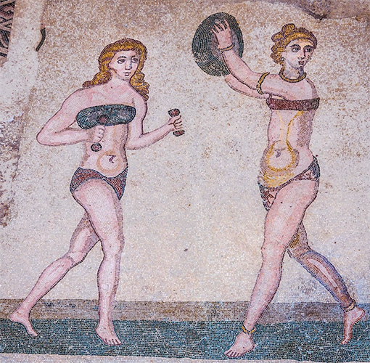
Issues
Ideological dimension
  Identity and education
Gender issues
  Women’s athletics
Historical dimension
  Continuity and change

Slide 7
Breakout Discussions
How did athletic agōn figure into constructions of Hellenic identity? Can athletics help us understand what it meant to be Greek under Rome? How?
Does van Nijf seem to make a convincing case that culturally Greek cities in the Roman East, or at least in the region he studies, namely, Lycia, valued athletic over intellectual achievement? Should we be studying "jocks," not sophists? (Well, we're studying both.)

Slide 8
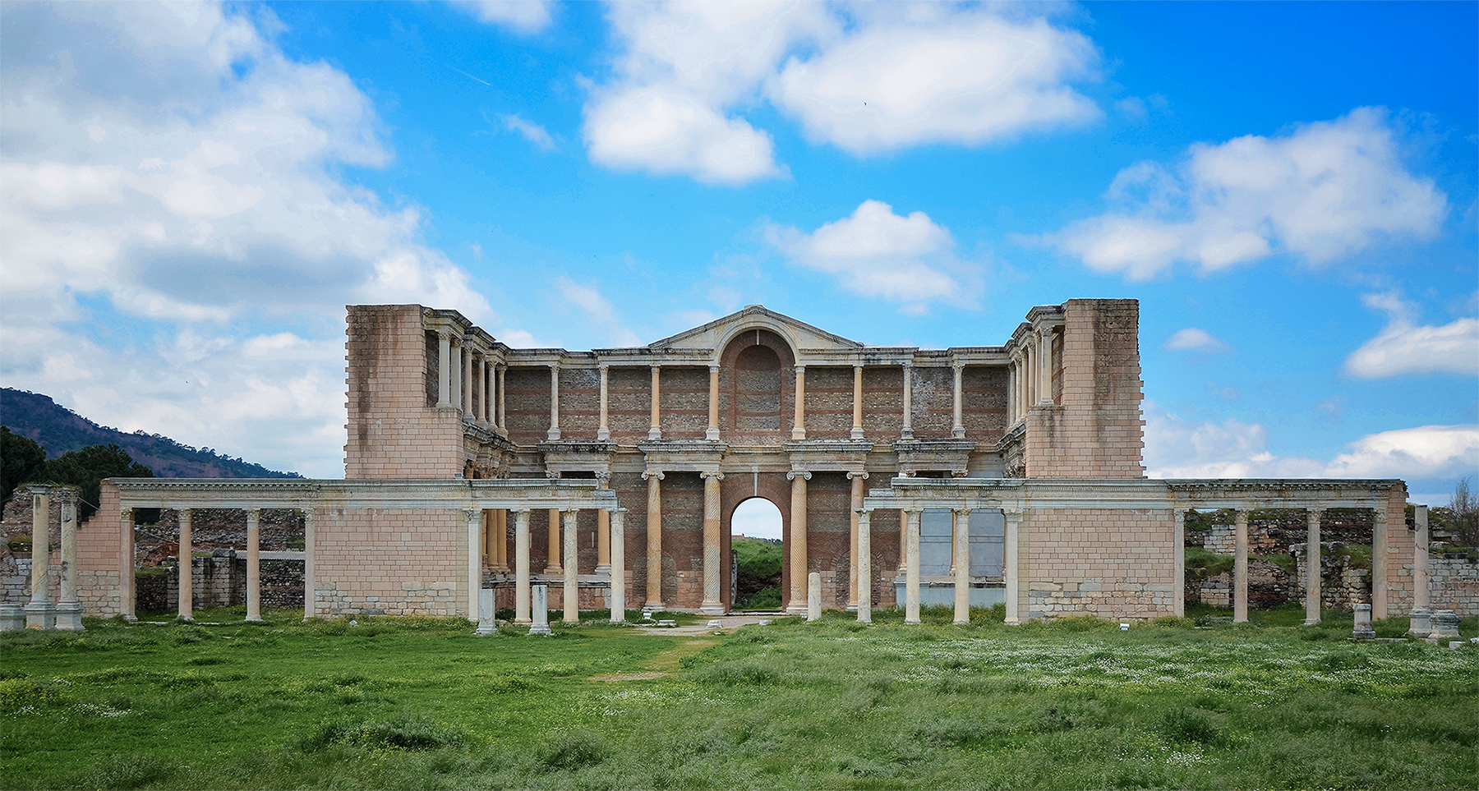
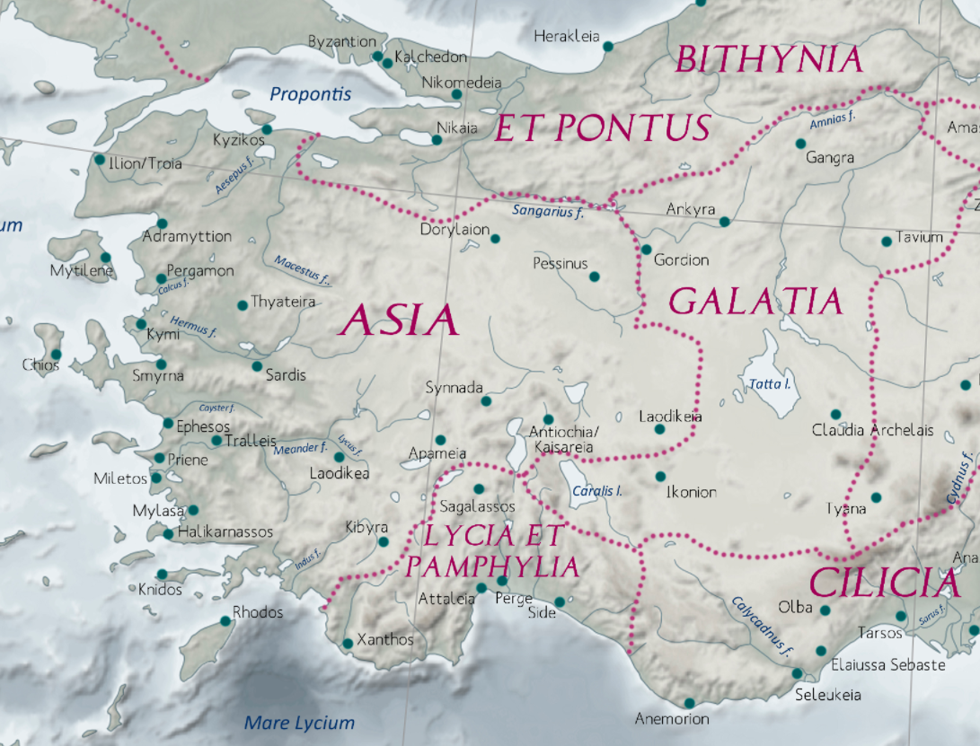
Sardis
Oinoanda
Gymnasium complex, Sardis, Asia Minor. Late 2nd/early 3rd CE
Notes:
gumnasion. Also spelled gymnasion, in Latin, gymnasium. The word derives from gumnos, "nude/naked." It was where Greek men and boys exercised in the nude. Originally, it would have simply been an open field outside the city. In the Roman East, gumnasia could be exercise-bathing establishments on a grand scale, and inside the city. Greco-Roman gymnasia were still a locus of physical training, but also offered a place for intellectual training. In addition to bathing facuilities, such establishments might boast of a roofed, indoor track (a xustos) and an auditorium.
you see here remains of the gymnasium in sardis, in the roman province of asia. but we’re more interested in another city to its south west, Oinoanda

Slide 9
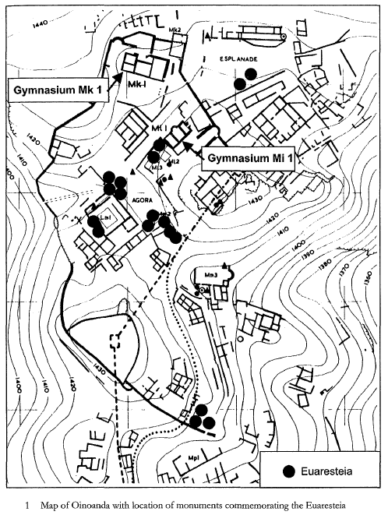
“Many have put up fair prizes for cities, after they were dead, but, in his own life, no mortal man. … So, abating your criticism, all those who have dread Envy, look upon my statue with emulous eyes.” (Euarestos inscription, van Nijf, p. 204)
Notes:
schoolmaster Euarestos, wrestler Fronto. both wealthy, both connected to the gymnasium.
oinoanda had 2 such gymnasia: exercise area, track, bath, latrines, study area.”Their relatively modest scale does not compare to the more elaborate buildings that were found in larger cities, but they do testify to an active cultural and athletic life.” (207)
van Nijf, Onno. 2001. “Local Heroes: Athletics, Festivals, and Elite Self-Fashioning in the Roman East.” In Being Greek under Rome: Cultural Identity, the Second Sophistic, and the Development of Empire, edited by Simon Goldhill. Cambridge and New York: Cambridge University Press.
310-311. on what Robert calls the "agonistic explosion" ({Robert, 1982 #250@38}. "In the entire Greek world, but above all in Roman Asia Minor, old festivals were revived or reorganized, and new ones were founded in large numbers. Louis Robert describes this phenomenon as an 'agonistic explosion'. There was hardly a town without at least one or two agonistic festivals to boast about.“
311. competition between festival-sponsoring towns, organzers, etc., to get top athletes and performers.
312. the euergetic character of most of these festivals. "As with most amenities of public life, the costs were met from private purses: they were paid for by elite benefactors, like Caius Iulius Demosthenes and L. Pilius Euarestos, who were active in the Lycian city of Oenoanda, and many, many others."
313-314. then goes on to make the point that sponsorship of such festivals also had to do with, inter alia, local identity: "the importance of being Greek in a contemporary world, the realities of Roman power, and the principles underlying the social hierarchy."
323. we know many athletes were from elite backgrounds, folks leveraging their wealth for the purpose of becoming more competitive. less clear is how many were members of sub-elite groups, people for whom prize money, participation imncentives, etc. would have represented professional remuneration ("socially mobile athletes," for many of whom elite status awaited post retirement). what is clear is, however: "Even if the aristocratic athletes did not fully monopolize the field, it is clear at least that their ideology was all pervasive" (323).
326-327. rather more speculatively discusses possibility that were a non-elite to be in a position to defeat an elite competitor, (elite) judges might move in to disallow the non-elite person access to competition - it was important to protect the elite's reputation as a kind of victor class. even those not winning at events might receive an honorary statue simplpy for competing.

Slide 10
paideutēs,
“educator”
paidotribēs,
“trainer”
grammatikos,
“school teacher”

Slide 11
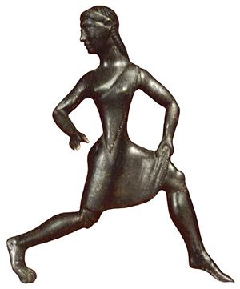
Gender Issues: Women’s Sport
Training at Sparta (archaic, classical period)
Heraia (Argos), Pythian, Isthmian, Nemean games
  Women’s events
Spartan girl runner, archaic statuette
Notes:
Athletics were not a male preserve. The young women of Sparta participated in athletic training, just like the young men, and together with them. Women were not allowed to attend the Olympic games, but they could still win victories there by sponsoring chariots. And they could attend as spectators at most other games. And even though women could not compete in person at the Olympics, they certainly did compete at the games of Hera (the "Heraea"), a sort of women's Olympics held at the same site. (The Olympics honored Zeus; the Heraea, Hera; both gods had temples at the site.) At the Heraea held at Argos, women also competed, as they did at the Pythian, Isthmian, Nemean, and other games during the Hellenistic period (323-30 BCE). Footraces for girls were, in fact, a wide-spread phenomenon. Note as well that women could compete in certain poetic competitions.
Did athletic victory for women differ from that for men ideologically? A young woman's victory in a footrace could bring honor to her family, though some felt that women's participation devalued sport. Under Rome, female victors in running and wrestling at the Antioch Olympics became priestesses. As for a woman's taking individual pride in a victory, that, notes Golden, seems to have been rare; our only evidence is the record left by Cynisca, Olympic chariot victor in the early fourth century BCE.

Slide 12
Historical Dimension
776 BCE. First recorded Olympics
573 BCE. Periodos (“circuit”) in place
  Olympic, Pythian, Isthmian, Nemean games
  Panhellenic festivals
146. Destruction of Corinth
1st-3rd cent. CE. Proliferation of games

Slide 13
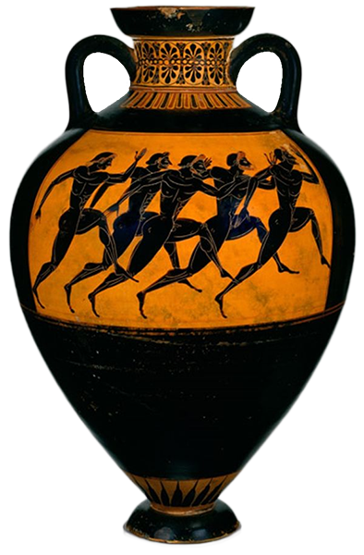
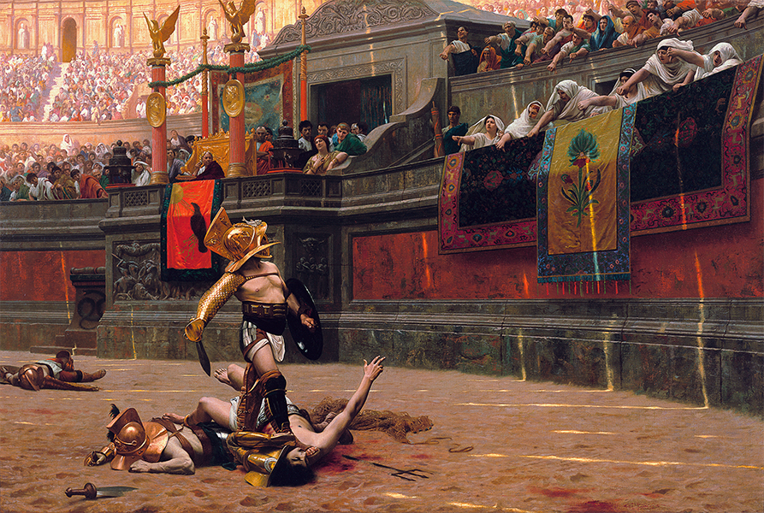
Gladiators, Athletes
Pollice verso, Gérôme (gladiators)
Panathenaic prize amphora, c. 520 BCE

Slide 14
Marcus Aurelius Asclepiades
“I ... Marcus Aurelius Asclepiades, ..., senior temple warden of the great Sarapis, high priest of the entire guild of which I am president for life, in charge of the Imperial Baths (etc. etc. etc.), undefeated periodonikēs in the pancratium, (etc. etc. etc.), after competing for a total of six years, I retired from the ring at the age of twenty five because of the dangers and envies (phthonous) to which I had been exposed”
(ca. 200 CE, IG IVX 1102. IGR I 153. Moretti 79)

Slide 15
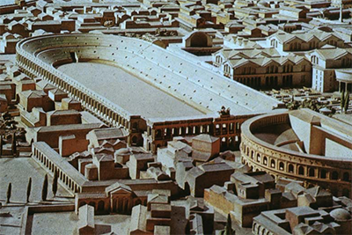
Athletic Guilds
sunodoi
  sing. sunodos, "synod")
xustoi
  “indoor running tracks”
“Athletic associations sought recognition and privileges for their members: relief from military service, billeting troops and other civic duties, the right to wear purple at festivals, the patronage of the powerful. In return, they founded and organized games in the emperor’s honour.” (Golden Sport)
Stadium of Domitian, Rome

