Slide 1
Sophia and the Art — and Science —
of Networking

Slide 2
Agenda
Discussion
  What Stands Out, Needs Discussing?
Polemon’s Physiognomy
  Play It Safe!
Alciphron Letters
  (Dys)functional, subelite competition

Slide 3
Discussion
What Stands Out, Needs Discussing?

Slide 4
QUESTION: What are your thoughts about the assigned texts? How, if at all, do they resonate with, how do they differ from, ways of thinking about competition, gender, race, etc. familiar to you? How do you respond?

Slide 5
Polemon’s Physiognomy
Play It Safe!
Notes:
beware of those with whom you associate! some for seemingly no reason will seek to harm you. it helps to see beyond the surface. yet the surface is as well the window into the soul.

Slide 6
Polemon and his Physiognomy
Marcus Antonius Polemon (c. 90–146 CE)
  Sophist
  Statesman
  All-around big-wig
Physiognomy
  Reading the soul through bodily signs
Polemon’s Physiognomy
  Translations, epitomes, paraphrases

Slide 7
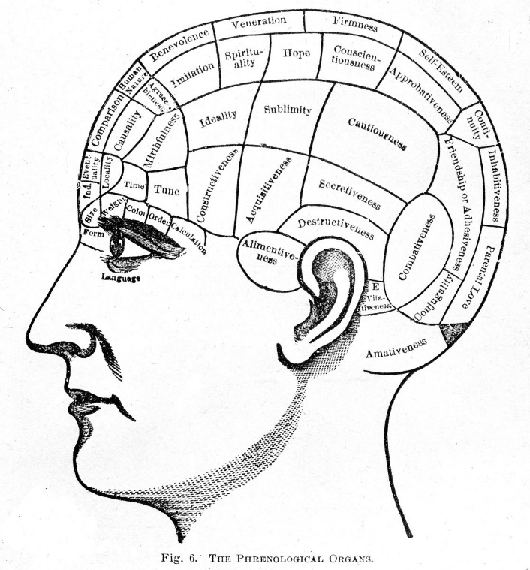
Connecting the Dots 1
Context
  Mutual inspection
  Elite competition
Method
  Integrative-summative reading
  Rhetorical, abductive, analogical reasoning
Notes:
341-381. p on the eyes.
341. note already the seemingly intended to be plausible analogies, humans-animals. analogical reasoning big; stereotyping, an appealing way to reason, apparently.
"in animals, physical traits correlate strongly with certain known character traits. humans are animals. human physical traits correlate strongly with certain know character traits."
the process is actually one of abductive reasoning, which asks, given a particular effect, what is the most likely cause? abductive reasoning is necessarily false; it's just that it's different from deriving data from direct observation.
the work presents itself as science, yet it is every bit as rhetorical, every bit as focused on winning approval and enhancing the author’s prestige, as any of his declamations.

Slide 8
Connecting the Dots 2
Sudden misfortune
  A bereaved mother’s grief (457 ff.)
The man from Corinth
  “Cunning, suspicion, envy, and jealousy” (361 ff.)
Bride abductions/elopements
  “A physiognomical insight came to me” (457 ff.)
Notes:
Polemon’s account of a woman whose sudden and otherwise unforeseen misfortune he foretells from her face and movements (Leiden 457). To Polemon, she offers an opportunity to demonstrate to an “astonished” bystander the power of his art; to readers, the spectacle of a bereaved mother overcome with grief.
the case of the “man from Corinth.” This man, Polemon’s locus classicus for the “cunning, suspicion, envy, and jealousy” associated with small, hollow eyes (Leiden 361–65; cf. Ad 1.12), embodies all the malice, treachery, and antisociality endemic to rivalrous passion (Leiden 363; cf. Plato Philebus 48b; Galen Passions of the Soul [Aff. dig.] 5.35.11–12; Alciphron 2.27.3). But the reality of it all does not fully sink in until Polemon’s Corinthian stumbles into an intervention-like event. Happening upon the physiognomist and others conversing about him and his faults, he terrifies the group and confirms their suspicions. He then confesses and breaks into tears.
Polemon’s eyewitness account of a pair of bride abductions foretold by him solely on the evidence of bodily signs (Leiden 456–459). Those signs — one abductor’s green eyes and angry looks, another’s quivering nose and rapidly cycling facial coloring; a complicit bride’s watery eyes and keen gaze, another’s feigned laughter — betray the passions (the Arabic mentions anger, desire, fear) and the intentions of the principal actors. At each of the two weddings, they matter for the role they play in the physiognomist’s brilliant display. But they also matter because, had the affected parties but studied the physiognomist’s art, had they but read the signs, they could have shielded their respective households from matrimonial mayhem and the attendant tragedy and disgrace.
Yet passion here is not fully realized until given utterance by witnesses, for instance, in the ensuing gossip of townsfolk asserting the complicity (Leiden 459) and, by implication, the unsupervised passion of one of the brides.

Slide 9
Race, Ethnicity, Geography 1 (p. 425)
“Just as the north is the opposite of the south, likewise the judgement of its people is contrary to the judgements of the people of the south. Regarding whoever is in the middle of the two conditions, judge for them accordingly.”

Slide 10
Race, Ethnicity, Geography 2 (p. 427)
Greeks
Who are these guys?
The pure Greek is of medium stature, between tall and short, broad and weak. He is of erect posture, beautiful in face and appearance, white in colour, mixed with red, medium in flesh, with medium palms and elbows, alert, quick to learn [etc. etc.]”
“... the Greeks ... share in their land. Others have become numerous among them, because people want them and their land, either for the pleasantness of their life and their moderate temperament and passion, or out of a desire for their knowledge, their good way of life and their laws.”

Slide 11
Alciphron Letters
(Dys)functional, subelite competition

Slide 12
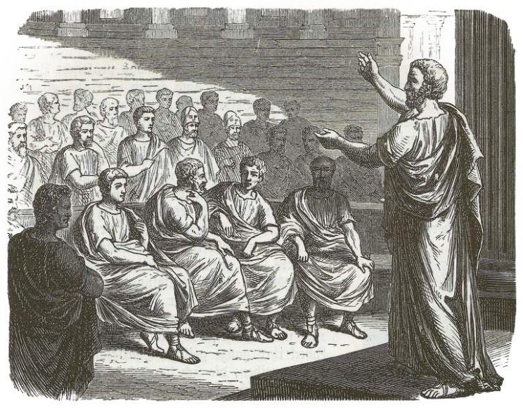
Alciphron and His Collection
Rhetorician
Ca. 200 ce?
Letters of
  Fishermen
  Farmers
  Parasites
    Professional spongers
  Courtesans
    Women sex workers
Notes:
About our author not much is known. We are told that he was a rhētōr, a teacher-practitioner of rhetoric, and one who cultivated the use of Attic Greek dialect. Those data, along with evidence internal to the letters that are his sole surviving work, tend to date the latter to about 200 ce or later, and to align our author with others likewise given to nostalgic classicizing; it’s a period we call the second sophistic.
As for the collection itself, it is divided into books organized by letter writers: fishermen, farmers, parasites (professional spongers), and women sex workers. Something that stands out about Alciphron’s collection is the fact that it, though prone to learned allusion and literary exhibitionism, nevertheless evinces considerable empathy for the trials and tribulations of its often struggling characters.

Slide 13
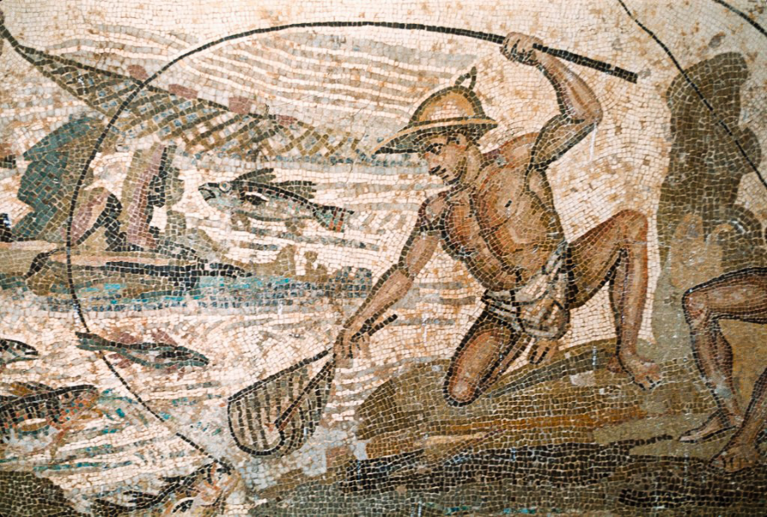
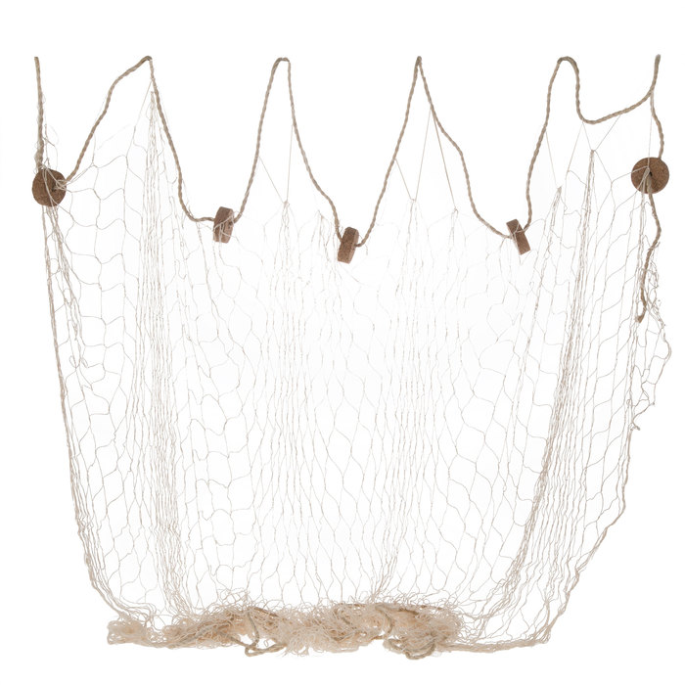
A Tale of Two Fishermen
Alciphron Letters 1.17–19
Detail, Mosaic, ca. 200 ce. Lepcis Magna, Libya
Notes:
I start with a tale of two fishermen. Once upon a time, one of them lost a net, which the other finds years later, rotting on a beach. Seeking to take possession, the net’s finder makes his case in a letter to the owner. How does the owner respond? With bile and vitriol. Thus the finder, driven by envy’s evil eye, by a “hunger for other people’s stuff,” by “insatiable lust,” asks for “unjust favors,” or so the owner claims — why? Why all this combative talk about envy and lust, and for what, a rotting net? What has the finder done to trigger this outburst?

Slide 14
“Ill-natured and envious is the eye of your neighbour, says the proverb. ... Restrain your hands, or rather your insatiate desires, and don’t let the itching for other people’s property drive you to request unfair favours.” (Book 1 Letter 18)
Notes:
“Ill-natured and envious is the eye of your neighbour, says the proverb. What concern with my property have you? And why do you think that any possession lightly esteemed by me is yours? Restrain your hands, or rather your insatiate desires, and don’t let the itching for other people’s property drive you to request unfair favours.” (Book 1 Letter 18)

Slide 15
Professional Rivalry (Book 4 Letter 7)
A boy
  Euthydemus
A courtesan
  Thais
A sophist
  [name?]
“Do you think a sophist is any better than a courtesan? So far, possibly, as the means by which they seek to persuade are different; but one end—gain—is the object of both.”
Notes:
“Ever since you took it into your head to study philosophy you have put on airs and have raised your eyebrows above your temples.”
“But since he is apparently turning you away from your intimacy with me, I’ll let him come; and, if you like, I’ll show you that your woman-hating schoolmaster is not content with the usual pleasures of a night. It’s4 stuff and nonsense and money-making off boys, that’s what it is, you ninny.”
“We do not say there are no gods; on the contrary, when our lovers take oath to their affection for us, we believe them; and we don’t approve of men’s having intercourse with their sisters or their mothers—or even with other men’s wives.”
“We teach young men just as well as they do.”

