Slide 1
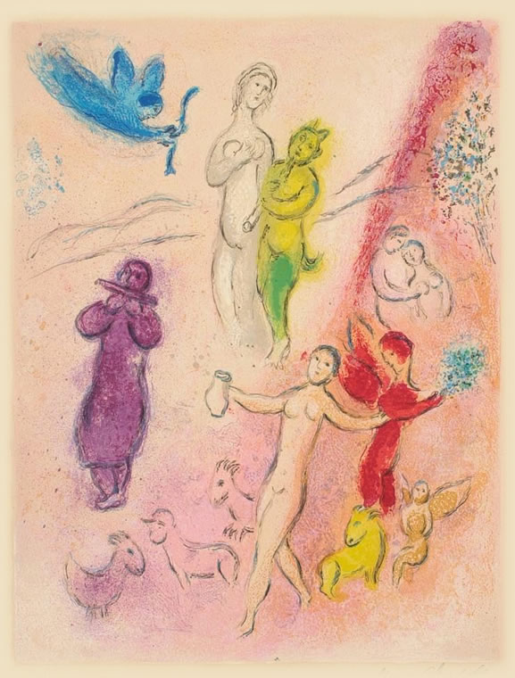
What’s Love Got to Do with It?
Longus Daphnis & Chloe
Daphnis & Chloe, Marc Chagall

Slide 2
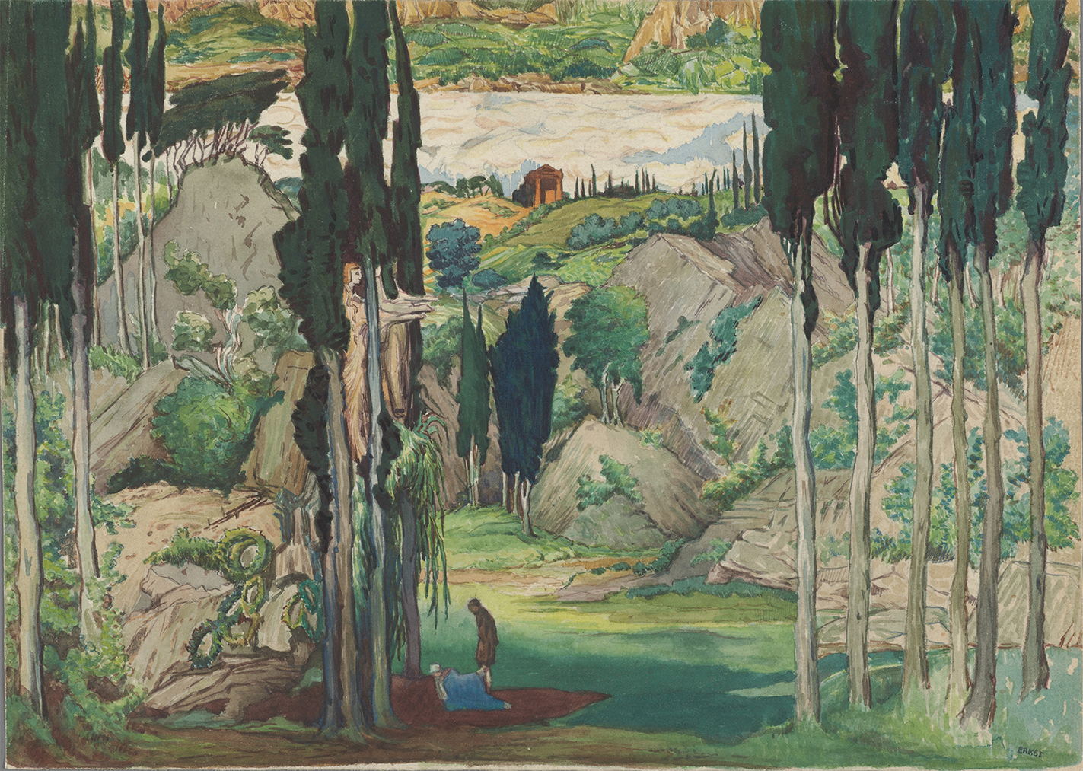
Set design by Léon Bakst for the world premiere of Daphnis et Chloé, Paris 1912.

Slide 3
Writing
https://brightspace.binghamton.edu/d2l/le/news/204082/153160/view

Slide 4
Agenda
Introduction to
  Longus Daphnis and Chloe
Discussion: Daphnis and Chloe
  Beyond RFG
A Look Ahead
  Ecphrasis (description), Ambition, and Sophistic in D&C Prologue

Slide 5
Introduction to
Longus Daphnis and Chloe

Slide 6
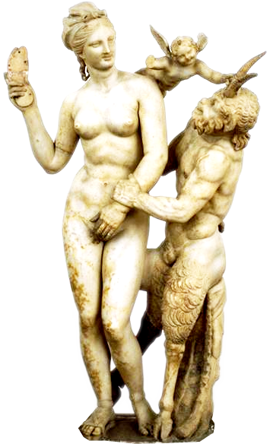
Daphnis & Chloe: Basics 1
Composition date
  ca. 200 CE
Setting
  “Classical” Lesbos
Aphrodite, Eros, Pan (1st BCE)
Notes:
Title Group of Aphrodite & Pan Date 160-30 B.C Material Marble Description From Delos Repository Ethnikon Archaiologikon Mouseion (Greece) Subject Sculpture--Greek: Hellenistic--160-30 B.C Collection The Image Gallery Source Data from: University of California, San Diego Download Size 1024,1024

Slide 7
Daphnis & Chloe: Basics 2
Genre
  Prose romance
  Bucolic
    aka pastoral
  Bildungsroman
    Education in erōs
  New-Comic evocations
    Marriage & household
  “Second sophistic”
    Allusive, rhetorical
Aphrodite, Eros, Pan (1st BCE)
Notes:
Title Group of Aphrodite & Pan Date 160-30 B.C Material Marble Description From Delos Repository Ethnikon Archaiologikon Mouseion (Greece) Subject Sculpture--Greek: Hellenistic--160-30 B.C Collection The Image Gallery Source Data from: University of California, San Diego Download Size 1024,1024

Slide 8
Analysis: Plot and Themes
PROLOGUE
BOOK 1
  Nature / art
  Creative erōs
    Madness / sanity
  Ambition, zēlos
  Birth, rearing, education in nature
    Eros – what/who’s that?
      Chloe’s for Daphnis
      Daphnis’ for Chloe
    Wolf-trap, Daphnis objectified
    Dorco as “wolf”
  Pirates
    Chloe rescues Daphnis
Notes:
chloe at this point takes the initiative
daphnis is passive and objectified by her, though d’s teaching c the syrinx, plus the tale of the wood pidgeon, suggest movement toward male dominance

Slide 9
Discussion: Daphnis and Chloe
Beyond RFG

Slide 10
For much of the course, we've been viewing things through a kind of "race for glory" lens, one that focuses on how the impulse to stand out, to win, shaped Eastern Imperial cultural production (writings, art, etc.). But does such a lens bring everything into focus? What insights become possible when we switch out the lens for something else?

Slide 11
A Look Ahead
Ecphrasis (description), Ambition, and Sophistic in D&C Prologue
Notes:
Ecphrasis, Ambition, and Sophistic – let’s look for these elements

Slide 12
On Lesbos while hunting I saw in a Nymphs’ grove a display, the fairest I ever saw: an image depicted, a story of love. Fair also was the grove, thick with trees, flowery, well watered: a single spring nourished it all, flowers and trees alike. But that depiction was lovelier still, owning outstanding technique and an amorous subject, so that its prestige drew many visitors, even strangers, to worship the Nymphs and to view the image.

Slide 13
In it were women giving birth and other women adorning babies in swaddling clothes, babies abandoned and beasts feeding them, shepherds taking them up, youngsters plighting their troth, a pirate raid, an enemy invasion, and much more, all of it amorous.

Slide 14
I looked and marveled, and a longing seized me to rival the depiction in words; I sought out an interpreter of the image and have carefully fashioned four books, an offering to Love and the Nymphs and Pan, a delightful possession for all mankind that will heal the sick and encourage the depressed, that will stir memories those experienced in love and for the inexperienced will be a lesson for the future.

Slide 15
Prologue Elements
Ecphrasis
Ambition
Sophistic

