Slide 1
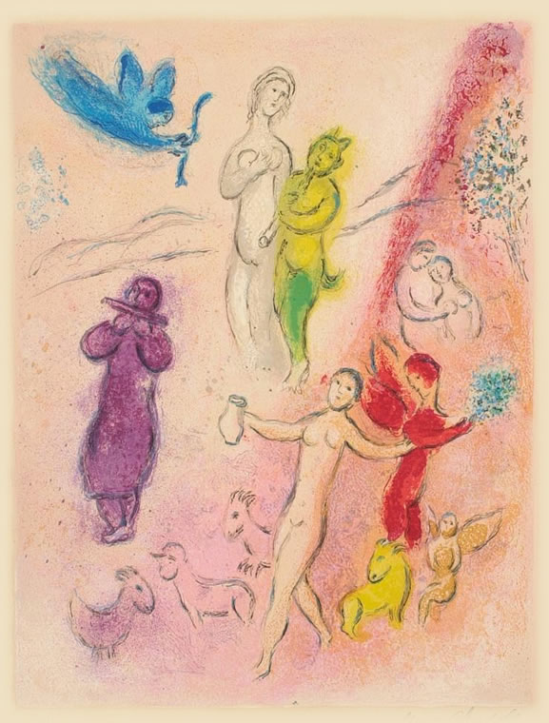
What’s Love Got to Do with It?
Longus Daphnis & Chloe
Daphnis & Chloe, Marc Chagall

Slide 2
What do you hear?
(If you know what this is, please sit this one out)
Debussy “Syrinx,” for solo flute
https://www.youtube.com/watch?v=yTZ2IowwGSQ&t=1s

Slide 3
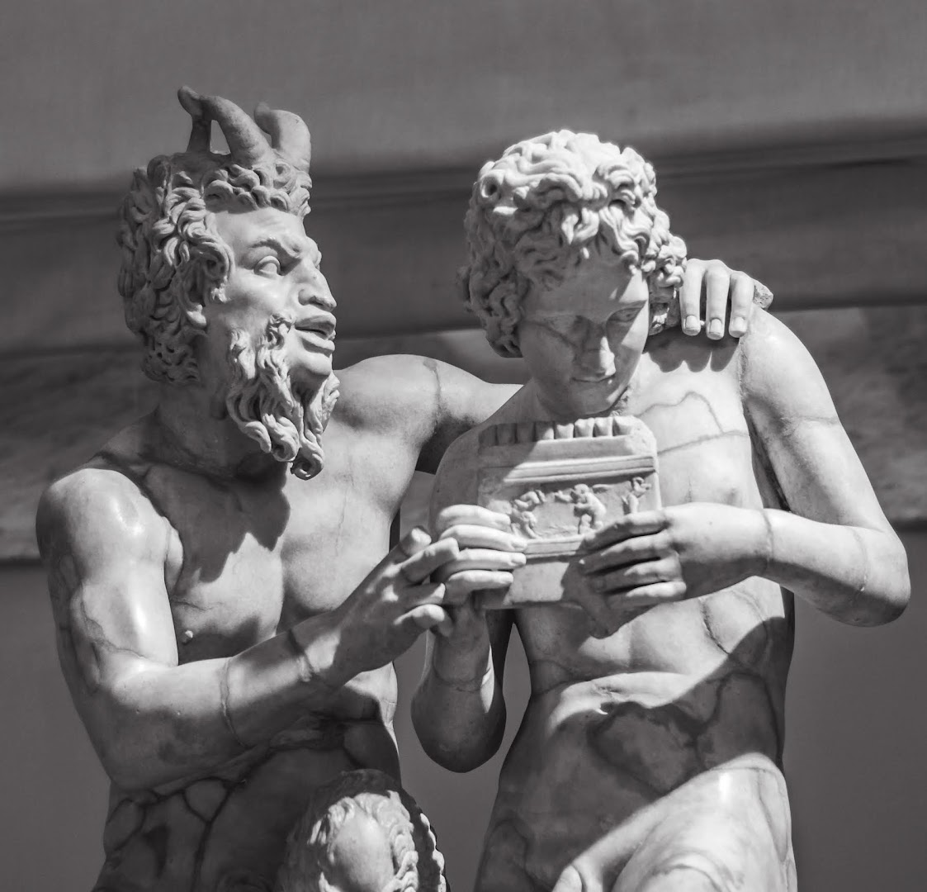
Pan gives a syrinx lesson to Daphnis. National Archaeological Museum, Naples
Notes:
Syrinx was written as part of incidental music to the play Psyché by Gabriel Mourey, and was originally called "Flûte de Pan". It was given its final name in reference to the myth of the amorous pursuit of the nymph Syrinx by the god Pan, in which Pan falls in love with Syrinx, however, as Syrinx does not return the love to Pan, she turns herself into a water reed and hides in the marshes. Pan cuts the reeds to make his pipes, in turn killing his love. D&C pp. 97.
at the celebration party (rescue of chloe), lamo tells story of the invention of the syrinx. pan attempts rape syrinx. "When she tired from running, she hid in some reeds and vanished into a marsh." pan fashions the reeds into an instrument. violence, including, but not limited to, sexual violence, as ever present in this fantasy world. a dose of reality. what the music perhaps fails to capture.
this section of the story begins to introduce reality into the frame: maturation, the transformation of innocent symmetry into asymmetrical maturity. the violent punishment of the unwilling echo by an angry pan, the god of unrestrained
Il gruppo statuario in marmo (h. 1.58 m) di Pan e Dafni, facente parte della Collezione Farnese, è esposto nel Museo archeologico nazionale di Napoli (inv. 6329). Copia romana da un originale greco di Eliodoro (III-II secolo a.C.), mostra il dio-capro intento ad insegnare al giovane pastorello Dafni a suonare la siringa (flauto di Pan), ed intanto tradisce nei suoi gesti affettuosi, nello sguardo, e nel sesso eretto il suo amore e desiderio per il grazioso discepolo.

Slide 4
Agenda
Recap and Update
  Ekphrasis and agōn, Politics and Rhetoric in Daphnis and Chloe
Discussion: Daphnis and Chloe
  Beyond RFG

Slide 5
Recap and Update
Ekphrasis and agōn, Politics and Rhetoric in Daphnis and Chloe
Notes:
let’s look for these elements
i need five readers, αβγδε, to read the prologue

Slide 6
Readers for D&C Prologue
Α Β Γ Δ Ε

Slide 7
On Lesbos while hunting I saw in a Nymphs’ grove a display, the fairest I ever saw: an image depicted, a story of love. Fair also was the grove, thick with trees, flowery, well watered: a single spring nourished it all, flowers and trees alike.
Α

Slide 8
But that depiction was lovelier still, owning outstanding technique and an amorous subject, so that its prestige drew many visitors, even strangers, to worship the Nymphs and to view the image.
Β

Slide 9
In it were women giving birth and other women adorning babies in swaddling clothes, babies abandoned and beasts feeding them, shepherds taking them up, youngsters plighting their troth, a pirate raid, an enemy invasion, and much more, all of it amorous.
Γ

Slide 10
I looked and marveled, and a longing seized me to rival the depiction in words; I sought out an interpreter of the image and have carefully fashioned four books,
Δ

Slide 11
a delightful possession for all mankind that will heal the sick and encourage the depressed, that will stir memories those experienced in love and for the inexperienced will be a lesson for the future.
Ε

Slide 12
Prologue Elements
Ekphrasis
Ambition
Rivalry
Sophistic

Slide 13
D&C: Analysis
BOOK 2
  Vintage fest
  Philetas
    Education in eros
  Methymnian youths
BOOK 3
  Winter separation
    Daphnis’ “more sagacity than a girl”
  Lycaenium’s tutorial
  Myth of Echo
    Daphnis gets it
    Chloe, not
Notes:
BOOK 2
Vintage fest
Philetas
education in eros
homoerotic attraction
age issues
eros illness, cure
Methymnian youths
Daphnis “tried.” paired speeches, pro and con
war, C abducted, country v. town
war averted, but this kind of disturbance speaks to the absence of roman authority in this fantasy world
philetas performs on the syrinx. dryas dionysus dance, a choregic ekphrasis of the vintage. dc then dance lamo's story. the writing "dances" dc's dance. this all reproduces pastoral poetic scenes
afterwards, dc "compete" with each other in love. Καὶ τούτοις ἅπασι θερμότεροι γενόμενοι καὶ θρασύτεροι πρὸς ἀλλήλους ἤριζον ἔριν ἐρωτικὴν καὶ κατ᾿ ὀλίγον εἰς ὅρκων πίστιν προῆλθον.
BOOK 3
winter separation
D’s “more sagacity than a girl”
“Chloe was awfully helpless and stumped, for her reputed mother was always with her, teaching her how to card wool and turn the spindle, and mentioning marriage. But Daphnis, who had spare time and more sagacity than a girl, came up with the following ploy for seeing Chloe.
Lycaenion courts D
echo: D understands, C doesn’t
131. naive chloe doesn't understand the phenomenon of echo. d mansplains it with the myth of echo. mortal daughter of a nymph. refuses pan. "Pan grew angry with the girl, being jealous of her music and unsuccessful at winning her beauty. He afflicted the shepherds and goatherds with madness, and they tore her apart like dogs or wolves and scattered her limbs, still singing, over all the earth.“ c delighted but there’s the veiled threat: yield or else.

Slide 14
Discussion: Daphnis and Chloe
Beyond RFG

Slide 15
What insights become possible when we switch out the RFG lens for something else?

