Slide 1
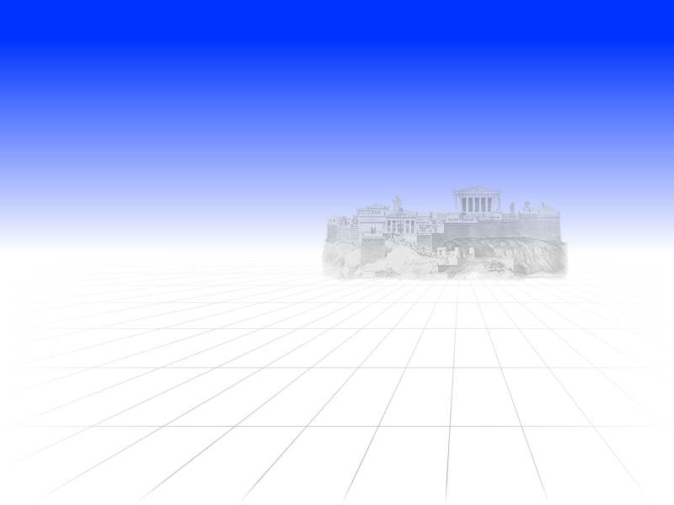
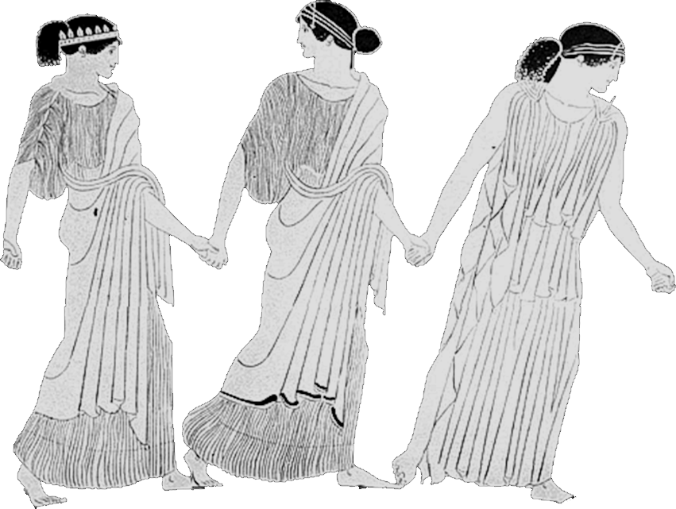
Aristophanes’ Assemblywomen
Persuasion = Salvation?
Notes:
The mood of Aristophanes’ Assembly Women is unmistakably one of crisis. Sōtēria, “salvation” for Athens and its citizens, dominates the agenda, not just of the political meeting alluded to in the play’s title, but of the play as whole. To an Athenian audience, that will have suggested a city and its institutions seriously at risk.

Slide 2
What is the Crisis at Athens?
“Don’t you remember, today was the day for proposals on how to save Athens. The first speaker was Neocleides.” (Chremes, p. 235)
Notes:
What is it, then, that poses such a threat?
We hear of a dêmos coddled
by demagogues, of the city’s straitened finances, of a widening gulf between
rich and poor, of Athenian selfishness generally.3 But how does that, business
as usual, some might call it, make for a crisis on the order of, say, the ravages
of war, the precariousness of peace, the misrule of a grotesquely corrupt and
corrupting leader, the plight of a poorly led city facing immanent defeat and
possible destruction — the sort of crisis, in other words, the poet’s earlier
plays would have led us to associate with measures as drastic as those enacted
here?4 For what could have been more drastic than for the city’s men first
to surrender power to women, then to acquiesce to a generalized sharing of
property, spouses, children, everything?

Slide 3
Isocrates on stasis and its Avoidance
“And when we have freed ourselves of material privation, which dissolves comradeship and drives kin to become enemies and incites all humanity to war and stasis, then there will be no avoiding homonoia among us or genuine good will.” (Panegyricus 174)
Notes:
Stasis of 411-410
oligarchy of 400
constitution of 5,000
democratic restoration
Stasis of 404-403
citizenry of 3,000
council (boulē) of 30
reign of terror!
democratic restoration
amnesty
homonoia?
Corinthian War, 395-387 BCE
This curiously overdetermined yet underwhelming crisis we can connect
with an interpretive “enigma” the play has long posed: the question of what
it is all about.6 One recurrent observation, that material issues — “Demon
Poverty” and wealth-disparity — are central to the play’s theme, receives
ample justification within the text itself.7 Yet the crux of the matter lies not
with poverty per se but with its discontents. According to Isocrates, privation
leads to a breakdown of inter-personal ties, indeed, to violent conflict: war
or civil strife (4.174). Thus in a play produced in or about the year 391 bce,8
when Athens was still recovering from military defeat, loss of empire, and its
own, rather traumatic encounter with civil strife, there can be no clean break
between themes of socio-economic health and those of political health. And
in that period, questions of political health lead almost inevitably back to civil
strife and its avoidance.
So my question is whether issues of civic concord and discord do not
figure in the crisis at hand, and if so, how.9 My starting point for this investigation
will be textual clues suggesting as much. Reading those clues against the
cluelessness enacted onstage, I suggest resonances with the widely praised, yet
problematic, amnesty ratified in association with the restoration of democracy
in 403 bce.10 Civic harmony predicated on collective forgetting thus provides
Aristophanes with a theme. For he “hears” in this harmony an ideologically
charged point of contention between, on the one hand, a discourse of democratic
consensus as antidote to civic unrest, on the other hand, a discourse of
civic-phallic autonomy as bulwark against antidemocratic hubris.
To see how that works, it will help to consider Assemblywomen

Slide 4
Cognitive Triangle?
homonoia (consensus)
isēgoria (free speech)
stasis (strife)
Notes:
Lysias writes, “The greatest consensus (homonoian) is the freedom of all” (2.18). Consensus, he means, is strongest when achieved without coercion. And democracy survives through consensus, specifically, collective acquiescence to the will of the many.
… an “erôs to sail” that, like a hostile force or a fit of laughter, “fell upon (enepese)” its victims “all alike” (thuc. 6.24.3).

Slide 5
Agenda
Discussion
  Aristophanes’ Assemblywomen and peithō
Oral Presentation
  Aristophanes’ Assemblywomen
Play and Context
  Athens 404-387 BCE

Slide 6
Discussion
Aristophanes’ Assemblywomen and peithō

Slide 7
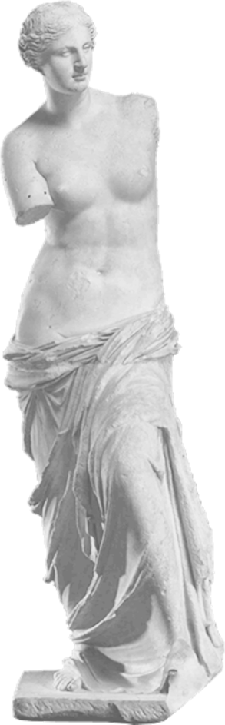
Questions
Aristophanes’ Assemblywomen as…
  endorsement
  critique
of (feminine?) peithō?

Slide 8
Oral Presentation
Aristophanes’ Assemblywomen

Slide 9
Play and Context
Athens 404-387 BCE

Slide 10
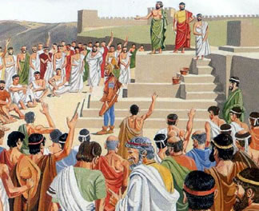
Historical Background (cont’d)
404 Athens’ defeat. Oligarchic episode.
403 Amnesty decree. (Don’t think badly!).
Restoration of democracy.
Establishment of nomothetai (“law-givers”).
Pnyx, Assembly meeting

Slide 11
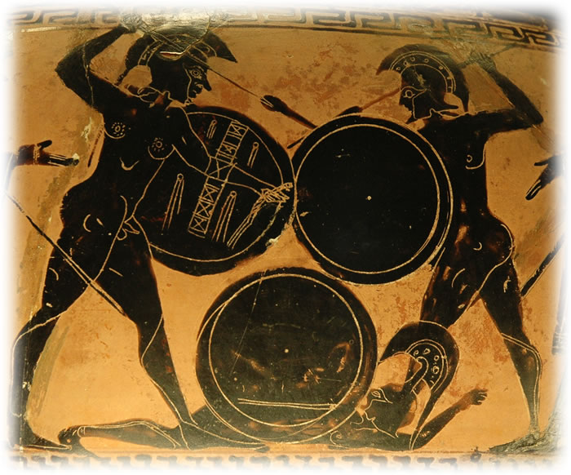
Historical Background (cont’d)
395-387 Corinthian War.
c. 392 Assemblywomen produced.
338 Battle of Chaeronea.
337/6 Anti-tyranny decree.
336-323 Reign of Alexander III ("the Great") of Macedon.
322 Macedonians overthrow Athenian democracy.
Hoplites fighting

