Slide 1
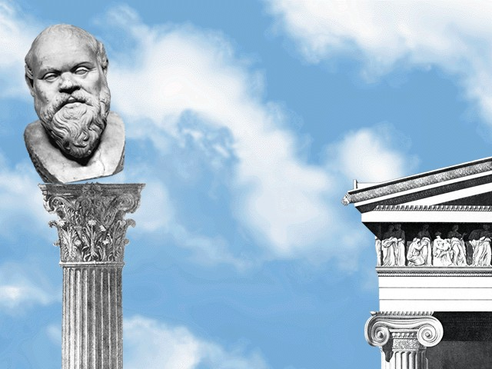
Aristophanes’ Clouds
Sophistic Under Attack

Slide 2
Agenda
Epideixis
  Topoi, Figures, Argumentation
Oral Report
  Aristophanes’ Clouds
In-Class Debate (+ Epideictic Exhibition)
  Better Argument versus Worse Argument

Slide 3
Epideixis
Topoi, Figures, Argumentation

Slide 4
Epitaphic topoi: Gorgias, Periclean FO
The speaker’s challenge
  “May I find the power to say what I wish! May I find the wish to say what I must!”
    Cf. “For it is hard to speak properly upon a subject where it is even difficult to convince your hearers that you are speaking the truth” (Thuc. 2.35.1, Perseus)
Sense of loss
  “. . . though they have died, the loss we feel has not.”
    Cf. “Pericles in his funeral oration [for the fallen at Samos] said that the loss to the city of its young men was as if someone had taken spring from the year” (Aristotle Rhetoric 1365a31-33)
The good death
  “their trophy of triumph, their gift to the god — the sacrifice of themselves.”
    cf. “They laid [their valor] at her feet as the most glorious contribution that they could offer” (Thuc. 2.43.1, Perseus)
Notes:
The speaker’s challenge
“May I find the power to say what I wish! May I find the wish to say what I must!”
cf. Thuc. 2.35.1: “And I could have wished that the reputations of many brave men were not to be imperiled in the mouth of a single individual, to stand or fall according as he spoke well or ill. For it is hard to speak properly upon a subject where it is even difficult to convince your hearers that you are speaking the truth.”
Loss
“. . . though they have died, the loss we feel has not.”
cf. in ar. rhet. peri samian fo: “the youth who had perished in the war had vanished
from the city just as if someone had removed the spring from the
year” (1411a2–4; cf. also 1365a31–33). (trans Tracy Pericles: A Sourcebook and Reader‎ 2009 p. 27)
The good death
“their trophy of triumph, their gift to the god — the sacrifice of themselves.”
cf. Thuc. 2.43.1 – the eranos (shared undertaking) to which the dead have contributed.

Slide 5
Fragmentum epideicticum
“What better example than for a young man to come home and see the work of his father? What better example than for a young man to come home and see the sacrifice of his father — his father, who, together with his fellow workers, formed the backbone of this city. The foundation of the city was built through hard work and dedication like that of his father. And yet what worse example than for a young man to come home and see his father as merely one who takes, as one who does not provide.”
epanaphora, epanastrophe
antithesis with preceding
Notes:
[after the animations, “what is the argument, and how are the writers seeking to drive it home?”

Slide 6
Play Facts
Produced 423
2nd ed. ca. 419-16 BCE
Characters
  Strepsiades (“Twister”)
  Pheidippides (“Horse-thrifty”)
  Chorus of Clouds
  and…
Notes:
Produced 423
2nd ed. ca. 419-16 BCE
Characters
Strepsiades (“Twister”)
Pheidippides (“Horse-thrifty”)
Chorus of Clouds
and…
Socrates (469–399 BCE)
Historical
stone mason
at first, hoplite class
later, poor
early interests (?)
Anaxagorean physics
mature interests
ethical refutation (elenkhos)
definitions
associations
aristocratic (oligarchic)
impiety trial, 399
Caricature
“quack” teacher
runs “Thinkery”
natural sciences
grammar
eristic
religious innovator
i.e., a sophist

Slide 7
Analysis
prologue (pp. 159 ff.)
  Str, Pheid, Xanthias (slave)
  Str, students
  Str, Socr
parodos (172 ff.)
  Chorus, Socr, Str
scenes (174 ff.)
  Str, Socr (application)
1st parabasis (185 ff.)
scenes (190 ff.)
  Socr, Str (lesson)
  Str, Pheid (demonstration)
  intro + agon of the 2 logics (203 ff.)
2nd parabasis (215 f.)
scenes (dinner interrupted, 217 ff.)
  Str, Socr
  Str, Pheid (demonstration)
  Str, creditors (drubbing)
  Str, Pheid (agon, drubbing)
exodos (140 ff.)
  All (arson, drubbing, mayhem)
Notes:
p. 164. pheidippides refers to the class of Knights, who'll be the chorus in Knights. They represent wealth and class. They also tend toward the anti-democratic opposition. here, they're represented as enemies of the new learning. i.e., for aristophanes, they're tradition.
p. 182. the clouds promise political success to sophistic students. but strep only wants to learn courtroom skills.
parabases make reference to political situation in the 420s, to the revision (1st par), to the political situation in the 410s before 415.
first parabasis praises ar for not producing plays with cheap tricks: “Here you see no ….”
so the play relies on its poetry - its words - to have its effect
yet that poses a problem, since the comedy ends with violence and arson - indeed, i’d suggest with almost tragic reversals for certain characters
further, the comedy pleads the playwright’s political credentials vis-a`-vis his tangling with a politician, the ever popular, ever reviled cleon
so if we’re to take the playwright’s claims as advisor to, benefactor, his city seriously, how do we assess the ending?
what to make of the conflagration and chaos with which the play ends?
what does the playwright say - and how effectively - about education and its relationship to the well-being of the state?

Slide 8
Oral Report
Aristophanes’ Clouds

Slide 9
In-Class Debate (+ Epideictic Exhibition)
Better Argument versus Worse Argument
Notes:
Pheidippides' Choice of Education Revisited: "Better" Argument v. "Worse" Argument
Prepare one argument pro-"Better Argument, one argument pro-"Worse Argument." In other words, be prepared to argue either side of the question of whether Pheidippides should study with one or the other. Try to pitch your case to Pheidippides as best you can. Approach this basically as an experiment to see what sorts of arguments best convince. We'll choose a panel of judges to represent Pheidippides' interests. We'll not, however, stipulate winning criteria in advance.
In class I will form you into three groups
Pro BETTER ARGUMENT
Pro WORSE ARGUMENT
Judges
Points awarded for. . .
Ringing phrases appealing to shared values (review Gorgias Epitaphios [Funeral Oration])
Spin well spun (Protagoras, sophists generally)
If you can convincingly spin the "radish" argument (see below) either pro or con, then you'll win the special door prize
Appropriate leveraging of ideas dealt with by Weber, Michels, Finley
Any suitably convincing utilization of concepts operative in our class
Points subtracted for
Offensive language, sentiments, etc. (again, standards have changed)
Mere echoing of the play
Poor prep, incomplete reading, etc.
In short, read and meditate on the whole play, not just the agon!

