Slide 1
Peitho Personified, Reified
Notes:
you’ll have noticed that the ancient readings for today run the gamut from inscriptions to bits of travel literature to short poems, fragments of poems, lengthy excerpts from epic poems, history, etc. etc.
why those readings?

Slide 2
Shape of Things to Come
Peitho, Myth to Reality

Slide 3
Upcoming
Today
  Peithō-Persuasion in Greek Culture
Thu (2-Feb) – 9-Feb
  Aeschylus’ Oresteia: peithō legitimized
16-Feb – 23-Feb: peithō in action
  Plutarch Themistocles
  Thucydides pt. 1
  Plutarch Pericles
Notes:
the course is called “persuasion in ancient Greece,” and part of the point is to explore the attitudes and values associated with persuasion in greek culture, that as background to our exploration of persuasion in Athenian culture and, specifically, in Athenian democracy.
today’s readings explore the first part of that.
for this Thursday through next Thursday, we read Aeschylus’ Oresteia, a trilogy of plays that, in many ways, celebrates the emergence of persuasion as a central feature of Athenian political, and especially judicial, culture. the plays don’t provide a strictly political perspective. rather, they treat persuasion’s emergence at athens as a national myth. the plays thus offer insight into the ideological resonance of persuasion in the city, and at a time of crisis for the fledgling democracy.
from there we move on to historical readings to shed light on persuasion in action in the Athenian democracy. There we’ll have a chance to meet Themistocles, trickster-persuader extraordinaire, hero of the democracy yet quite corrupt. also pericles, another hero of the democracy and a master speaker, so good, in fact, that some likened his influence over the Athenian people to the rule of a monarch or tyrant.
in short, persuasion was clearly valued at Athens; it was a pillar of the democracy, but could be viewed with ambivalence, too. in a way, that ambivalence is what animates this course.

Slide 4
Historical Sketch
Archaic Period, ca. 800–500 BCE
  Emergence of polis
  Homer, Hesiod, Sappho, Pindar, Alcman
“Classical” Period, ca. 500-300 BCE
  Athenian democracy (508–323 BCE)
  Empedocles, Euripides, Archippus, Demosthenes
  Aphrodite Pandemos at Athens (?)
Post-classical Period, ca. 300–
  Political dedications to Aphrodite
  Plutarch (CE 46–120)

Slide 5
Peithō Problematics
Opposites? Analogues?
peitho (persuasion) | bia (force, violence)
verbal persuasion | non-verbal persuasion
sexual persuasion | non-sexual persuasion
Notes:
by ambivalence I mean the curious flip-flopping of our ancient sources on it
now persuasion is a really good thing!
now it’s a really bad thing!
it’s so good because it’s the opposite of bad things like violence – it allows for free choice, a kind of political-personal empowerment
it’s bad because it’s just like violence: it makes you do stuff you don’t want to

Slide 6
Recap
Theory Lenses

Slide 7
Theory Lenses
Dahl’s Criteria
Ober’s Dialectical Model
Scholtz
  Speech Acts
  Dialogue
Notes:
Dahl’s Criteria
Effective participation by citizens.
Voting equality at the decisive stage.
Citizens’ enlightened understanding of issues.
Popular control of agenda.

Slide 8
Scholtz (me!)…
Speech acts (alter social reality)
Dialogical democracy
Constatives v. performatives
Social constraints
Response to response
Social…
  evaluation
  performance
Discursive…
  normativity
  pluralism
Notes:
scholtz dialogical model in some ways an attempt to consider further the implications of ober dialectical model. ober calmly announces that speech acts mediated the extremes and produced a more or less stable compromise between competing elements, constant assertions of shared values “smoothed over” differences – a kind of dialectical synthesis.
i don’t seriously challenge ober on any point. rather, i ask if we’ve fully figured out the mechanisms of these mediations. in so wondering, i suggest that it’s not so simple as athenians talking themselves into some sort of contented live and let live – that first of all, the dynamics of speech itself, understood as dialogue, needs to be worked into a theory of speech-based democracy. second, that always a dynamic system whose tensions, even if they but rarely proved fully destabilizing (and never fully fatal), nevertheless subjected the state to constant threat of self-defeat and occasional fulfillment of that threat.
first, Dialogue: the never-ending answer:
Production of utterance.
Reception of utterance. (i.e., by addressee.)
Evaluation of utterance. (ditto)
Response to utterance. (ditto)
hence sociality of language and the element of social evaluation in formation of speech communities. this is key to the workings of “speech-ocracy.” ober’s understanding of the role of topoi needs to be interrogated: what they are, how they work, their dynamic, even potential stasiastic potential in marking out a community.
but this model also considers the both the generative and constraining implications of this ideological field within which the ober thing operates. Vološinov’s “ideological chain” is a product of dialogue; but the ideologies formed thereby also constitute not just a springboard for further dialogue but a necessary precondition of dialogue. but the enabling common ground of dialogue also constrains it. hence the simultaneity of pluralistic / normative dynamics, concordia discors.
complex analysis of the clytemnestra quote.
the question is not so much what the quotation “says” (a straightforward interpretation-translation of the information thereby conveyed). what does it do??
the locution are the words themselves, the content. the illocution, the type of utterance, = command + assertion-statement. the perlocution, well, to get ag to step on the carpet and, through that act of hubris, step into the sea of trouble that clyt intends for him.
the “The power is yours if you surrender, / all of your own free will, to me” part manipulates. as a whole, the utterance seeks to create a special bond between speaker and addressee – a bond that is unequal in contradictory ways. in the process, it seeks to alter ag’s perception of reality.
the “O give way (pithou, “obey”)” part, though, bids – is an instruction compressed into the bare essence of its intended result. paradoxically, it is intended as a type of verbal coercion, a spoken shove, a bit of magical incantation.
ober’s understanding of homonoia, “consensus,” emphasizes shared attitudes and ideologies, common ground. in dialogical-theory terms, that’s the “shared language” that both enables and yet constrains dialogue.
isegoria, “equal political speech,” emphasizes debate. in dialogical-theory terms, that’s dialogue seeking to break free from constraints, ober’s homonoia-consensus, that also are the foundation of political speech.

Slide 9
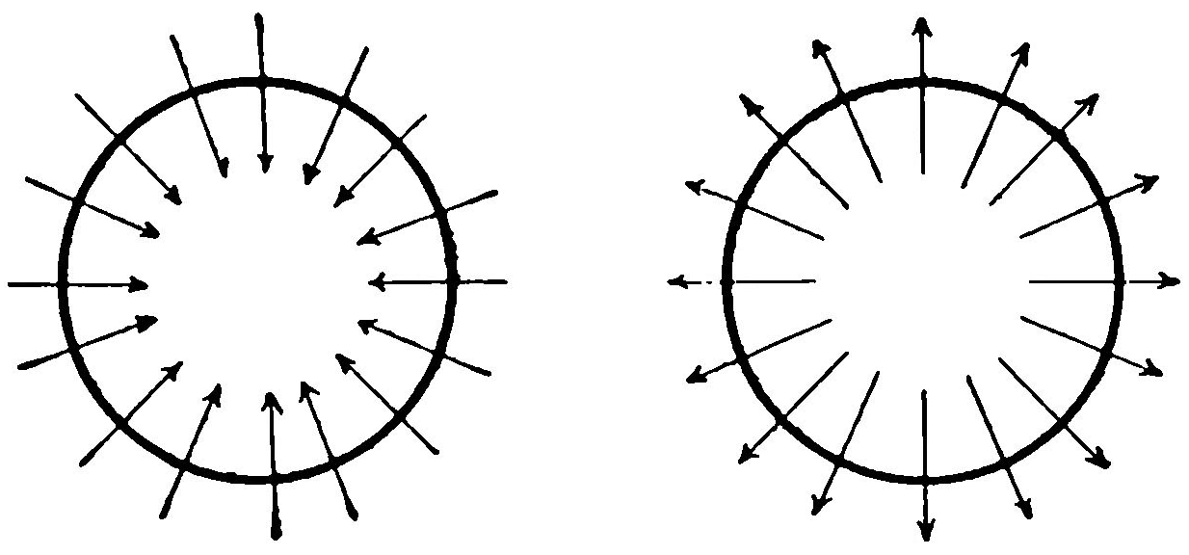
Dialogue, Athenian Democracy
Centripetal discourse
normative
homonoia (“consensus”)
Centrifugal discourse
pluralistic
isegoria (“freedom of speech”)

Slide 10
Discussion: which, if any, of the previous lenses shed light on the following?

Slide 11
Pausanias Description of Greece 1.22.4
  When Theseus had united into one state the many Athenian demes, he established the cult of Aphrodite Pandemos [Aphrodite “Of the Whole People”?] and of Persuasion.
Nicander of Colophon, quoted by Athenaeus
  [Solon established public prostitution at Athens “for … youths in their prime.” Founds cult of Aphrodite Pandemos with proceeds.]
  Philemon (comic poet ca. 300 BCE) Brothers
  Solon: Your inventions have served all human kind! For they say that you first devised the custom, once that is democratic and has saved the city. For you saw the city full of young men, and that they were possessed of a nature that inclined to things they ought not do. So you purchased young women and set them up in public spots — they stand there naked.....
Notes:
QUESTIONS:
Why politicize this sexual goddess? (Why sexualize this political goddess?)
Do these two views of the goddess present us with any kind of a contradiction? Could there be connections?
What can they tell us about attitudes to persuasion, to its role under democracy?
WHAT CULTURAL ASSUMPTIONS MAY BE ENCODED HERE?

Slide 12
Peitho / peithō
Cult, Allegory, Myth
Notes:
the ambivalence of peitho-persuasion is very much a question relevant to today’s readings – it may be the single most important question of the class.
– and will, too, in some of the art I’m going to show. to be precise, we have examples of persuasion, here mostly designated by the greek word peitho (whether as common noun or as proper name) showing up in distinct realms of activity – sex, politics, etc. – though at least sometimes, maybe often, with the sense that these are not wholly separate, but parallel, even overlapping, areas. and the way all of this is showing up strongly suggests that we’re touching persuasion as a key matter of concern in ancient greece, at a variety of levels and in complex ways.

Slide 13
Peithō: Word Notes
peithesthai
  “obey/comply”
peithein
  “persuade”
“Peitho”
  female name
peithō
  feminine noun
Peitho: personification or thing itself?
Notes:
and that ambivalence gets expressed at the symbolic level by a flip-flopping between metaphor and literality in the treatment of persuasion in our sources
there’s sexual and political persuasion, really two different things
but by talking about political persuasion as if sexual, maybe we can shed light on the irrational, passionate aspect of political decision-making
no, hold on, they’re really the same thing. they’re eros either way – eros, passionate, irrational desire, enters the political and sexual arenas in surprisingly similar ways
But first, some word notes.
[….]
The Greek noun peithō means "persuasion," but it seems to have started life as a proper name! In our evidence, Peitho as proper name refers to a minor deity, possibly multiple minor deities, connected somehow to persuasion.
In some cases, Peitho seems to be the byname, or "epithet," of another goddess: Aphrodite (goddess of sex) or Artemis (goddess of the hunt and of young people).
So Peitho (proper name) in such cases will be a personification, and when dealing with personifications, it isn't always easy to tell whether one is dealing with a person, the thing personified, or both at once. But what aspects of persuasion will Peitho personify? It depends. In some cases, there will be reason to think it's all about sexual persuasion. Hence Peitho as goddess of seduction. In other cases, it may something else, for instance, the persuasiveness of a ruler or of a politician or speaker. In any case, Peitho as personification (in art, poetry, or religious cult) represents something held up as important in the cultural system that we're finding her in.

Slide 14
Allegory-Personification
Daughter of Ocean (“Oceanid”)
  Hesiod Theogony 349-363
  Pherecydides of Athens F 66
Aphrodite’s daughter
  Sappho fr. 90
Kinship cont’d. Peitho as…
  Fortune’s (Tukhe’s) mother
  Foresight’s (Promathea’s) daughter
    Alcman fr. 64
Notes:
what the evidence listed on the slide does is locate peitho within a web of shared values expressive of identity – narratives that, at a mythical level, express who “we” are. peitho and admete in hesiod: if nothing else associate a quality like persuasiveness or attractiveness with the origin of the world order.
“He (Ocean) begat a holy race of daughters to watch over men upon the earth with lord Apollo and the rivers: Peitho and Admete and …. These, then, were born of Ocean and Tethys, their eldest daughters”
Hesiod Theogony 349-363
“Peitho, daughter of Ocean”
Pherecydides of Athens F 66
“In other poems she [Sappho] has called Peitho a daughter of Aphrodite”
Sappho fr. 90
“[Fortune] is sister of Good-Law (Eunomia) and Peitho, and daughter of Foresight”
Alcman fr. 64

Slide 15
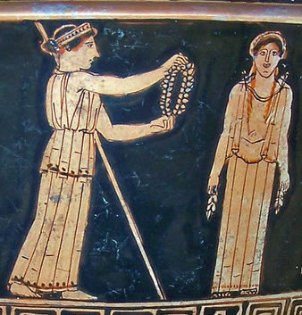
Peitho, Pandora in Hesiod
“… and the divine Graces and queenly Peitho put necklaces of gold upon her, ….” (Works and Days)
Male ambivalence toward feminine persuasion
Notes:
more complicated is hesiod’s tale in the works and days, which dates from the late 700s, some 200 years earlier than the Athenian democracy. Pandora embodies sexiness; peitho helps with that. but the poetry, reflecting strongly male perspectives, is deeply ambivalent about all the sexiness. that sexiness, and men’s ambivalence toward same, translate to the idea of persuasion (peitho) as something potent yet dangerous.
Hesiod Works and Days 60-82:
(60-68) So said the father of men and gods, and laughed aloud. And he bade famous Hephaestus make haste and mix earth with water and to put in it the voice and strength of human kind, and fashion a sweet, lovely maiden-shape, like to the immortal goddesses in face; and Athene to teach her needlework and the weaving of the varied web; and golden Aphrodite to shed grace upon her head and cruel longing and cares that weary the limbs. And he charged Hermes the guide, the Slayer of Argus, to put in her a shameless mind and a deceitful nature.
(69-82) So he ordered. And they obeyed the lord Zeus the son of Kronos. Forthwith the famous Lame God [Hephaestus] moulded clay in the likeness of a modest maid, as the son of Kronos purposed. And the goddess bright-eyed Athene girded and clothed her, and the divine Graces and queenly Peitho put necklaces of gold upon her, and the rich-haired Hours crowned her head with spring flowers. And Pallas Athene bedecked her form with all manners of finery. Also the Guide, the Slayer of Argus [Hermes], contrived within her lies and crafty words and a deceitful nature at the will of loud thundering Zeus, and the Herald of the gods [Hermes] put speech in her. And he called this woman Pandora [? "All Gift," "Gift for All"], because all they who dwelt on Olympus gave each a gift, a plague to men who eat bread.

Slide 16
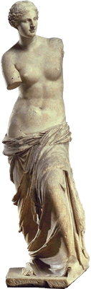
Homer: Aphrodite’s “Girdle”
“As [Aphrodite] spoke she loosed from her bosom the curiously embroidered girdle into which all her charms had been wrought - love, desire, and that sweet flattery which steals the judgment even of the most prudent.” (Homer Iliad 14.214-217)
Notes:
more of same in the “deception of zeus” episode in homer’s iliad, which dates from even earlier than hesiod. it’s not that hera, zeus’s wife, is persuading her husband to alter his stance on the Trojan war. rather, it’s the interconnection of all those lovely devices contained in Aphrodite’s pouch – qualities later will imagined to play a role in persuasion, verbal and otherwise, political and otherwise.

Slide 17
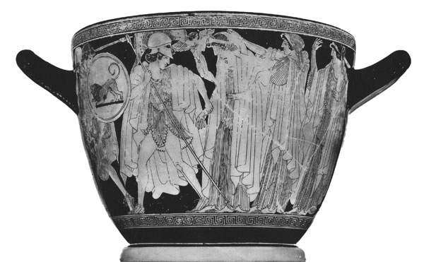
“Makron Vase” – early 5th BCE, Athenian

Slide 18
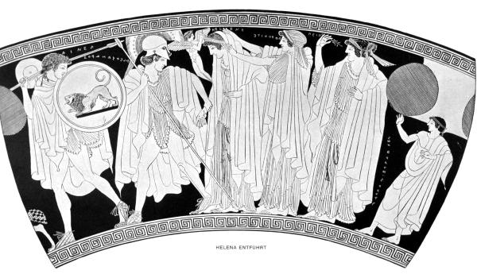
Eros
Aphrodite
Peitho
Alexandros
(Paris)
Helen
Aeneas

Slide 19
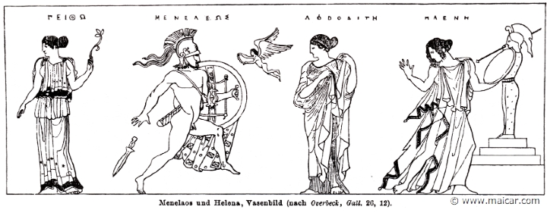
Peitho
Menelaus
Eros
Aphrodite
Helen
Athenian RF vase, ca. 425 BCE
Notes:
What do you see going on?
Collection:Vatican MuseumsSummary:The Rape of HelenWare:Attic Red FigurePainter:Attributed to the Heimarmene PainterContext:VulciDate:ca. 430 BC - ca. 420 BCDimensions:H. 0.355 m; max. diam. (body) 0.138 mPrimary Citation:ARV2, 1173.3Shape:OinochoeBeazley Number:215554

Slide 20
Sexual-Political Peitho, Aphrodite

Slide 21
Pausanias Description of Greece 1.22.4
  When Theseus had united into one state the many Athenian demes, he established the cult of Aphrodite Pandemos [Aphrodite “Of the Whole People”?] and of Persuasion.
Nicander of Colophon, quoted by Athenaeus
  [Solon established public prostitution at Athens “for … youths in their prime.” Founds cult of Aphrodite Pandemos with proceeds.]
  Philemon (comic poet ca. 300 BCE) Brothers
  Solon: Your inventions have served all human kind! For they say that you first devised the custom, once that is democratic and has saved the city. For you saw the city full of young men, and that they were possessed of a nature that inclined to things they ought not do. So you purchased young women and set them up in public spots — they stand there naked.....
Notes:
QUESTIONS:
Why politicize this sexual goddess? (Why sexualize this political goddess?)
Do these two views of the goddess present us with any kind of a contradiction? Could there be connections?
What can they tell us about attitudes to persuasion, to its role under democracy?
WHAT CULTURAL ASSUMPTIONS MAY BE ENCODED HERE?

