Slide 1
Exemplary Statesman or Stealthy Tyrant?
Plutarch’s Life of Pericles

Slide 2
Agenda
The Art of Spin
  Corinthians, Athenians, Pericles
Oral Report
  Plutarch’s Pericles
Plutarch’s Life of Pericles
  Notes on Today’s Reading
Class Debate
  Periclean Democracy? Periclean Autocracy?

Slide 3
The Art of Spin
Corinthians, Athenians, Pericles

Slide 4
Speeches in Thucydides …
Debate at Sparta
  Corinthian
  Athenian
  Spartan
    Archidamus
    Stheneleidas
Pericles’ first speech
Funeral Oration
Pericles Last Speech
argument
from
probability
polupragmosunē
versus
apragmosunē
Notes:
Debate at sparta
Corinthians to Spartans:
“An Athenian is always an innovator, quick to form a resolution and quick at carrying it out. You, on the other hand, are good at keeping things as they are”
(1.70, Peloponnesian Congress 432)
Corinthians to Spartans:
“An Athenian is always an innovator, quick to form a resolution and quick at carrying it out. You, on the other hand, are good at keeping things as they are” (1.70, Peloponnesian Congress 432)
Athenians to Peloponnesians:
“We did not gain this empire by force” (1.74)
“… clearly no longer safe to risk letting our empire go” (1.75)
“It has always been a rule that the weak should be subject to the strong”
“Those who deserve praise pay more attention to justice than they are compelled to do” (1.76)
Spartans to Peloponnesians:
ARCHIDAMUS (king): “As for being slow and cautious – which is the usual criticism made against us – … “slow” and “cautious” can equally well be “wise” and “sensible” (1.83)
STHENELEIDAS (ephor): “… this is not a matter to be settled by law-suits and by words…” (1.86)
Pericles to Athenians:
“They are farmers, not sailors” (1.142)
“We do not say that a man who takes no interest in politics is a man who minds his own business (apragmōn); we say that he has no business here at all” (2.40)
“No doubt all this (i.e., empire) will be disparaged by people who are politically apathetic (apragmōn); but those who, like us, prefer a life of action will try to imitate us” (2.64)
Periclean Funeral Oration:
“When it is a question of … public responsibility, what counts is not membership of a particular class, but the actual ability which the man possesses” (2.37)
“Our love of what is beautiful does not lead to extravagance; our love of things of the mind does not make us soft” (2.40)
“We do not say that a man who takes no interest in politics is a man who minds his own business (apragmōn); we say that he has no business here at all” (2.40)
“We do not think that there is an incompatibility between words and deeds” (2.40)
“What I would prefer is that you should fix your eyes every day on the greatness of Athens as she really is, and should fall in love with her” (become erastai – “lovers,” of her, 2.43)

Slide 5
Funeral Oration: Quotations…
“In name, it [our government] is called a democracy, (dēmokratia) because it is managed not for a few people, but for the majority.”
“For we alone think that a man who does not take part in public affairs is good for nothing while others only say he is ‘minding his own business’ (apragmōn).”
To women: “Your glory (doxa) is great … if you have as little fame (kleos) among men as possible, whether for virtue or by way of reproach.”
Notes:
WHY SPIN DEMOCRACY THUS HERE?
“In name, it [our government] is called a democracy, (dēmokratia) because it is managed not for a few people, but for the majority.”
καὶ ὄνομα μὲν διὰ τὸ μὴ ἐς ὀλίγους ἀλλ᾽ ἐς πλείονας οἰκεῖν δημοκρατία κέκληται (2.37.1).
def of democracy seems an odd spinning of democracy. isonomia. note all the qualifying formulae. "although." etc. seemingly an attempt to soften democracy's impact on the skeptical? rotating offices compensated by seeming stress on strategia. in effect, a meritocracy.
WHY SPIN POLUPRAGMOSUNE THUS?
“For we alone think that a man who does not take part in public affairs is good for nothing while others only say he is ‘minding his own business’ (apragmōn).”
μόνοι γὰρ τόν τε μηδὲν τῶνδε μετέχοντα οὐκ ἀπράγμονα, ἀλλ᾽ ἀχρεῖον νομίζομεν (2.40.2).
WHY THIS AFTERTHOUGHT FOR WOMEN?
To women: “Your glory (doxa) is great … if you have as little fame (kleos) among men as possible, whether for virtue or by way of reproach.”
εἰ δέ με δεῖ καὶ γυναικείας τι ἀρετῆς, ὅσαι νῦν ἐν χηρείᾳ ἔσονται, μνησθῆναι, βραχείᾳ παραινέσει ἅπαν σημανῶ. τῆς τε γὰρ ὑπαρχούσης φύσεως μὴ χείροσι γενέσθαι ὑμῖν μεγάλη ἡ δόξα καὶ ἧς ἂν ἐπ᾽ ἐλάχιστον ἀρετῆς πέρι ἢ ψόγου ἐν τοῖς ἄρσεσι κλέος ᾖ (2.45.2).

Slide 6
Oral Report
Plutarch’s Pericles

Slide 7
Plutarch’s Life of Pericles
Notes on Today’s Reading

Slide 8
Timeline
495 | Pericles born to Xanthippus and Agariste
477 | Delian League founded. (454 treasury transferred to Athens.)
463-1 | Ephialtes ascendant. Areopagus partially disempowered.
461 | Ephialtes murdered.
461-429 | Pericles ascendant. Archonship qualification broadened (458) Archons, jurors paid Archonship, council lottery absolute Pericles’ citizenship legislation (451/50) Free speech (isegoria) achieved Liturgy system introduced/perfected
447 | Parthenon begun.
446/5 | 30-years peace, Athens-Peloponnesians.
442 | Adopts sever style.
431-404 | Peloponnesian war.
Notes:
495. pericles born.
477. Delian League founded.
466. Enters politics a democrat. Changes public image.
454. transfer of Delian treasury.
463-1. Ephialtes ascendant. Areopagus partially disempowered.
461. Areopagus reorganized. Cimon, Athens lead general ostracized. Ephialtes murdered.
461-429. Pericles ascendant.
Archonship qualification broadened (458)
Archons, jurors paid
Archonship, council lottery absolute
Pericles’ citizenship legislation (451/50)
Free speech (isegoria) achieved
Liturgy system introduced/perfected
458. Oresteia produced.
447. Parthenon begun.
446/5. 30-years peace, Athens-Peloponnesians.
444. Thucydides son of Melesias leads the “few” v. the “many.”
442. Adopts sever style. Thucydides ostracized.
431-404. Peloponnesian war.

Slide 9
Prostatēs tou dēmou
“He standing before the dēmos”
“(Unofficial) leader/protector of the dēmos”

Slide 10
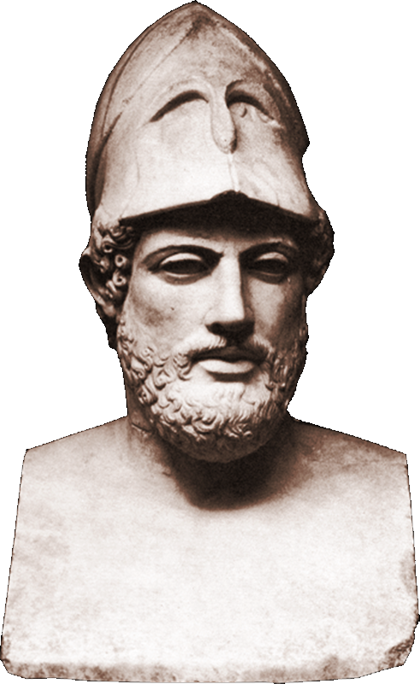
Pericles’ and His Several Masks
Exemplary statesman?
Resourceful demagogue?
Stealth tyrant?
Notes:
Exemplary statesman?
changes image, 460s.
tightens reins, p. 182.
182. p’s rhetoric. his reputation.
431. spartan invasion of attica. pericles announces (to remove suspicion of spartanizing) that if archidamus ravages all farms but his, will donate his farm to athenian demos.
Resourceful demagogue?
p. 174
pp. 176-7. further concessions-popular policy to demos during struggle with thuc. building projects.
Stealth tyrant?
the empire as administered by pericles as tyranny. accusations of opposition vis-à-vis biolding, p. 177. p. 178. thee athenians were not obliged to give the allies any account of how their money was spent, provided that they carried on the war for them and kept the persians away.
“he came to hold more power in his hands than many a king and many a tyrant” (183)

Slide 11
Class Debate
Periclean Democracy? Periclean Autocracy?

Slide 12
Journal & Class Debate
RESOLVED: Periclean democracy was democratic in fact as well as in name.

