Slide 1
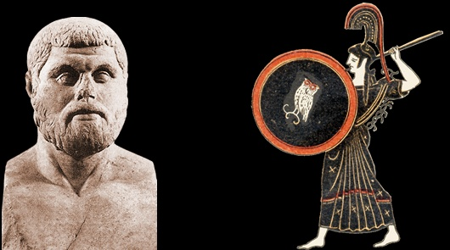
Plutarch’s Life of Themistocles
Peitho in the Service of City and Self

Slide 2
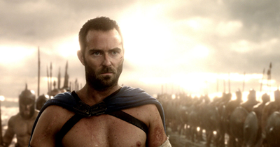
QUESTION: Is this Themistocles?
https://youtu.be/_1CjYBSVY2g
Why or why not?
Notes:
QUOTATIONS:
“… his master [teacher] remarked to him more than once: ‘At least there will be nothing petty about you, my boy. You are going to be a great man one way or the other, either for good or evil’ ” (Plutarch The Rise and Fall of Athens p. 78).
“It is said, in fact, that Themistocles was quite carried away by his yearning for fame and that his ambition to play a part in great events had become a passion with him” (praxeōn megalōn hupo philotimias erastēs, “driven by ambition to lust for great deeds,” p. 80).
“… he was the only man who had the courage to come before the people and propose that the revenue from the silver mines at Laurium, which the Athenians had been in the habit of dividing among themselves, should be set aside and the money used to build triremes for the war against Aegina” (p. 80).
More on that issue: “… he had only to play upon the enmity and the jealousy the people felt towards the Aeginetans to make them agree to the outlay” (p. 80).
Seeking to persuade Athenians to evacuate Athens rather than defend it from the Persian army, “Themistocles, seeing no hope of winning over the people to his plans by any power of human reasoning, set to work to influence them with oracles and signs from heaven” (86).
goes on: “He seized upon the episode of the snake, which is believed to have disappeared at this time from its sacred enclosure on the Acropolis, and treated it as a divine portent. When the priests discovered that the first-fruits of sacrifice which were offered to it every day had been left untouched, they gave out to the people on Themistocles’ instructions that the goddess Athena had abandoned her city and was showing them their way to the sea. In his efforts to sway the people he again invoked the famous oracle from Delphi, 1 and insisted that the ‘wooden wall’ could only refer to their ships and that Apollo had spoken of Salamis in his verses as divine, not as terrible or cruel, for the very reason that its name would one day be associated with a great blessing for the Greeks.
On Themistocles fortification of Athens’ port town (the Piraeus) and expansion of Athens’ navy: “The effect of this was to increase the influence of the people at the expense of the nobility and to fill them with confidence, since the control of policy now passed into the hands of sailors and boatswains and pilots” (i.e., the common folk, previously marginalized politically because too poor to pay for infantry weapons, as paid sailors felt central to Athens’ military might, p. 96).
OTHER GOOD QUOTATIONS?

Slide 3
Agenda
Recap and Update
  The Road to Democracy…
Themistocles Son of Neocles
  Biographical Overview
Theory to the Rescue!
  How to Parse Plutarch’s Themistocles?

Slide 4
Recap and Update
The Road to Democracy…

Slide 5
Historical Sketch
Greece
Athens
ca. 1200 BCE
  Myth: Trojan War
  Archaeology: Iron Age
ca. 800
  Archaic period
  Poleis
ca. 620
  Draco’s law code
594/3
  Solon’s reforms
560-510
  Peisistratean tyranny
507
  Cleisthenic reforms
Themistocles career
  493/2 – 472 BCE

Slide 6
Cleisthenic Reforms (507 BCE)
from oligarchy
clan/village constituencies
4 tribes
archons
Council of 400
to proto-democracy
deme-trittys organization
10 tribes
archons + stratēgoi
Council of 500
isonomia
Notes:
CLEISTHENIC DEVELOPMENTS. further comments.
by forming an agenda-preparing council of 500 (50 chosen annually by lot from each tribe), in effect halts aristocratic control over legislative initiatives, and works to a fully sovereign assembly. (boule also oversees finances, foreign policy)
further weakening of old aristocratic identifications in introducing practice of identifying self from one’s deme, evidently with aim of setting aside practice of patronymic, though intermittently practiced.
participation at level of deme crucial: deme exam age 18 = citizenship exam. deme assembly. selection of pool for offices like councilman.
and tribal elections of generals = extension of this new identification, organization. tribal affiliation basis of required citizen military service.
by reorganizing military, created a new class of leader: stratēgos. created tribally elective board of strategoi, “generals,” but with important civil role.
these measures required approval of democratic assembly.
expanded role for demos = expanded role for logos.

Slide 7
Athenian Democracy ca. 485
dēmos
9 archons
boulē 500
diskastēria
10 stratēgoi
“The polis . . .
Areopagus…
. . . of the Athenians”
Notes:
[brief comment on chart]
THEMISTOCLEAN DEVELOPMENTS
487/6 BCE. The nine archons (chief officials of state) henceforth elected from “pre-elected” pool, 100-500 (??) by either tribes or demes. Promotes honesty in office but not ability.
Chief archon (ARCHON EPONYMOUS) still from the wealthy, but this makes it more difficult for a wealthy elite to control officials beholden to them etc. wider distribution of offices leading to weakening of offices.
strategoi (“generals”) promoted
nothing to connect th’s name to this development but important. archonships opened to knights (hippeis), by lottery.
487/6 BCE. Because the polemarch archon ("commander in chief") now chosen by lottery, the 10 generals (strategeoi) elected by the tribes now the de facto chief military and civil officials.
in consequence, the stratēgia, an elective office, promoted in functional importance.
stratēgoi could be re-elected.
likely to reduce prestige of Areopagus, filled exclusively by ex-archons.

Slide 8
Themistocles Son of Neocles
Biographical Overview

Slide 9
Biographical, Historical Info
ca. 528. Birth (background…)
493/2. Archon
490-479. Persian Wars
  483/2 expansion of fleet
  482. Aristides ostracized
  481 (?) recall of banished (e.g., Aristides)
  480. Themistocles strategos
    Unifier of Greeks
    Battle of Salamis
ca. 471–470. Themistocles’ ostracism, condemnation
462. Death in exile
Notes:
ca. 528, born
father Eupatrid (Lycomids), mother foreign
493/2 archon
begins to develop Piraeus as port
487/6 archon lottery
from 70 to 200 triremes
in response to news of Persian fleet build-up
490 Battle of Marathon
Miltiades victorious
Themistocles envious
483 Fleet commissioned
mining surplus
482 Aristides ostracized
480 Themistocles strategos
Battles of …
Artemisium
Salamis
Plataea
early 470s fortification
Athens, Piraeus
on Themistocles’ and Aristides’ urging.
471 Themistocles ostracized
ca. 471/0 condemned traitor
exile
confiscation
disfranchisement
462 death in exile

Slide 10
“… his family was too obscure to have lent him any distinction at the beginning of his career. … On his mother’s side he was an alien…. Themistocles persuaded a number of young men of good family to go out to Cynosarges and take their exercise there with him, and by this ingenious social manoeuvre he is believed to have done away with the discrimination between pure Athenians and those of mixed descent. In spite of his own alien origins, it is clear that he was also connected with the family of the Lycomidae….” (Plut. Them. pp. 7)
Notes:
then again:
Again, when he went to Olympia, he annoyed the Greeks by trying to rival Cimon in the dinners he gave and in the magnificence of his furniture and the tents in which he entertained his visitors. People were prepared to excuse this kind of extravagance in Cimon because he was young and belonged to a great family. But coming from a man who had neither made himself a reputation nor possessed the means to support these expenses, such an attempt to raise himself above his station was regarded as sheer imposture.
Plutarch. The Rise and Fall of Athens: Nine Greek Lives (Classics) (p. 82). Penguin Books Ltd. Kindle Edition.

Slide 11
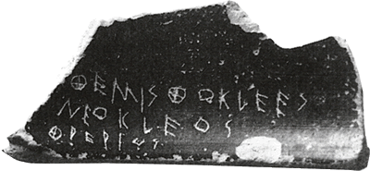
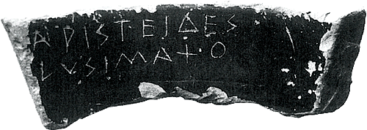
Ostracism
Themistocles son of Neocles, of the deme Phrearrus
Aristides son of Lysimachus
Notes:
10-year banishment
without loss of
citizenship
property
dignity
invented?
every year, once a year, assembly votes: should we hold an ostracism?
if yes, then an ostracism held shortly afterwards. in agora. you could vote for anyone you wished. the winner (with a minimum of 6000 votes total - possibly a minimum of 6000 for one individual [philochorus]) sent away for 10 years.
comes into own 487
last ostracism: hyperbolus in 417.
used by themistocles against his rival aristides, among others (484).
found was a hoard of pottery sherds - 190 - all inscribed with the name themistocles, written by only a few individual inscribers: clearly a campaign against them.
them finally ostracized in ca. 470.
ober p. 74: “Ostracism was a way to expel from the community any individual who threatened the national consensus, especially by advocating ideas or acting in ways that threatened the values of political society. Ostracism also served as a public demonstration of the binding nature of democratic decisions on an individual.” seemingly, a kind of social control sending the message that “Active dissent is unacceptable.”
anti-stasis, anti-tyranny?
elite “time out”?
political weapon

Slide 12
“But the greatest of all his achievements was to put an end to the fighting within Greece, to reconcile the various cities with one another and persuade them to lay aside their differences because of the war with Persia. In this task he is said to have been greatly helped by Chileos, the Arcadian.” (Plut. Them. pp. 83)

Slide 13
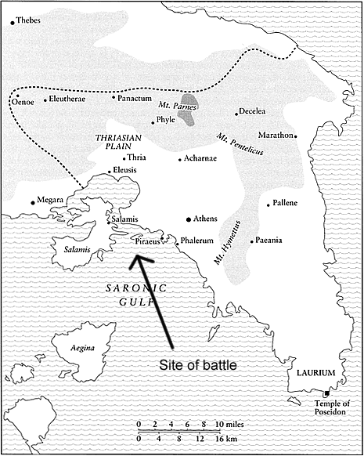
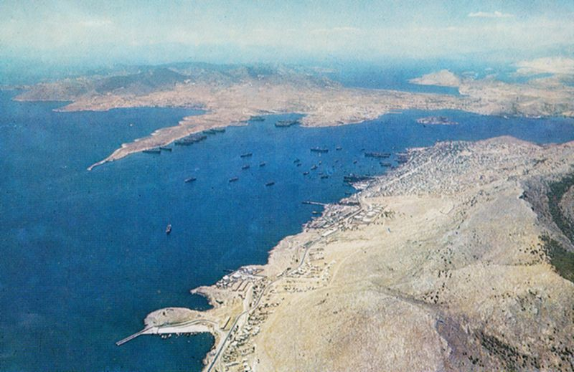
Battle of Salamis

Slide 14
Theory to the Rescue!
How to Parse Plutarch’s Themistocles?
Notes:
discussion

Slide 15
Our Theorists
Dahl’s
  “Strong equality”
  Four criteria
Ober’s
  Ideological contradictions
  Ideological negotiations
My
  Dialogical-social connection
  Normative/pluralistic tensions
Notes:
Dahl’s
“Strong equality”
The belief that “all members of [an] association are adequately qualified to participate on an equal footing with others in the process of governing the association”
(Dahl 31)
Four criteria
1. Effective participation by citizens.
2. Voting equality at the decisive stage.
3. Citizens’ enlightened understanding of issues.
4. Popular control of agenda.
Ober’s
Ideological contradictions
Mass/elite
Equality/inequality
Freedom/consensus
Popular sovereignty/rule of law
Ideological negotiations
Rhetorical mediation
Topoi
Elitism
Popular hegemony
My
Dialogical-social connection
Normative/pluralistic tensions

