Slide 1
Enlightened Understanding?
The Political Oratory of Lysias and Demosthenes

Slide 2
Questions
What idea is the speaker trying to “sell”?
What challenges do you imagine to selling that idea?
How do you rate the speaker? Why?
https://goo.gl/VgtnYF
Notes:
start at 8:22

Slide 3
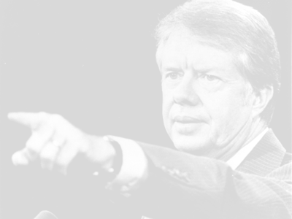
Questions
What idea is the speaker trying to “sell”?
What challenges do you imagine to selling that message?
How do you rate the performance? Why?
Jimmy Carter, “Crisis of Confidence Speech,” 15-Jul 1979
Notes:
in 1979: energy crisis, plus two decades of assassinations, war, Watergate, recession, inflation combined with unemployment – an exhausted president and an apathetic American people. at first produced an uptick in polls; later, it bummed the American people out. the carter presidency became emblematic of dispirited ineffectualness.
will later in the speech propose energy conservation measures. but the real tough talk is earlier on when he tells the audience that the “nation” – but he really means “you” – have lost confidence. that you’re apathetic. that confidence – by which he means something close to an engaged sort of patriotism – is largely absent from the American people. in effect, “you” are a threat to your democracy.
it is in effect a public rebuke.
but is expressed with rhetoric. carter’s tough talk is framed with patriotic button pushing (topoi)
confidence is “the idea which founded our nation and has guided our development as a people. Confidence in the future has supported everything else -- public institutions and private enterprise, our own families, and the very Constitution of the United States. Confidence has defined our course and has served as a link between generations. We've always believed in something called progress. We've always had a faith that the days of our children would be better than our own.”
like carter’s speech, the speeches assigned for today feature substantive policy recs, at times accompanied by detailed facts and figures, that do not always play to the whims of the demos.
unlike carter’s, they also feature attacks targeting the messages of opponents, attempts to characterize these last as resorting to deception and rhetorical gratification.
by contrast, our speakers claim for themselves a willingness to talk tough to the demos.
a social rhetoric stressing points of common identification to procure buy-in.

Slide 4
Agenda
Recap and Update
  From Democracy to Oligarchy and Back Again. . .
Lysias 34
  Patrios politeia? (Ancestral Constitution)
Demosthenes’ Anti-Macedonian Crusade
  First Philippic, Third Olynthiac
Discussion
  Mixing and Matching: Speech, Concepts, Lenses

Slide 5
Recap and Update
From Democracy to Oligarchy and Back Again. . .

Slide 6
Concept Update
Older. . .
Newer. . .
Spin
  khrōma, color
  (re)valuation
Epideixis
Pros kharin legein
  dimensions
    rhetorical
    substantive
  cf. kolakeia
Parrhēsia
topos (“commonplace”)
  plural topoi
A fortiori argument
Rhetoric of anti-rhetoric

Slide 7
Lysias 34
Patrios politeia? (Ancestral Constitution)
Notes:
403/2. opposes phormisius' property qualification bill. evokes slogan: patrios politeia, one as capable of oligarchic as democratic spin. (thus related to the "founding fathers" topos.)
339. ghost-written. (lysias as logographos)

Slide 8
Late Fifth-Century Events
411-410 Oligarchy 1, Athens.
404-403 End Peloponnesian War.
  Oligarchy of 30.
  Democracy restored.
403- Nomoi v. psēphismata.
403/2 Lysias’ Preserving the Ancestral Constitution
Versus proposal from Phormisius.
Notes:
411-410 Oligarchy 1, Athens.
404-403 End Peloponnesian War.
Oligarchy of 30.
Democracy restored.
403- Constitutional adjustments: nomoi v. psēphismata.
lysias’ speech: logographos,

Slide 9
Demosthenes’ Anti-Macedonian Crusade
First Philippic, Third Olynthiac

Slide 10
The 4th-cent. Democracy
403- Nomoi v. psēphismata.
  359 Philip II crowned king of Macedon
  355-346 Eubulus & Theoric Fund.
  351 Demosthenes’ First Philippic
349 Demosthenes’ Third Olynthiac
338 Battle Chaeronea.
323 Alexander dead.
322 Battle of the Crannon.
  Pro-Macedonian oligarchy at Athens.
  Demosthenes’ suicide.
Notes:
403- Constitutional adjustments: nomoi v. psēphismata.
355-346 Eubulus & Theoric Fund.
351 Demosthenes’ First Philippic.
349 Demosthenes’ Third Olynthiac.
348 Olynthus captured.
338 Battle of Chaeronea (Macedonia dominant).
323 Alexander the Great dead.
322 Battle of the Crannon.
Pro-Macedonian oligarchy at Athens.
Demosthenes’ suicide.

Slide 11
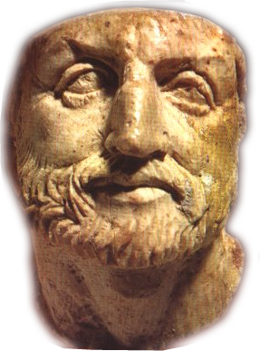
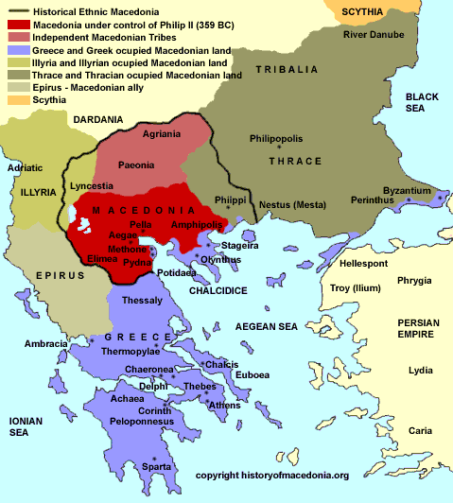

Philip
Olynthus
Athens
Demosthenes
Notes:
first philippic, perhaps 351. Philip attacking thrace and seemingly seeking to foment rebellion on island of Euboea. Philip has even been seizing Athenian shipping and has harassed attica.
d’s speech opens debate – first time d dos that. the best defense is a good offense.
350/349, Olynthus appeals to Athens for help v Philip. the three orations seek to dispatch that aid
ol 1-2 seek to send mercenaries, but with inadequate funding. they resort to plunder and seek gainful employment from Persian governor in asia minor. suggestion of repurposing theoric fund, but that unconstitutional.
in ol 3, proposal to alter the constitution (to change the nomoi) to allow for the theoric fund to be raided. also, proposal to involve Athenians alongside mercenaries to prevent previous issues.
we don’t know what happened with theoric fund. but overall, but too little too late: Olynthus falls in 348

Slide 12
Discussion
Mixing and Matching: Speech, Concepts, Lenses

Slide 13
Mix and Match
Speeches
  Lysias
    Speech 34 (Preserving the Ancestral Constitution)
  Demosthenes
    First Philippic
    Third Olynthiac
Lenses
  Weber
  Michels
  Finley
Concepts
  A fortiori argument
  Ethnic “othering”
  Kolakeia
  Patrios politeia
  Parrhesia
  Pros kharin legein
  Rhetoric of anti-rhetoric
  Spin
  Substantive advice
  topoi

