Slide 1
Democracy: Plausible Paradox?
Modern Readings in Theory 1

Slide 2
Agenda
Three “Lenses”
  Dahl, Ober, Scholtz
Discussion
  And Plato’s Gorgias?

Slide 3
Three “Lenses”
Dahl, Ober, Scholtz

Slide 4
Dahl’s Strong Principle of Equality
The belief that “all members of [an] association are adequately qualified to participate on an equal footing with others in the process of governing the association”
(Dahl 31)
Notes:
i.e., no one is more qualified, “more equal than others,” a primus inter pares
contradicts oligarchy, “guardianship,” noblesse oblige etc.
dahl sees this, or something like this, not just in greek democracy, but in many different kinds of societies (non-western) worldwide.
under strong principle, a democracy is “democratic” with respect to self but not necessarily to others
seeming paradox: democracy can be imperialistic!!
can we affirm/deny the strong principal of equality at athens, whether as ideological “reality,” or as socio-politcal actuality?

Slide 5
Dahl’s “Assumptions”
… for a political order
… for a democratic order
Purposeful association
Decision making involving
  Agenda setting
  Outcome-deciding
Equality before the law
Equality of interests
Notes:
106-7. ASSUMPTIONS OF A POLITICAL ORDER
106. starts with idea of a purposeful association, one with aims and binding rules designed with a view to those aims. the decision making process = governmental or collective decision making process.
deals with issue of social control: binding does not = coercive. but something induces obedience. democratic order can thus describe non-state (non-coercive) situations.
107. decision-making involves 2 elements: setting the agenda and deciding the outcome (decisive stage), this last the "moment of sovereignty." "Until the decisive stage is completed, the process of decision making is tentative. ... Decisions become binding only at the conclusion of the decisive stage. ... In principle, a stage is decisive if all prior decisions can still be recalled or reversed. Thus, prior to the decisive stage decisions may be thought of as having been delegated but not alienated by those who participate in the decisive stage, a distinction we return to below."
107 ff. ASSUMPTIONS JUSTIFYING A DEMOCRATIC POLITICAL ORDER
no lawmaker may be above the law.
the interests of all members equally deserving of consideration.
No adult member of the association should ever be required to demonstrate adequate competence for protecting that member's own interests, except where compelling justification could be shown. that "presupposes that each member of the association is, taken all around, a better judge of his or her interests than others would be. ... let us call the adult members who satisfy this presumption citizens; collectively the citizens constitute the demos, populus, or citizen body."
In the decision-making process, each citizen's claim as to what is desirable is as valid as the next, none more or less valid - hence, what Dahl calls "strong equality" will obtain within the citizen body under democracy.
"... scarce and valued things should be fairly allocated." (fairness, not equality - deserts may justify larger allocation.) but at times equal chance to gain scarce item must not be denied.

Slide 6
“Criteria for a democratic process”
1. Effective participation by citizens.
2. Voting equality at the decisive stage.
3. Citizens’ enlightened understanding of issues.
4. Popular control of agenda.
Problems?. . .
Notes:
108 ff. CRITERIA FOR A DEMOCRATIC PROCESS
the above understood as requiring a certain set of preconditions, hence what can be understood as “benchmarks” of democracy.
109. EFFECTIVE PARTICIPATION. citizens must be able to have a voice, be allowed to participate. (ISEGORIA) related to princ of equal consideration of interests.) equality and freedom as essential to democracy, a principal that goes back to aristotle.
those who make the decisions must be the same as those who are subject to the decisions if it is to be thought of as a democratic order. (cf. ari's rule and be ruled in turn.)
111. ENLIGHTENED UNDERSTANDING.
citizens ought to have the opportunity somehow to make informed choices.
these three criteria allow us to judge whether a system more or less democratic, and therefore, more or less good - if we presume "good" to equate with "democratic." but "agenda" and even "demos" can imply limiting elements: agendas necessarily restrict the discussion, a demos might itself be constituted restrictively [which leaves us not with democracy but with oligarchy].
111 f. CONTROL OF THE AGENDA.
hence the need for a fourth criterion: control of the agenda in the hands of the people. Even if demos decides that some matters to be up to other sorts of process (e.g., justice), still, "As long as the demos could effectively retrieve any matter for decision by itself, the cdriterion would be met.“
116. PROBLEMS
there is the problem of what should the demos be constituted out of. is a limited franchise democratic?? early in book (as already noticed) considers conflicting visions of what democracy should be about. p. 5: “Critics, not only the adversaries but those who are sympathetic to 'rule by the people,' contend that a process of collective decision-making, no matter how 'democratic,' cannot be justified unless it produces-or at least tends to produce-desirable results.”

Slide 7
Ober’s “Dialectical” Model. . .
Operative antitheses
Ideological negotiations
Mass/elite
Equality/inequality
Freedom/consensus
Popular sovereignty/rule of law
Rhetorical mediation
  Topoi
Elitism
Ideology
  Popular hegemony
Notes:
Mass v. elite
elites: social power
masses: political power
Political equality
material inequality
Freedom (isēgoria)
consensus (homonoia)
Popular sovereignty
rule of law
Ideological negotiations
312. "... public speech was a natural medium of social mediation." feedback, basically dialogical process leading to a dicourse evolving, ultimately, in dialectical ways.
compromise, smoothing out of differences, stress on community of interests, diffusion of tensions. “Public rhetoric not only revealed public tension, it was a primary vehicle for resolving tensions” (308 – same page, “symbols of social mediation”)
since contradiction could not be balanced constitutionally, it had to be balanced "on the ideological plane." the "trick" was to balance somehow power of masses and that of elite: not too much power to latter, but former had to surrender something to them - community over individual interests ultimately. here courtroom oratory - where ideological compromises - played a role. courts where elite litigants often explained themselves to the masses, the mainstay of the large athenian juries "well-established language," i.e., topoi, through which elites reconciled their elite status to the many.
“The importance of being elitist”
the need for some sort of better equipped advisory class.
political rhetoric could involve more incentive to a speaker to demonstrate elite status, a value insofar as wishes to present self as deserving to lead. birth and wealth could suggest patriotism, integrity, generosity.
“Ideological hegemony of the masses”
“The ideological hegemony of the masses effectively chanelled the fierce competitiveness of elites, a legacy of the aristocratic code, into patterns of behavior that were in the public interest” (333).
Ober Mass and Elite p. 294:
“On the other hand, the existence of the democratic political order posed a quandary for the elite Athenian. As Aristotle noted (Rhet. 1378b26-1379a9; cf. Pol. 1283b34-1284b34), an individual who is superior to his fellows in any one way tends to believe he is entitled to a generally privileged position in society. He who considers himself worthy of privilege because of his social superiority may regard it as an injustice to be placed on equal political footing with average citizens.”

Slide 8
Elite (rhētōres)
Mass (dēmos)
Notes:
so, who’s in charge?

Slide 9
Scholtz’s “Dialogical” Model
Speech acts (alter social reality)
Dialogical democracy
Constatives v. performatives
Social constraints
Response to response
Social…
  evaluation
  performance
Discursive…
  normativity
  pluralism
CLYTEMNESTRA
“O give way (pithou, “obey”)! The power is yours if you surrender, / all of your own free will, to me”
Notes:
scholtz dialogical model in some ways an attempt to consider further the implications of ober dialectical model. ober calmly announces that speech acts mediated the extremes and produced a more or less stable compromise between competing elements, constant assertions of shared values “smoothed over” differences – a kind of dialectical synthesis.
i don’t seriously challenge ober on any point. rather, i ask if we’ve fully figured out the mechanisms of these mediations. in so wondering, i suggest that it’s not so simple as athenians talking themselves into some sort of contented live and let live – that first of all, the dynamics of speech itself, understood as dialogue, needs to be worked into a theory of speech-based democracy. second, that always a dynamic system whose tensions, even if they but rarely proved fully destabilizing (and never fully fatal), nevertheless subjected the state to constant threat of self-defeat and occasional fulfillment of that threat.
first, Dialogue: the never-ending answer:
Production of utterance.
Reception of utterance. (i.e., by addressee.)
Evaluation of utterance. (ditto)
Response to utterance. (ditto)
hence sociality of language and the element of social evaluation in formation of speech communities. this is key to the workings of “speech-ocracy.” ober’s understanding of the role of topoi needs to be interrogated: what they are, how they work, their dynamic, even potential stasiastic potential in marking out a community.
but this model also considers the both the generative and constraining implications of this ideological field within which the ober thing operates. Vološinov’s “ideological chain” is a product of dialogue; but the ideologies formed thereby also constitute not just a springboard for further dialogue but a necessary precondition of dialogue. but the enabling common ground of dialogue also constrains it. hence the simultaneity of pluralistic / normative dynamics, concordia discors.
complex analysis of the clytemnestra quote.
the question is not so much what the quotation “says” (a straightforward interpretation-translation of the information thereby conveyed). what does it do??
the locution are the words themselves, the content. the illocution, the type of utterance, = command + assertion-statement. the perlocution, well, to get ag to step on the carpet and, through that act of hubris, step into the sea of trouble that clyt intends for him.
the “The power is yours if you surrender, / all of your own free will, to me” part manipulates. as a whole, the utterance seeks to create a special bond between speaker and addressee – a bond that is unequal in contradictory ways. in the process, it seeks to alter ag’s perception of reality.
the “O give way (pithou, “obey”)” part, though, bids – is an instruction compressed into the bare essence of its intended result. paradoxically, it is intended as a type of verbal coercion, a spoken shove, a bit of magical incantation.
ober’s understanding of homonoia, “consensus,” emphasizes shared attitudes and ideologies, common ground. in dialogical-theory terms, that’s the “shared language” that both enables and yet constrains dialogue.
isegoria, “equal political speech,” emphasizes debate. in dialogical-theory terms, that’s dialogue seeking to break free from constraints, ober’s homonoia-consensus, that also are the foundation of political speech.

Slide 10
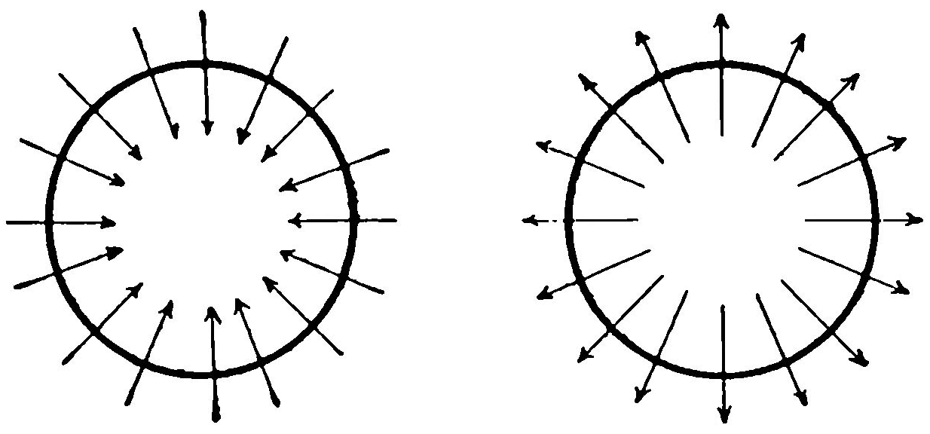
Dialogue, Athenian Democracy
Centripetal discourse
normative
homonoia (“consensus”)
Centrifugal discourse
pluralistic
isegoria (“freedom of speech”)

Slide 11
Discussion
And Plato’s Gorgias?

Slide 12
Do any of the assigned theoretical readings relate to Plato’s Gorgias? How? / How not?
Notes:
Readings Journal Assignment
I would like you to pick an ANCIENT PASSAGE from Plato's Gorgias and ask yourself:
Do any of the assigned theoretical readings relate to it? If so, how? (Again, I'm not looking for extremely lengthy responses, but some good observations.)
I'd like you, in other words, to start thinking about how we can start theorizing persuasion and / or democracy through these kinds of "lenses" (theoretical frameworks or models). This will form the basis of discussion in class, as well as of the first paper.

