Slide 1
elementary ancient greek 1 (grk 101)
introduction

Slide 2
Zoom link via myCourses,
“Announcements”

Slide 3
Welcome to Greek 101!
ἀσπάζομαι ὑμᾶς εἰς τὰ πρῶτα μαθήματα τὰ τοῦ ἀρχαίως ἑλληνίζειν
  aspazdomai humas eis ta prōta mathēmata ta tou arkhaiōs hellēnizein
  “I welcome you to Elementary Ancient Greek”
Andrew Scholtz, Instructor
LT 509 (office hours M 1-3 or by appointment)
ascholtz@binghamton.edu

Slide 4
Agenda
Elements of Course
λαλῶμεν ἑλληνιστί — Greetings
The Greek Alphabet
First Reading, First Approach

Slide 5
Elements of Course

Slide 6
Course Resources, Procedures
Online
  http://blackboard.binghamton.edu
  http://bingweb.binghamton.edu/~grk101
Text: Athenaze vol. 1 (2 ed.)
Objectives
  Alphabet, pronunciation
  Basic grammar
    morphology
    syntax
  Basic vocabulary

Slide 7
Resources, Procedures (cont.)
Objectives (cont.)
  read
    Athenaze Greek
    Real Greek (quiz-quotes)
  culture, civilization
Attendance
Assessment (grading)
  participation
    oral Greek
    other, including assignments
  quizzing
  testing
Honesty

Slide 8
Curriculum
Greek Sequence
Major Propgrams
GRK 101, 102
GRK 203, 204
GRK 380A >
Majors
  Classics Greek & Latin
  Latin
  Classical Civilization
Minors
  Greek
  Latin
  Classical Civilization

Slide 9
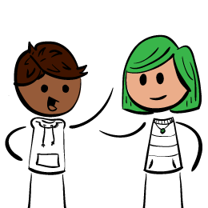
λαλῶμεν ἑλληνιστί
Let’s Speak Greek!

Slide 10
The Greek Alphabet
Homework, Drill-Quiz

Slide 11
group 1
Αα Ββ Γγ Δδ

Slide 12
group 2
Εε Ζζ Ηη Θθ

Slide 13
group 3
Iι Kκ Λλ Mμ

Slide 14
group 4
Νν Ξξ Οο Ππ

Slide 15
group 5
Ρρ Σσ (-ς) Ττ Υυ

Slide 16
group 6
Φφ Χχ Ψψ Ωω

Slide 17
extra letters (rarely encountered)
Ϙϙ (koppa “k”), Ϝϝ (waw, “w”)

Slide 18
Agenda, 22-Feb
Athenaze first story
  Questions/answers in Greek
  Finish translating
Athenaze, CH1 alpha section
  Look ahead

Slide 19
Athenaze, 1st reading
ἐρωτήματα, ἀποκρίσεις. Questions, answers

Slide 20
ἐρωτήματα, ἀποκρίσεις
Multiple-choice question flagged by πότερον. Which choice is right?
ὦ _______· πότερόν ἐστιν ὁ Δικαιόπολις
  Κορίνθιος (Corinthian, from Corinth), ἢ
  Ἀθηναῖος;
ὦ διδάσκαλε· _______

Slide 21
ἐρωτήματα, ἀποκρίσεις
ὦ _______· πότερον οἰκεῖ
  ἐν ταῖς Ἀθήναις, ἢ
  ἐν τοῖς ἀγροῖς;
ὦ διδάσκαλε· _______

Slide 22
ἐρωτήματα, ἀποκρίσεις
Yes/no question flagged by ἆρα. If “no,” what’s the right answer?
ὦ _______· ἆρα ὁ Δικαιόπολις τὸν οἰκεῖ μισεῖ; (Does Dicaeopolis hate — μισεῖ — his house?)
ναί / οὐκ (yes/no) ὦ διδάσκαλε· _______

Slide 23
Homework
Finish translating first story

Slide 24
Look Ahead
Athenaze CH1, alpha grammar section, “oral quiz”

Slide 25
λέξεις (vocab)
δέ
  ὁ δὲ Δικαιόπολις
οὖν
  ὁ οὖν Δικαιόπολις

Slide 26
λέξεις (vocab)
γάρ, ἐστί(ν), οἶκος
  ὁ οὖν Δικαιόπολις χαίρει. ὁ γὰρ κλῆρος καλός ἐστι καὶ ὁ οἶκος καλός
ἀλλά
  ὁ Δικαιόπολις Ἀθηναῖός ἐστιν· ἀλλὰ οὐκ εν ταῖς Ἀθήναις οἰκεῖ

Slide 27
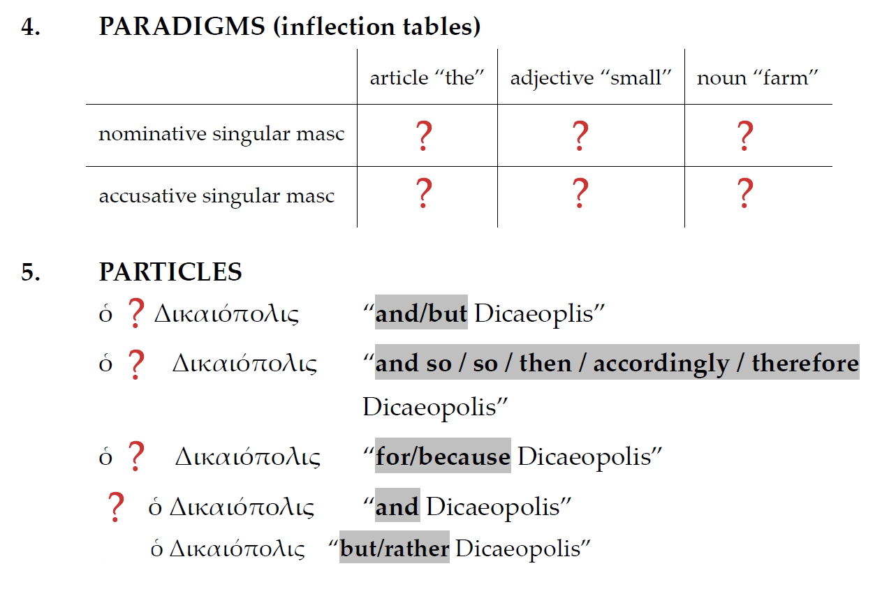


Slide 28
