Slide 1
elementary classical greek 1 (grk 101)
chapter 1

Slide 2

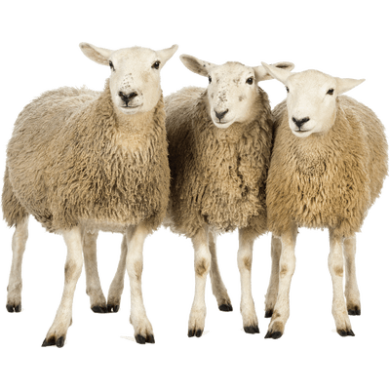
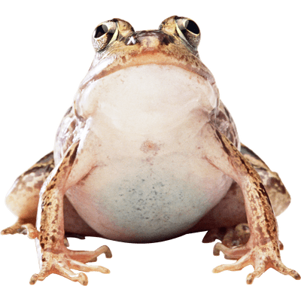
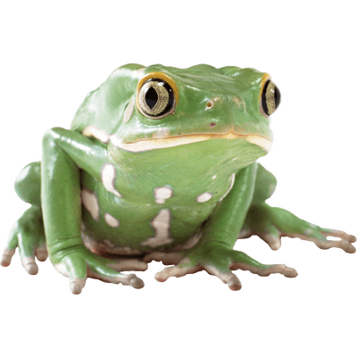
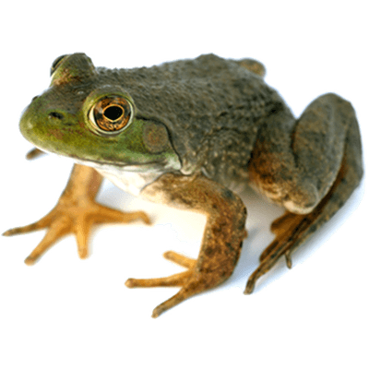
Animals Speak Greek…
βαῦ βαῦ
βῆ βῆ
βρεκεκεκὲξ κοὰξ κοάξ
Notes:
Βρεκεκεκεξ κοαξ κοαξ

Slide 3
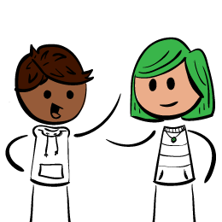
λαλῶμεν ἑλληνιστί
Let’s Speak Greek!

Slide 4
Forms Quiz + Practice
Articles, Adjectives, Nouns, Particles

Slide 5
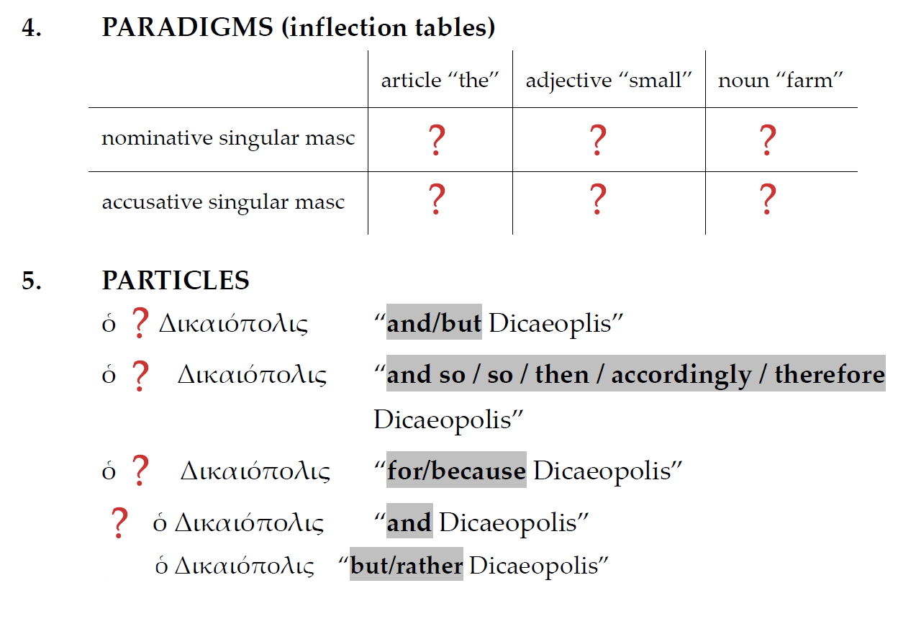


Slide 6
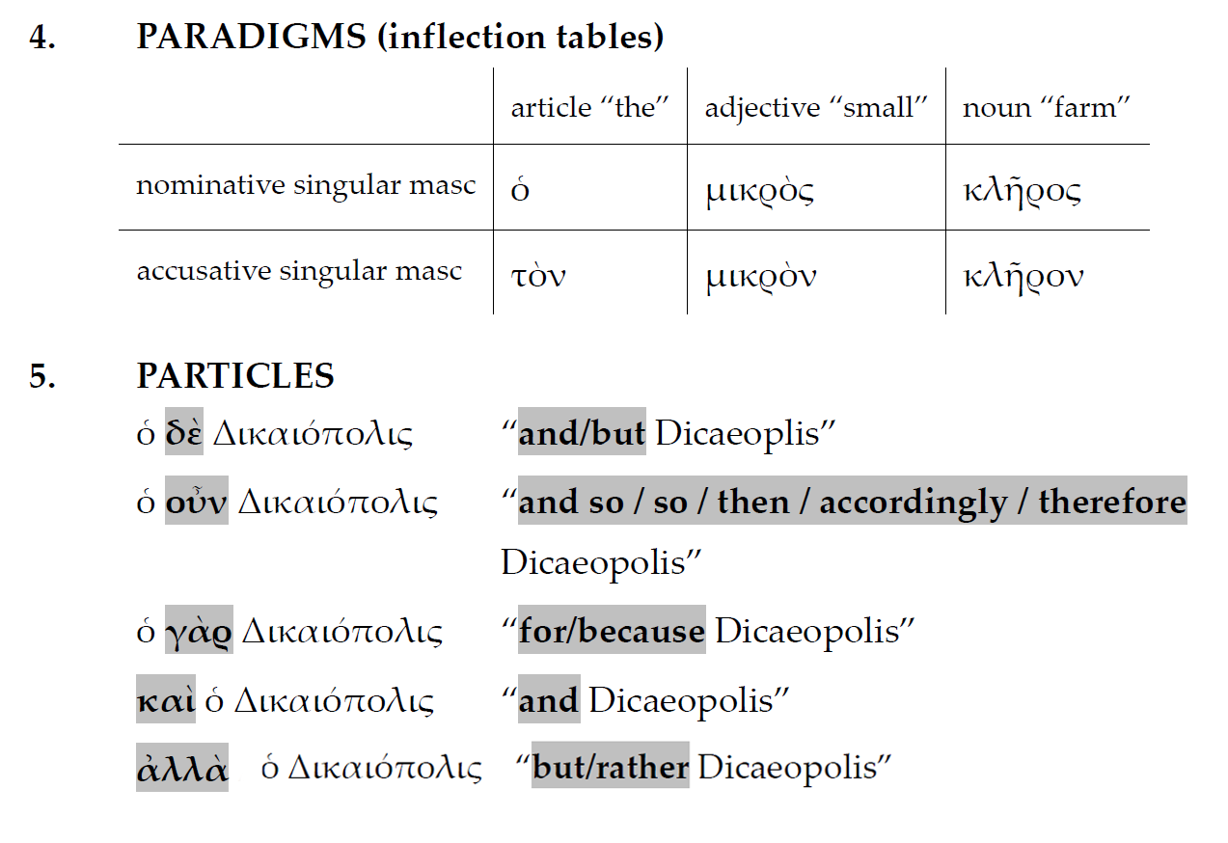

Slide 7
Grammar Function/Syntax
labels
quiz!
S — “subject”
LV — “linking verb”
TV — “transitive verb”
IV — “intransitive verb”
C — “complement”
DO — “direct object”
Dicaeopolis is on the farm
Dicaeopolis is on the farm
Dicaeopolis is a farmer
Dicaeopolis walks home
Dicaeopolis loves his home
Dicaeopolis loves his home
Dicaeopolis is good
Grammar Concepts
http://bingweb.binghamton.edu/~grk101/grammar_concepts.html

Slide 8
Quiz Quotation for Chapter One
γνῶθι σαὐτόν

Slide 9
Greek Language
A Historical Perspective

Slide 10
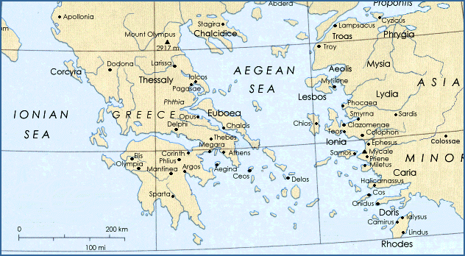
The Greek World

Slide 11
Ancient versus Modern Greek
Ancient
Modern
πῶς ἔχεις;
  “How are you?”
    (Lit, “How are you holding”)
ἔχω καλῶς
  “I’m well!”
ἔχω κακῶς
  “I’m not well/I’m feeling poorly”
τί κάνεις;
  “How are you?”
    (Lit, “How are you holding”)
κάνω καλά
    “I’m well!”
κάνω κακά
  “I’m not well/I’m feeling poorly”

Slide 12
Greek and English, Relationships?…
angelos ~ ?
  angel
psukhē ~ ?
  psychology (“psych”)
mētēr ~ ? (not “meter” measurement)
  mother
patēr ~ ?
  father
Derivatives versus…
Cognates

Slide 13
Greek and Proto-Indo-European

Slide 14
Stages of Greek
Pre-alphabetic
Alphabetic
Mycenean 1600-1100 BCE
Iron-age
Archaic
  ca. 750-ca. 500
Classical
  ca. 500-ca. 320
Hellenistic + koine
  ca. 320 BCE-ca. 330 CE
Medieval (aka Byzantine)
  ca. 330 CE-1453
Modern
  1453-present

