Slide 1
ch3
grk 101

Slide 2
Verb Morphology. Old Forms Plus New Ones

Slide 3
Verb Morphology. Old Forms Plus New Ones

Slide 4
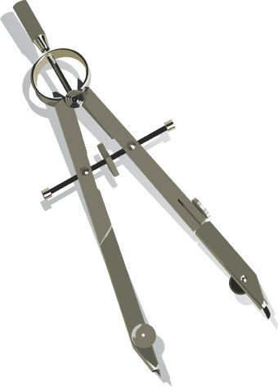
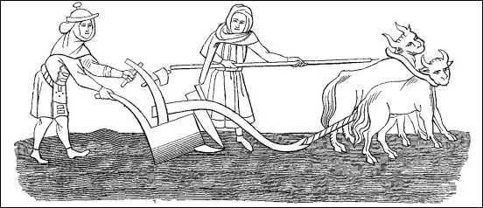

κέντρον
κέντρον
κέντρον

Slide 5
Quiz Quote...
κοινὰ τὰ τῶν φίλων

Slide 6



Second Declension Masc. & Neut, Full Paradigm

Slide 7
Second Declension Masc. & Neut, Full Paradigm
ἐστί
πονέω
αἴρω
φέρω
(οὐ) δυνατόν ἐστι
—
ἐν
πρός
ἐκ
—
ὁ ἀγρός
τὸ ἄροτρον

Slide 8
CH3 Civilization
Deme and Polis

Slide 9
Polis, Deme …
polis
deme
oikos
oikos
deme
oikos
oikos
oikos
oikos
Hē polis hē tōn Athēnaiōn
ἡ πόλις ἡ τῶν Ἀθηναίων
“The City of the Athenians”

Slide 10
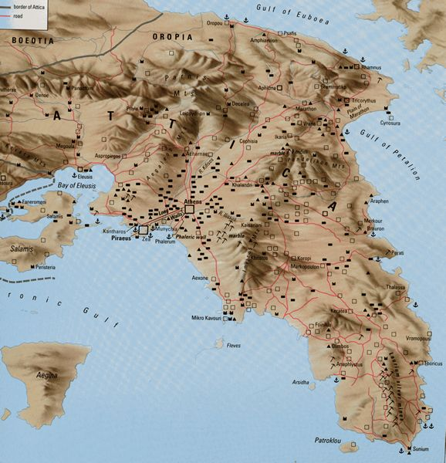
Cholleidae
Athens
ATTICA

Slide 11
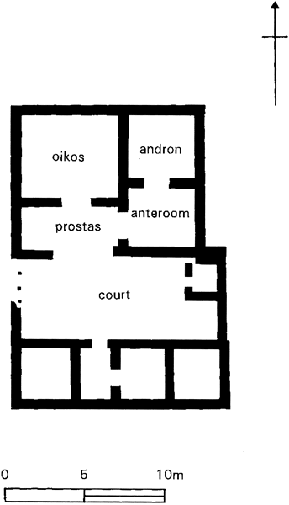
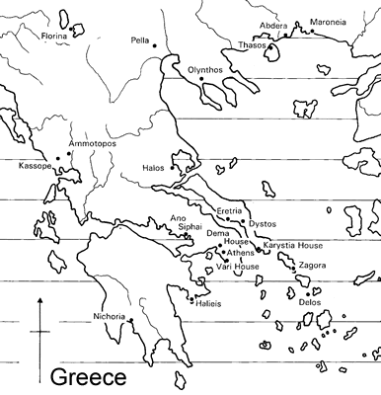
Greek House: Abdera, Thrace (300s BCE)
Abdera
Athens
entrance
Nevett, Lisa C. House and Society in the Ancient Greek World. New studies in Archaeology. Cambridge and New York: Cambridge University Press, 1999.
Notes:
more recently, lisa nevett has looked into the question using archaeological evidence.
now, she has not been able to confirm or refute the conclusions of pomeroy and others, nor has she proposed a definitive interpretation for passages like the one just quoted.
she has, however, in examining the evidence for classical greek houses from a variety of places throughout the ancient greek world, noticed patterns allowing her to offer a more nuanced interpretation of our quote.
what she proposes is that classical greek houses probably did not feature discrete and well defined spaces exclusive to each of the two sexes, or at least one, a women’s quarters, from which non-kin men ordinarily would have been excluded, whether by a heavily bolted door or otherwise.
rather, what she tends to see is the oikia , the ouse itself, as space over which access was controlled by the householder, and to which access would be granted to outsiders in controlled ways.
a lot of this has to do with the andron, a room associated, as its names suggests, first and foremost, with men’s socializing - the symposium.
in several of the houses for which the evidence is good, it seems that guests would likely be admitted immediately to the open court, really, the heart of the anciwent greek house, and a space offering direct or indirect access to other spaces within.
this guest - we’re assuming a male guest - would then be conducted to the andron, whose placement and access in effect could cut it off from the rest of the house.
in effect, that andron became fro the duration of a symposium, an exlcusive space for male maerry-makers and their entertainers of whatevedr sex, and the rest of the house, a kind of off-limits space.

Slide 12
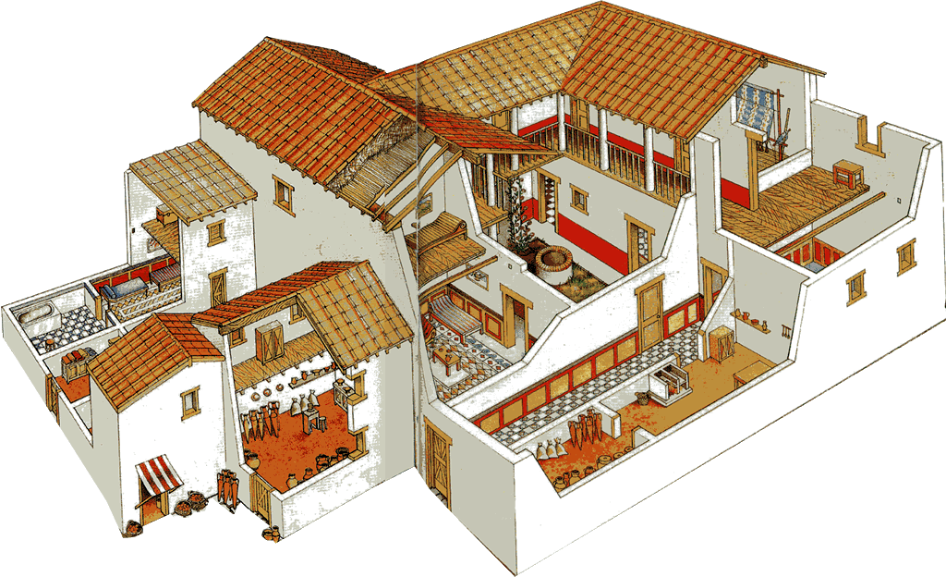
andron
Greek House (oikia), Olynthus, 4th cent. BCE (reconstruction)
Notes:
otherwise, however, the rest of the house will have been accessible to occupants of both sexes, and rooms evidently put to multiple use, including perhaps the andron.
thus we see no strict sequestration of women any more than we see them excluded from space external to the houses in which they lived. indeed, we have good reason to believe that, the farther down the socio-economic ladder one went, the greater the likelihood that the women of the house would have to participate in breadwinning outside its walls.
at the same time, the ideology of sequestration remained strong - not wholly a social fiction, though an idea that derived strength from the prestige it lent to the well-to-do householder.

