Slide 1
ch4 various
grk 101

Slide 2
πάθει μάθος

Slide 3
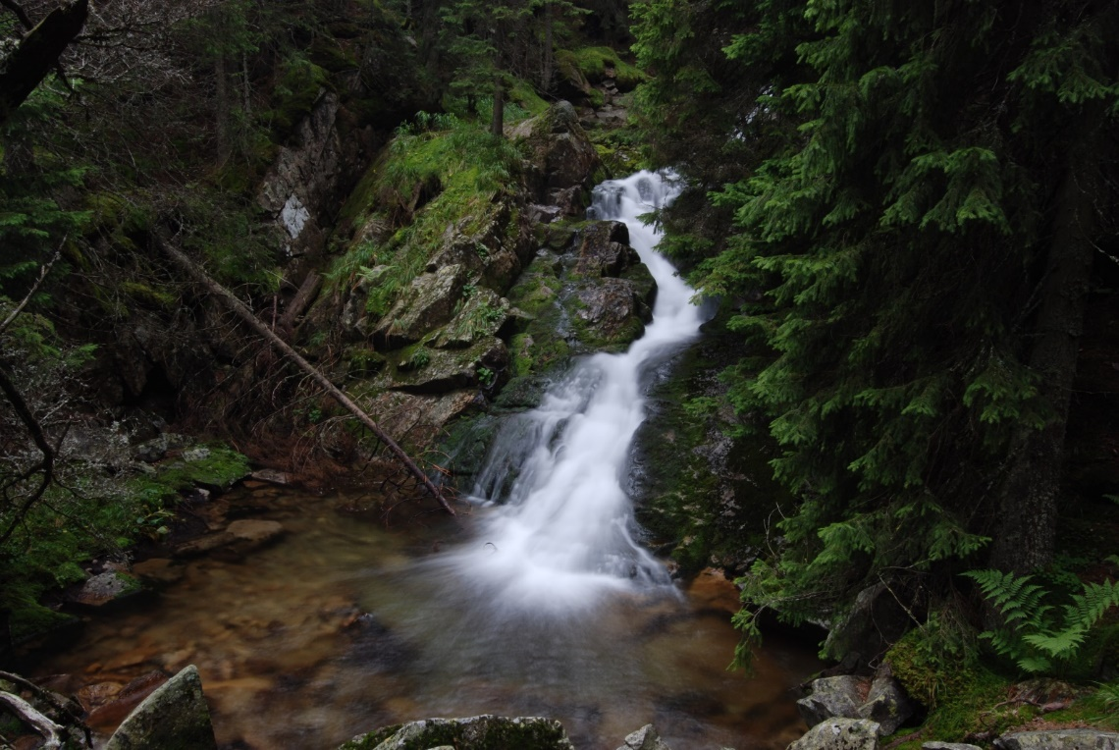
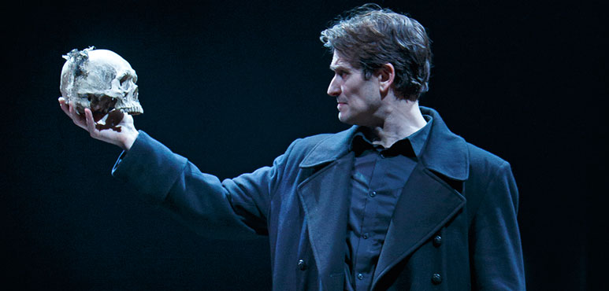
νέα μορφολογία
ἡ κρήνη
εἶναι ἢ μὴ εἶναι

Slide 4
ἡ καλὴ κρήνη. Fem. 1st Declension

Slide 5
ἡ καλὴ κρήνη. Fem. 1st Declension

Slide 6
εἰμι, Conjugation
 | present active indic. |  |  | pres. act. imperat. |  |  | pres. act. inf.
 | ω‑verbs | ε‑contract | irreg. | ω‑verbs | ε‑contract | irreg. | ω‑verbs | ε‑contract | irreg.
 | have | love | be | have! | love! | be! | to have | to love | to be
I | ἔχ-ω | φιλ-ῶ | εἰμι |  |  |  | ἔχ-ειν | φιλ-εῖν | εἶναι
you | ἔχ-εις | φιλ-εῖς | εἶ | ἔχ-ε | φίλ-ει | ἴσθι
he/she/it | ἔχ-ει | φιλ-εῖ | ἐστί
we | ἔχ-ομεν | φιλ-οῦμεν | ἐσμεν
you | ἔχ-ετε | φιλ-εῖτε | ἐστε | ἔχ-ετε | φιλ-εῖτε | ἔστε
they | ἔχ-ουσι(ν) | φιλ-οῦσι(ν) | εἰσι(ν)

Slide 7
εἰμι, Conjugation
 | present active indic. |  |  | pres. act. imperat. |  |  | pres. act. inf.
 | ω‑verbs | ε‑contract | irreg. | ω‑verbs | ε‑contract | irreg. | ω‑verbs | ε‑contract | irreg.
 | have | love | be | have! | love! | be! | to have | to love | to be
I | ἔχ-ω | φιλ-ῶ | εἰμι |  |  |  | ἔχ-ειν | φιλ-εῖν | εἶναι
you | ἔχ-εις | φιλ-εῖς | εἶ | ἔχ-ε | φίλ-ει | ἴσθι
he/she/it | ἔχ-ει | φιλ-εῖ | ἐστί
we | ἔχ-ομεν | φιλ-οῦμεν | ἐσμεν
you | ἔχ-ετε | φιλ-εῖτε | ἐστε | ἔχ-ετε | φιλ-εῖτε | ἔστε
they | ἔχ-ουσι(ν) | φιλ-οῦσι(ν) | εἰσι(ν)

Slide 8
λαλῶμεν ἑλληνιστί!
πολύς, δεσπότης

Slide 9
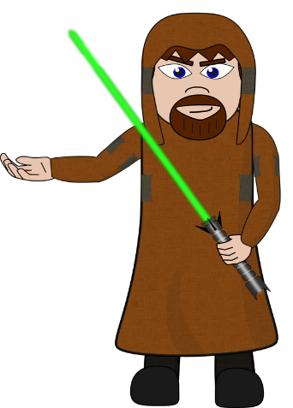


τὶ βούλεται λέγειν ἀγγλιστί...
πολύς;
δεσπότης;

Slide 10
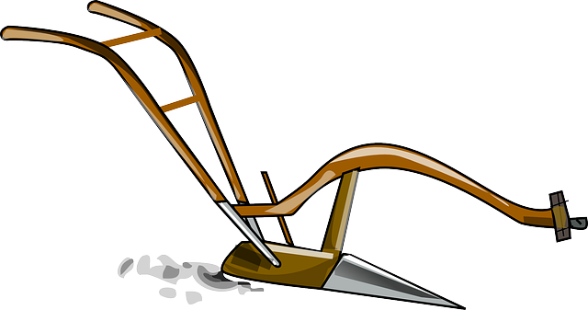
ἐρωτήματα
πόσοι δεσπόται εἰσίν· πότερον ὀλίγοι (few) ἠ πολλοί;
πόσα ἄροτρα ἔχει ὁ δεσπότης· πότερον ὀλίγα ἠ πολλά;

Slide 11
The Article
 | masc | fem. | neut
Singular
nom | ὁ | ἡ | τό
gen | τοῦ | τῆς | τοῦ
dat | τῷ | τῇ | τῷ
acc | τόν | τήν | τό
Plural
nom | οἱ | αἱ | τά
gen | τῶν | τῶν | τῶν
dat | τοῖς | ταῖς | τοῖς
acc | τούς | τάς | τά

Slide 12
 | FEMININE |  |  |  | MASCULINE
 |  | -η | -ᾱ | -ᾰ |  | -ης | -ᾱς
 |  | κρήνη | ὑδρίᾱ | ἅμαξᾰ |  | δεσπότης | Ξανθίᾱς
 |  | spring | jar | wagon |  | master | Xanthias
 | SING |  |  |  | SING
nom | ἡ | κρήν-η | ὑδρί-ᾱ | ἅμαξ-ᾰ | ὁ | δεσπότ-ης | Ξανθί-ᾱς
gen | τῆς | κρήν-ης | ὑδρί-ᾱς | ἁμάξ-ης | τοῦ | δεσπότ-ου | Ξανθί-ου
dat | τῇ | κρήν-ῃ | ὑδρί-ᾳ | ἁμάξ-ῃ | τῷ | δεσπότ-ῃ | Ξανθί-ᾳ
acc | τὴν | κρήν-ην | ὑδρί-ᾱν | ἅμαξ-ᾰν | τὸν | δεσπότ-ην | Ξανθί-ᾱν
voc | (ὦ) | κρήν-η | ὑδρί-ᾱ | ἅμαξ-ᾰ | (ὦ) | δέσποτ-ᾰ | Ξανθί-ᾱ
 | PLUR |  |  |  | PLUR
nom | αἱ | κρῆν-αι | ὑδρί-αι | ἅμαξ-αι | οἱ | δεσπότ-αι | Ξανθί-αι
gen | τῶν | κρην-ῶν | ὑδρι-ῶν | ἁμαξ-ῶν | τῶν | δεσποτ-ῶν | Ξανθι-ῶν
dat | ταῖς | κρήν-αις | ὑδρί-αις | ἁμάξ-αις | τοῖς | δεσπότ-αις | Ξανθί-αις
acc | τὰς | κρήν-ας | ὑδρί-ᾱς | ἁμάξ-ας | τοὺς | δεσπότ-ᾱς | Ξανθί-ᾱς
voc | (ὦ) | κρῆν-αι | ὑδρί-αι | ἅμαξ-αι | (ὦ) | δεσπότ-αι | Ξανθί-αι

Slide 13
Oral Quiz: πολύς
 | SING |  |  | PLUR
 | masc | fem | neut | masc | fem | neut
nom | πολύς
gen
dat
acc
voc | (none) |  |  | (none)

Slide 14
μέγας μεγάλη μέγα. “great,” “large,” “big.”
 | SING |  |  | PLUR
 | masc | fem | neut | masc | fem | neut
nom | μέγας | μεγάλ-η | μέγα | μεγάλ-οι | μεγάλ-αι | μεγάλ-α
gen | μεγάλ-ου | μεγάλ-ης | μεγάλ-ου | μεγάλ-ων | μεγάλ-ων | μεγάλ-ων
dat | μεγάλ-ῳ | μεγάλ-ῃ | μεγάλ-ῳ | μεγάλ-οις | μεγάλ-αις | μεγάλ-οις
acc | μέγαν | μεγάλ-ην | μέγα | μεγάλ-ους | μεγάλ-ας | μεγάλ-α
voc | μεγάλ-ε | μεγάλ-η | μέγα | μεγάλ-οι | μεγάλ-αι | μεγάλ-α

