Slide 1
GRK 101
Third Declension and Other Stuff

Slide 2


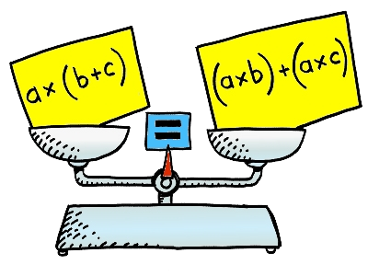

λαλῶμεν ἑλληνιστί (“Let’s Speak Greek Greek”) 1
ὁ (more frequent) / ἡ (less frequent) κύων, τοῦ / τῆς _________
τὸ πρόβλημα, τοῦ _____
ἔχω
ἔστι(ν)
ἀγαθός, ἀγαθή, ἀγαθόν
  οἱ ἀγαθοί
  αἱ ἀγαθαί
  τὰ ἀγαθά
κακός, κακή, κακόν
μοι / ἐμοί
σοι / σοί

Slide 3
λαλῶμεν ἑλληνιστί 2
λέξεις (vocab)
διάλογος (dialogue)
ἐμαυτόν
σεαυτόν
ἡμᾶς αὐτούς/αὐτάς
ὑμᾶς αὐτούς/αὑτάς
ὦ _____· ἆρα σεαυτὸν ὁρᾶις;
ναί, ὠ _________
οὐχί, ὦ _________

Slide 4
3rd-Decl. Endings
 | sing. |  | plur.
 | masc./fem. | neut. | masc./fem. | neut.
nom. | –––––––––––– | –––––––––––– | -ες | -α
gen. | -ος | -ος | -ων | -ων
dat. | -ι | -ι | -σι(ν) (-εσι, -ξι, -ψι) | -σι(ν) (-εσι, -ξι, -ψι)
acc. | -α, -ν | (same as nom.) | -ας | (same as nom.)
voc. | varies! | (same as nom.) | (same as nom.) | (same as nom.)

Slide 5
Oral Quiz Paradigms
 | sing. | plur.
nom. | ὁ/ἡ κύων | οἱ/αἱ κύν- ες
gen. | τοῦ/τῆς κυν‑ ός | τῶν κυν- ῶν
dat. | τῷ/τῇ κυν- ί | τοῖς/ταῖς κυσί(ν)
acc. | τὸν/τὴν κύν- α | τοὺς/τὰς κύν- ας
voc. | ὦ κύον | ὦ κύνες

Slide 6
Oral Quiz Paradigms
 | sing. | plur.
nom. | τὸ πρόβλημα | τὰ προβλήματ- α
gen. | τοῦ προβλήματ- ος | τῶν προβλημάτ- ων
dat. | τῷ προβλήματ- ι | τοῖς προβλήμα- σι(ν)
acc. | τὸ πρόβλημα | τὰ προβλήματ- α
voc. | ὦ πρόβλημα | ὦ προβλήματ- α

Slide 7
λαλῶμεν ἑλληνιστί
Forms of: χειμών, τίς; / τί;

Slide 8
3rd-Decl. Endings
 | sing. |  | plur.
 | masc./fem. | neut. | masc./fem. | neut.
nom. | –––––––––––– | –––––––––––– | -ες | -α
gen. | -ος | -ος | -ων | -ων
dat. | -ι | -ι | -σι(ν) (-εσι, -ξι, -ψι) | -σι(ν) (-εσι, -ξι, -ψι)
acc. | -α, -ν | (same as nom.) | -ας | (same as nom.)
voc. | varies! | (same as nom.) | (same as nom.) | (same as nom.)

Slide 9
3rd-Decl. Endings
 | sing. |  | plur.
 | masc./fem. | neut. | masc./fem. | neut.
nom. | –––––––––––– | –––––––––––– | -ες | -α
gen. | -ος | -ος | -ων | -ων
dat. | -ι | -ι | -σι(ν) (-εσι, -ξι, -ψι) | -σι(ν) (-εσι, -ξι, -ψι)
acc. | -α, -ν | (same as nom.) | -ας | (same as nom.)
voc. | varies! | (same as nom.) | (same as nom.) | (same as nom.)

Slide 10
Interrogative τίς; versus enclitic τις
SINGULAR |  |  |  |  | PLURAL
 | masc/fem |  | neut |  | masc/fem | neut
nom | τίς; |  | τί; |  | τίνες; | τίνα;
gen | τίνος; |  |  |  | τίνων;
dat | τίνι; |  |  |  | τίσι(ν);
acc | τίνα; | τί; |  |  | τίνας; | τίνα;
SINGULAR |  |  |  |  | PLURAL
 | masc/fem |  | neut |  | masc/fem | neut
nom | τις |  | τι |  | τινες | τινα
gen | τινος |  |  |  | τινων
dat | τινι |  |  |  | τισι(ν)
acc | τινα | τι |  |  | τινας | τινα

Slide 11
λέξεις. τί βούλεται λέγειν ...;
ἑλληνιστί
ἀγγλιστί
ὁ χειμών, τοῦ χειμῶν-ος
τὸ ἀεροπλάνον, τοῦ ἀεροπλάνου
τίς / τί (τίνος, τίνι, καὶ τὰ λοιπά)
τις / τι (τινος, τινι, κτλ.)
ὁρά-ω (ὁρῶ, ὁρᾶις, ὁρᾶι, κτλ.)
τί ἐστι τοῦτο;
  ἔστι(ν)
Storm/winter
airplane
Who? / What? (whose? to whom/ to what, etc.)
Someone, something, a certain, a
See
What is this?
  It is ...

Slide 12



λαλῶμεν ἑλληνιστί
τί ἐστι τοῦτο;
ἔστι (a/some sort of) ___________”
τί ὁρᾷς;
ὁρῷ (a/some sort of) ________

Slide 13

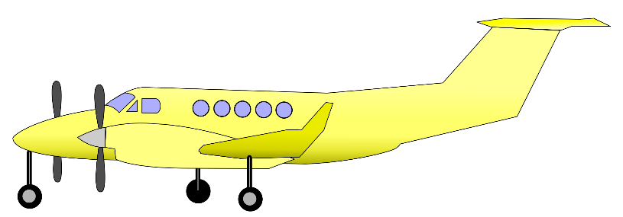
λαλῶμεν ἑλληνιστί (cont’d)
τί ἐστι τοῦτο;
“(It) is a/some ___________”
τί ὁρᾷς;
ὁρῶ (a/some sort of) ________

Slide 14

λαλῶμεν ἑλληνιστί (cont’d)
ποῦ (where) ἐστὶ τὸ ἀεροπλάνον;
τὸ ἀεροπλάνον ἐστὶν ἐν τῷ _______.

Slide 15

λαλῶμεν ἑλληνιστί (cont’d)
ποῖ (to where) ἔρχεται τὸ ἀεροπλάνον;
τὸ ἀεροπλάνον ἔρχεται εἰς τὸν _______.

Slide 16
λαλῶμεν ἑλληνιστί (cont’d)
πόθεν (from where) ἔρχεται τὸ ἀεροπλάνον;
τὸ ἀεροπλάνον ἔρχεται ἐκ τοῦ _______.

