Slide 1
chapter 10
athenaze – grk 101

Slide 2
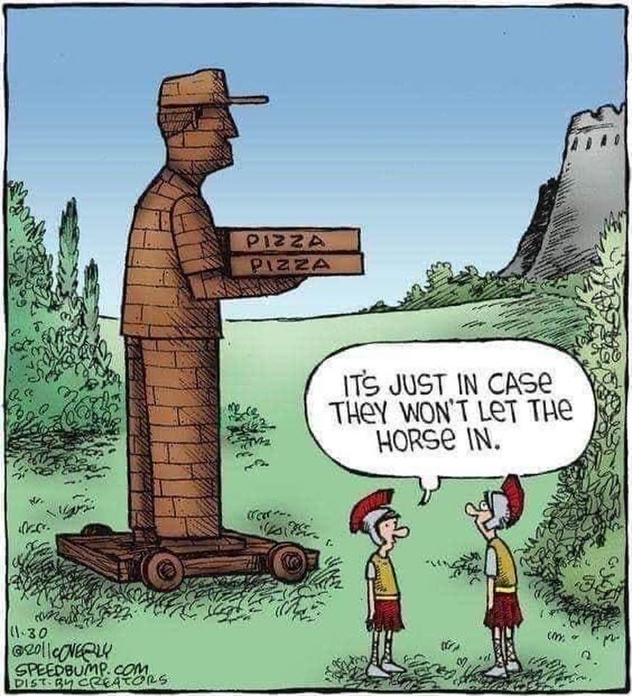

Slide 3
Future Grid
 | indicative
 | sing. | plur.
1st
2nd
3rd
 | infinitive
 | participle

Slide 4




λαλῶμεν ἑλληνιστί
ἔχω principal parts
  ἔχω, ἕξω/σχήσω, ἔσχον
  ποιέω, ___?___, ἐποίησα
Vocab
  πῶς ἔχεις;
  ἔχω καλῶς/κακῶς/μέσως
  τήμερον =
  αὔριον =
χαίρετε ὦ μαθηταί κτλ (κτλ. = καὶ τὰ λοιπὰ, “etc.”)
ὦ ___· πῶς ἔχεις τήμερον;
ὦ ___· πῶς ἕξεις αὔριον;
  ἕξω καλῶς/κακῶς/μέσω
  οὐκ οἶδα, ὦ διδάσκαλε
τί ποιεῖς τήμερον; πότερον...
  μανθάνεις, ἢ
  ἀναγιγνώσκεις, ἢ
  ἐσθίεις

Slide 5
Παιδεύω, principle parts 1st 3 of 6)
λύω (present system)
λύσω (future act/middle system)
ἔλυσα (aorist [simple past] act/middle system)
λέλυκα (perfect act system)
λέλυμαι (perfect mid/passive system)
ἐλύθην (aorist passive system)

Slide 6
Types of Future, Stem and Endings...
Regular Sigmatic Future
Other Future
λύω λύσω
Double-consonant sigmatic
  πέμπω πέμψω (= πέμ-πσ-ω)
Sigmatic with consonant (δ, τ, θ, ζ)
  σπεύδω σπεύσω
Contract verbs
  φιλέω φιλήσω
  τιμάω τιμήσω
  θεάομαι θεάσομαι (-ᾱ-)
Special -ίζω verbs
  κομίζω κομιῶ (ε-contr)
Deponent future
  ἀκούω ἀκούσομαι
Mix-and-matches, irregulars
  βαδίζω βαδιοῦμαι
  γίγνομαι γενήσομαι
  βοάω βοήσομαι
  εὑρίσκω εὑρήσομαι
  ἔχω ἕξω/σχήσω
To be continued…

Slide 7
Βάλλω (throw), κάμνω (be/become tired), ἔρχομαι (go)
(Semi-)Irregular Future

Slide 8
 | indicative |  | infinitive |  | participle
 | sing. |  | βαλεῖν | to be going to throw | βαλῶν, βαλοῦσα, βαλοῦν βαλοῦντος, βαλούσης, βαλοῦντος | going to throw, in order to throw
1st | βαλῶ | I’ll throw
2nd | βαλεῖς | you’ll throw
3rd | βαλεῖ | he/she/it will throw
 | plur.
1st | βαλοῦμεν | we’ll throw
2nd | βαλεῖτε | you’ll throw
3rd | βαλοῦσι(ν) | they’ll throw

Slide 9
 | indicative |  | infinitive |  | participle
 | sing. |  | βαλεῖν | to be going to throw | βαλῶν, βαλοῦσα, βαλοῦν βαλοῦντος, βαλούσης, βαλοῦντος | going to throw, in order to throw
1st | βαλῶ | I’ll throw
2nd | βαλεῖς | you’ll throw
3rd | βαλεῖ | he/she/it will throw
 | plur.
1st | βαλοῦμεν | we’ll throw
2nd | βαλεῖτε | you’ll throw
3rd | βαλοῦσι(ν) | they’ll throw

Slide 10
 | indicative |  | infinitive |  | participle
 | sing. |  | καμεῖσθαι | to be going to be tired | καμούμενος, καμουμένη, καμούμενον | going to be tired, in order to be tired
1st | καμοῦμαι | I’ll be tired
2nd | καμεῖ | you’ll be tired
3rd | καμεῖται | he/she/it will be tired
 | plur.
1st | καμούμεθα | we’ll be tired
2nd | καμεῖσθε | you’ll be tired
3rd | καμοῦνται | they’ll be tired

Slide 11
 | indicative |  | infinitive |  | participle
 | sing. |  | καμεῖσθαι | to be going to be tired | καμούμενος, καμουμένη, καμούμενον | going to be tired, in order to be tired
1st | καμοῦμαι | I’ll be tired
2nd | καμεῖ | you’ll be tired
3rd | καμεῖται | he/she/it will be tired
 | plur.
1st | καμούμεθα | we’ll be tired
2nd | καμεῖσθε | you’ll be tired
3rd | καμοῦνται | they’ll be tired

Slide 12
ἔρχομαι “go”
 | indicative |  | imperative |  | infinitive |  | participle
 | FUT |  | PRES |  | FUT/PRES |  | FUT/PRES
1st | εἶμι |  |  |  | to go ἰέναι |  | going ἰών ἰοῦσα ἰόν
2nd | εἶ |  | ἴθι
3rd | εἶσι(ν)
1st | ἴμεν
2nd | ἴτε |  | ἴτε
3rd | ἴασι(ν)

Slide 13
ἔρχομαι “go”
 | indicative |  | imperative |  | infinitive |  | participle
 | FUT |  | PRES |  | FUT/PRES |  | FUT/PRES
1st | εἶμι |  |  |  | to go ἰέναι |  | going ἰών ἰοῦσα ἰόν
2nd | εἶ |  | ἴθι
3rd | εἶσι(ν)
1st | ἴμεν
2nd | ἴτε |  | ἴτε
3rd | ἴασι(ν)

Slide 14



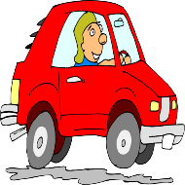

λαλῶμεν ἑλληνιστί (Let’s speak Greek!)
τί ποιεῖς νῦν (“right now,” present time, present tense); πότερον...
  τὴν σφαῖραν βάλλεις, ἢ
  ἔρχει πρὸς τὸ ἄστυ, ἢ
  οὐ ποιήσεις οὐδέν· κάμνεις γάρ
καὶ αὔριον· τί ποιήεις (fut time and tense);

Slide 15


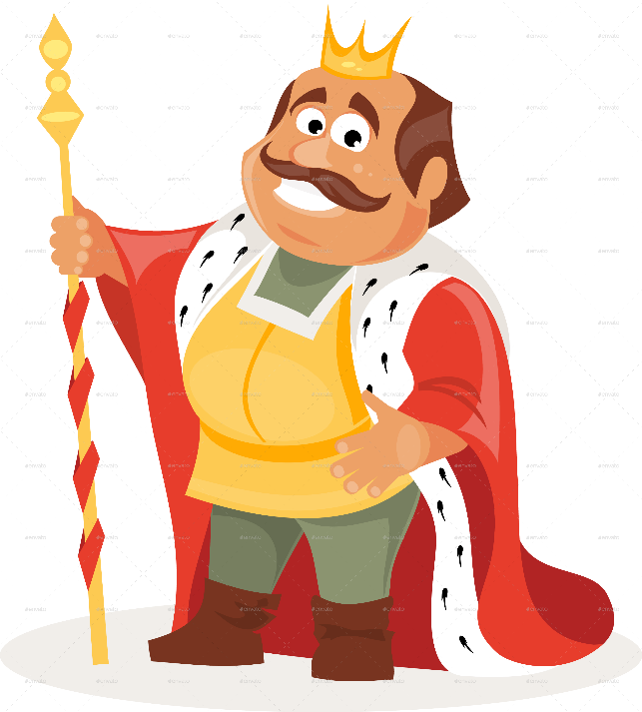
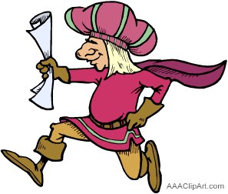
λαλῶμεν ἑλληνιστί
τί ποιεῖ ὁ βασιλεύς;
  ἄγγελος, -ου, ὁ
  ἀκούω ἀκούσομαι ἤκουσα
  λόγος, -ου, ὁ

Slide 16
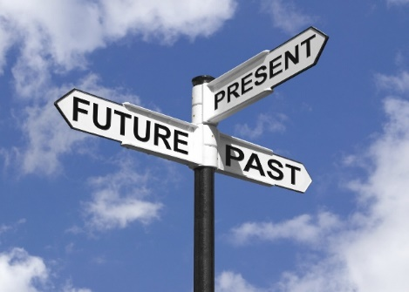
λαλῶμεν ἑλληνιστί
τίνες εἰσὶ
  αἱ τότε;
  αἱ νῦν;
  αἱ ἔπειτα;

Slide 17
λαλῶμεν ἑλληνιστί
Impersonal Verbs
Infinitve Phrases
ἔξεστι (+ dative)
δεῖ (+ acc.)
καιρός ἐστι
(οὐ) δυνατόν ἐστι
τὴν σφαῖραν βάλλειν, ἢ
ἔρχεσθαι πρὸς τὸ ἄστυ, ἢ
Question words
ἆρα
ποῖ
πόθεν
πότε
ποῦ
πῶς
τί; τίς/τί;

Slide 18
λαλῶμεν ἑλληνιστί
πότερον ἔξεστί τινι / δεῖ τινα / καιρός ἐστι / δυνατόν ἐστι
  τὴν σφαῖραν βάλλειν, ἢ
  ἔρχεσθαι πρὸς τὸ ἄστυ, ἢ
ἆρα εἶ ὡς
  σώσουσα τὸν παῖδα;
  θεᾱσομένη τὰς τραγουδίας;

