Slide 1
Passive Voice, CH16-alpha
GRK 102

Slide 2
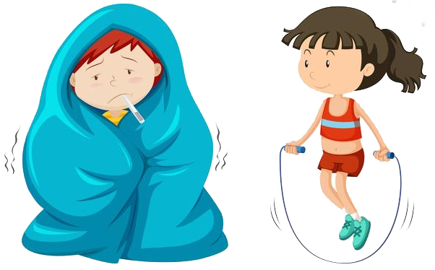
λαλῶμεν ἑλληνιστί! “Let’s speak Greek”
ὦ μαθητρί, πῶς ἔχεις; “O student (feminine), how are you?”
ὦ διδάσκαλε,
  καλῶς ἔχω! ☺ “I’m well!”
  κακῶς ἔχω! ☹ “I’m unwell!”
  ματρίως ἔχω! 😐 “I’m so-so!”

Slide 3

Active to Passive in English
ACTIVE
  Subject (doer) + active verb + direct object (done to)
PASSIVE
  Subject (done to) + passive verb + agent (doer)

Slide 4
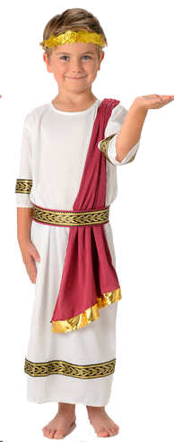
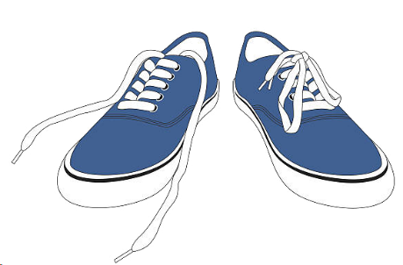
Active to Passive in English
ACTIVE
  “Philip unties the shoes”
PASSIVE
  “The shoes are untied by Philip”

Slide 5
Vocab prep
ὁ Φίλιππος, τοῦ Φιλίππου
τὰ ὑποδέματα, τῶν ὑποδεμάτων

Slide 6
Active Voice, Greek — choose the right one
“Philip unties the shoes”
  τῶν Φιλίππων τῶν ὑποδεμάτων λύομεν.
  τὸν Φίλιππον τοῖς ὑποδέμασι λύω.
  ὁ Φίλιππος τὰ ὑποδέματα λύει.
ὁ Φίλιππος, τοῦ Φιλίππου
τὰ ὑποδέματα, τῶν ὑποδεμάτων

Slide 7
Passive Voice, Greek — choose the right one
“The shoes are untied by Philip”
  ἐν τοῖς ὑποδέμασι ὁ Φίλιππος λύει.
  ὑπὸ τῶν ὑποδεμάτων τὸν Φίλιππον λύομεν.
  τὰ ὑποδέματα ὑπὸ τοῦ Φιλίππου λύεται.
ὁ Φίλιππος, τοῦ Φιλίππου
τὰ ὑποδέματα, τῶν ὑποδεμάτων

Slide 8
Passive Voice, Greek — choose the right one
“The shoes are untied by Philip”
  ἐν τοῖς ὑποδέμασι ὁ Φίλιππος λύει.
  ὑπὸ τῶν ὑποδεμάτων τὸν Φίλιππον λύομεν.
  τὰ ὑποδέματα ὑπὸ τοῦ Φιλίππου λύεται.
ὁ Φίλιππος, τοῦ Φιλίππου
τὰ ὑποδέματα, τῶν ὑποδεμάτων

Slide 9
