Slide 1
Passive Voice, CH17-alpha
GRK 102

Slide 2
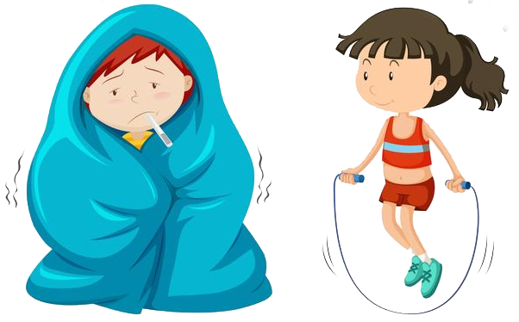
λαλῶμεν ἑλληνιστί! “Let’s speak Greek”
ὦ μαθητρί, πῶς ἔχεις; “O student (feminine), how are you?”
ὦ διδάσκαλε,
  καλῶς ἔχω! ☺ “I’m well!”
  κακῶς ἔχω! ☹ “I’m unwell!”
  μετρίως ἔχω! 😐 “I’m so-so!”

Slide 3

λαλῶμεν ἑλληνιστί! “Let’s speak Greek” (cont’d)
χάριν σοι ἔχω
  “Thank you (sing)”
χάριν σφῷν ἔχω
  “Thank you (dual)”
χάριν ὑμῖν ἔχω
  “Thank you (plural)”
ἀσμένως
  “Gladly!”
  “You’re welcome!”

Slide 4
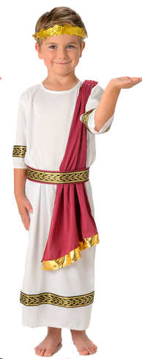
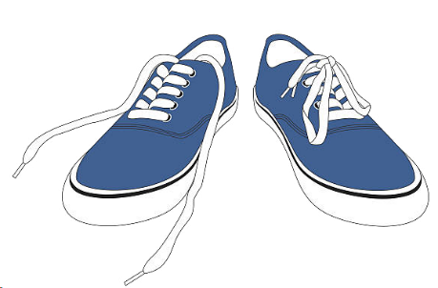
Passive Voice, Greek — aorist
“The shoes were untied by Philip”
  ὑπὸ τῶν ὑποδεμάτων τὸν Φίλιππον ἔλυσαν.
  τὰ ὑποδέματα ὑπὸ τοῦ Φιλίππου ἐλύθη.
  τὰ ὑποδέματα ὑπὸ τοῦ Φιλίππου ἐλύθησαν.
ὁ Φίλιππος, τοῦ Φιλίππου
τὰ ὑποδέματα, τῶν ὑποδεμάτων

Slide 5
Passive Voice, Greek — aorist
“The shoes were untied by Philip”
  ὑπὸ τῶν ὑποδεμάτων τὸν Φίλιππον ἔλυσαν.
  τὰ ὑποδέματα ὑπὸ τοῦ Φιλίππου ἐλύθη.
  τὰ ὑποδέματα ὑπὸ τοῦ Φιλίππου ἐλύθησαν.
ὁ Φίλιππος, τοῦ Φιλίππου
τὰ ὑποδέματα, τῶν ὑποδεμάτων

Slide 6
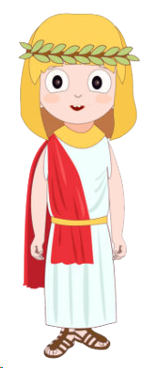
Passive Voice, Greek — aorist
τα ὑποδέματα, λυθέντα ὑπὸ τοῦ Φιλίππου, ὑπὸ τῆς Μελίττης ἐλήφθην
“The shoes, having been untied by Philip, were taken by Melissa”
ἡ Μέλιττα, τῆς Μελίττης
τὰ ὑποδέματα, τῶν ὑποδεμάτων

Slide 7

CH17-alpha Homework Notes
ἄριστα, μαθητρίδε!
  Super job, students! (fem dual voc)
ACT δηλῶσαι
  “to make known, disclose, reveal”
  “to have made known, disclosed, revealed”
PASS δηλωθῆναι
  “to be made known, disclosed, revealed”
  “to have been made known, disclosed, revealed”

