Slide 1
Passive Voice, CH17-beta
GRK 102

Slide 2
Announcements
Quiz Monday, 17-Sep
  CH17
  Closed book, but
  Focus on homework items
Some further adjustment of assignments over weekend

Slide 3
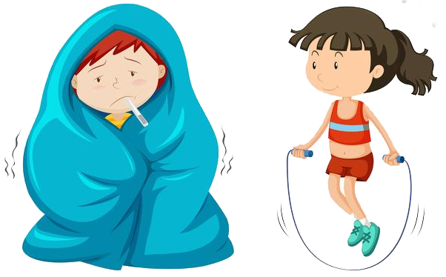
λαλῶμεν ἑλληνιστί! “Let’s speak Greek”
ὦ μαθητρί, πῶς ἔχεις; “O student (feminine), how are you?”
ὦ διδάσκαλε,
  καλῶς ἔχω! ☺ “I’m well!”
  κακῶς ἔχω! ☹ “I’m unwell!”
  μετρίως ἔχω! 😐 “I’m so-so!”

Slide 4

λαλῶμεν ἑλληνιστί! “Let’s speak Greek” (cont’d)
δῶρον φέρω σοι / σφῷν / ὑμῖν
  “I bring you (sing / dual / plur) a gift”
χάριν σοι ἔχω
  “Thank you (sing)”
χάριν σφῷν ἔχω
  “Thank you (dual)”
χάριν ὑμῖν ἔχω
  “Thank you (plural)”
ἀσμένως
  “Gladly!” “You’re welcome!”

Slide 5


Vocab-Morphology Study
ἀθήναζε πορευθῆναι βούλομαι (present)
  I want to travel to Athens
ἀθήναζε πορευθῆναι ________ (aorist)
  I wanted to travel to Athens
ἀθήναζε ________, εἰς τὴν Ρώμην πορευθῆναι βούλομαι
  Having traveled to Athens, I want to travle to Rome
βούλομαι βουλήσομαι ἐβουλήθην
  I want/wish
πορεύομαι πορεύσομαι ἐπορεύθην
  I travel/go/[etc.]
ἐβουλήθην
πορευθεῖσα

