Slide 1
CH18-beta
GRK 102

Slide 2



λαλῶμεν ἑλληνιστί! “Let’s speak Greek”
τί ἐποίησας χθές; πότερον…
  ἐμάνθανες, ἢ
  ἐκάθευδες, ἢ
  ταινίαν τινὰ (“a film”) ἔβλεπες;

Slide 3
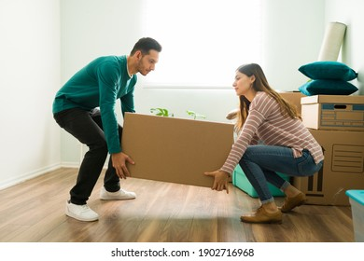
Principal Parts: τίθημι ( “put,” “place”)
pres active τίθημι.
fut active θήσω.
aor active ἔθηκα (mid ἐθέμην).
“perfect” active τέθηκα (“I have put”).
“perfect” middle-passive τέθειμαι (“I have been put”).
aor passive ἐτέθην (“I was put”).
“thesis” from ἡ θέσις from τίθημι
“antithesis” from ἡ ἀντίθεσις from τίθημι

Slide 4
λαλῶμεν ἑλληνιστί! “Let’s speak Greek”
A. τὸν κᾶδον τίθημι αὐτοῦ.
  “I’m putting/placing the box right here.”
B. χάριν σοι ἔχω.
A. ἀσμένως.
INDIC | IMPERAT | INFIN | PTC
present active
τίθη‑μι τίθη‑ς τίθη‑σι(ν) τίθε‑μεν τίθε‑τε τιθέ‑αςι(ν) | τίθει τίθετε | τιθέ‑ναι | τιθείς, τιθεῖσα, τιθέν (τιθέντος, etc.)

Slide 5
λαλῶμεν ἑλληνιστί! “Let’s speak Greek” (cont’d)
A. ὁ κᾶδος τίθεται αὐτοῦ.
  “The box is being placed right here.”
B. χάριν σοι ἔχω.
A. ἀσμένως.
INDIC | IMPERAT | INFIN | PTC
τίθε‑μαι τίθε‑σαι τίθε‑ται τιθέ‑μεθα τίθε‑σθε τίθε‑ενται | τίθε‑σο τίθε‑σθε | τίθε‑σθα | τιθέμενος, ‑η, ‑ον

Slide 6
λαλῶμεν ἑλληνιστί! “Let’s speak Greek”
A. τὸν κᾶδον ἔθηκα αὐτοῦ.
  “I put (past) the box right here.”
B. χάριν σοι ἔχω.
A. ἀσμένως.
INDIC | IMPERAT | INFIN | PTC
aorist active
ἔθηκ‑α ἔθηκ‑ας ἔθηκ‑ε(ν) ἔθε‑μεν ἔθε‑τε ἔθε‑σαν | θές θέτε | θεῖναι | θείς, θεῖσα, θέν (θέντος, etc.)

Slide 7
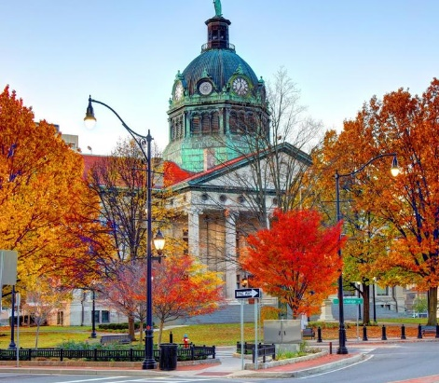
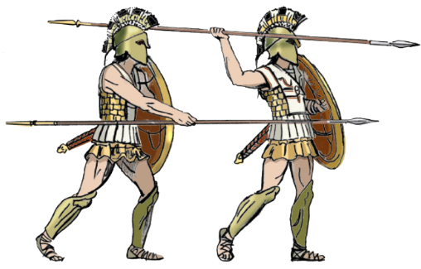
λαλῶμεν ἑλληνιστί! “Let’s speak Greek” (cont’d)
A. τῇ πόλει Binghamton ἐπεθέμην.
  “I attacked (the city of) Binghamton.”
B. χάριν σοι ἔχω.
A. ἀσμένως.
INDIC | IMPERAT | INFIN | PTC
aorist middle
ἐπ-ἐθέ‑μην ἐπ-έθου ἐπ-έθε‑το ἐπ-εθέ‑μεθα ἐπ-έθε‑σθε ἐπ-έθε‑ντο | ἐπιθοῦ ἐπιθέσθε | ἐπιθέσθαι | ἐπιθέμενος, ‑η, ‑ον

