Slide 1
CH19
GRK 102

Slide 2
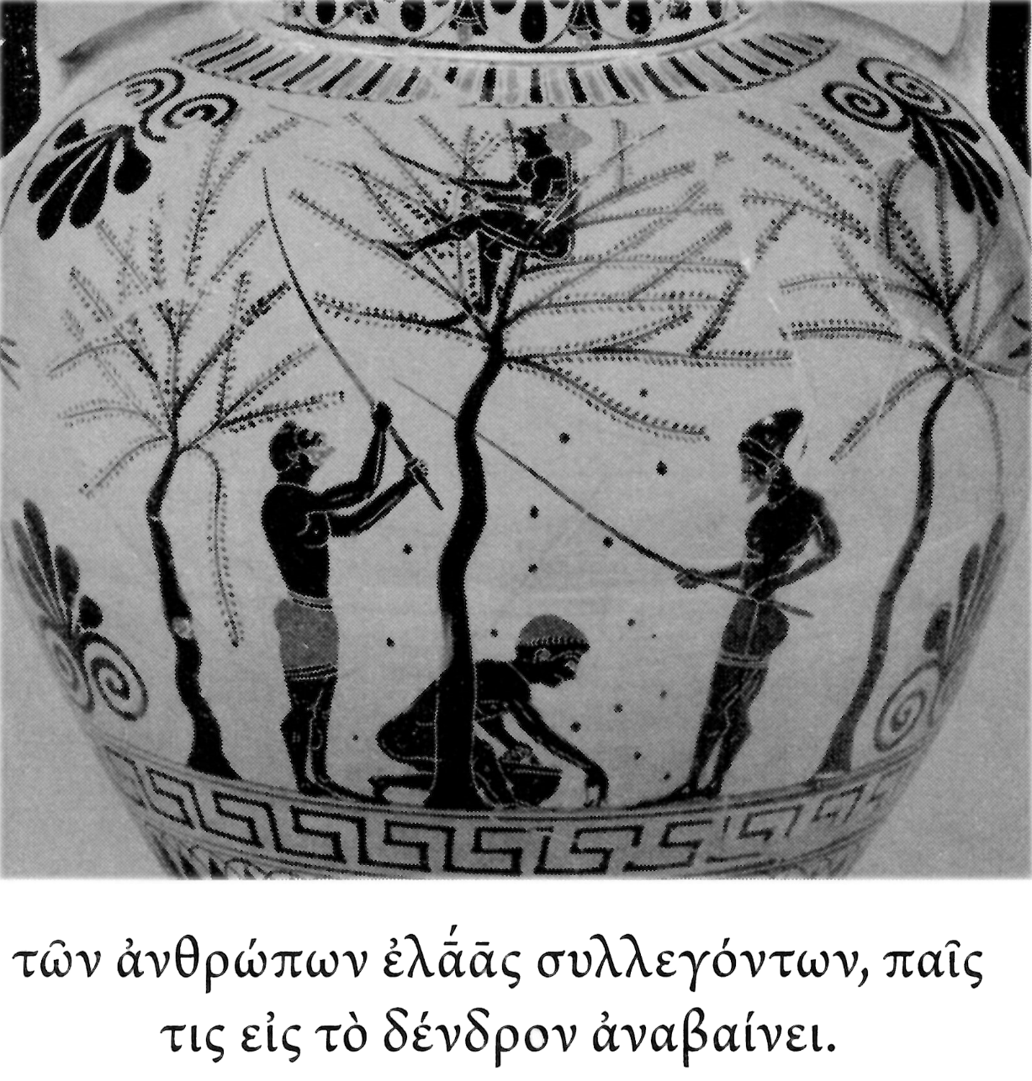
VOCAB
ἡ ἐλάᾱ, τῆς ἐλάᾱς olive
συλλέγω to collect
ἀναβαίνω to go up, to climb up

Slide 3
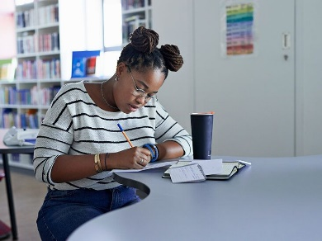
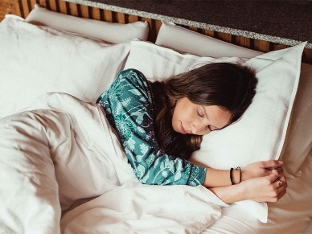
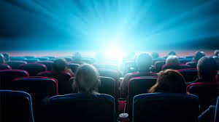

λαλῶμεν ἑλληνιστί! “Let’s speak Greek”
τί ἐποίησας χθές; πότερον…
  ἐμάνθανες, ἢ
  ἐκάθευδες, ἢ
  ταινίαν τινὰ (“a film”) ἔβλεπες, ἢ
  ἄλλο τι ἐποίησας;

Slide 4
Let’s Talk about ἵστημι
Comments/questions
Explain the principal parts
Discussion on handout
Discussion in book
1. ἵστημι
2. στήσω
3α. ἔστησα
3β. ἔστην
4. [ἕστηκα]
5. [ἕστᾰμαι]
6. ἐστάθην

Slide 5
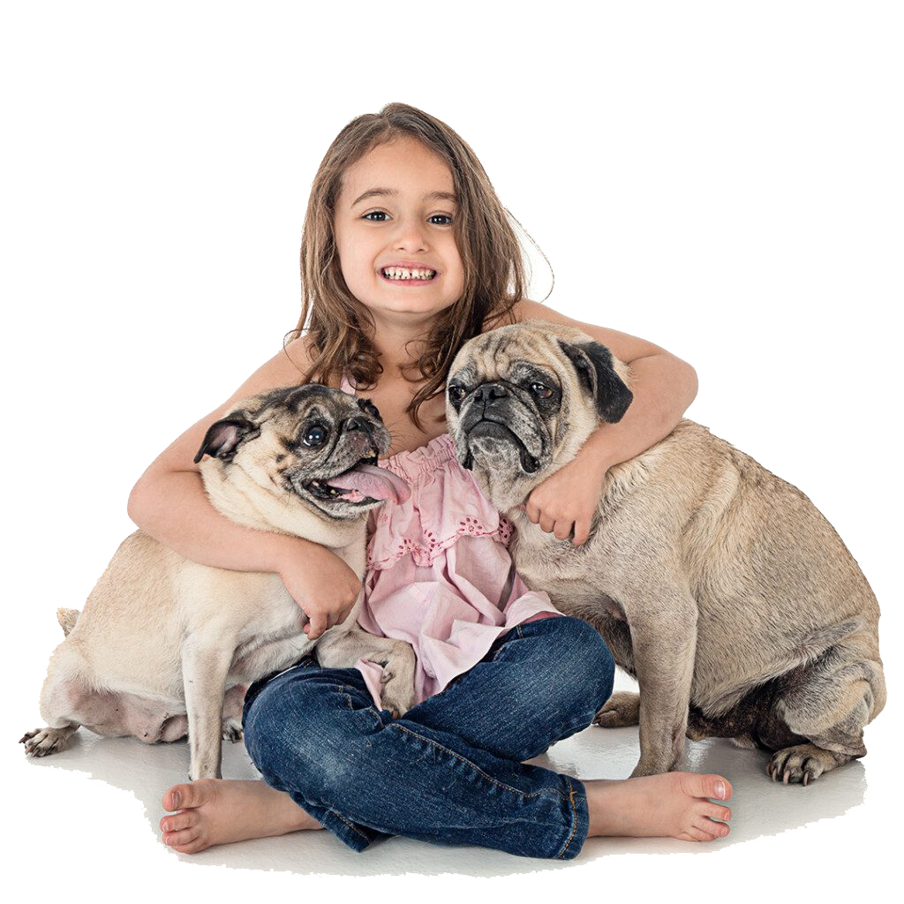
What’s going on? (translate, explain)
ἡ παῖς τοὺς κύνας ἔστησεν.
οἱ κύνες ἔστησαν.
οἱ κύνες ὑπὸ τῆς παιδὸς ἐστάθησαν.
κύον· στῆθι.
τοῦ κυνὸς στάντος, ἡ παῖς ἀνέστην.

Slide 6


λαλῶμεν ἑλληνιστί! “Let’s speak Greek”
τί ἐποίησας χθές; πότερον…
  ἐμάνθανες, ἢ
  ἐκάθευδες, ἢ
  ταινίαν τινὰ (“a film”) ἔβλεπες;

Slide 7
Let’s Talk about ἵστημι (again)
Comments/questions
Explain the principal parts
Discussion on handout
Discussion in book
1. ἵστημι
2. στήσω
3α. ἔστησα
3β. ἔστην
4. [ἕστηκα]
5. [ἕστᾰμαι]
6. ἐστάθην

Slide 8
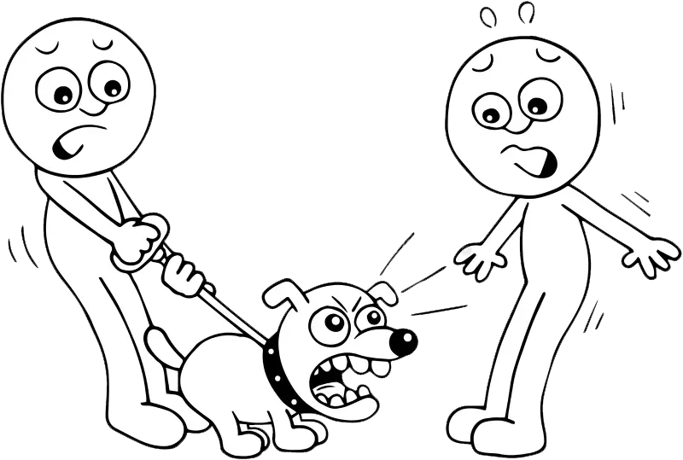
Let’s Talk about ἵστημι (again, cont’d)
ὁ κύων τὸν ξένον εἰς φόβον κατ-έ-στησεν (English?)
  present? (all else same)
  future?
  “The foreigner became afraid”
κύον· τὸν ξένον εἰς φόβον κατάστηθι

