Slide 1
CH20
GRK 102

Slide 2

λαλῶμεν ἑλληνιστί. οἶκος “home”
ΔΙΔΑΣΚΑΛΟΣ ὦ _______, ἐν τίνι πόλει οἰκεῖς;
ΜΑΘΗΤΡΙΣ ὦ διδάσκαλε·
  ἐν τῷ Νέῳ Ἐβοράκῳ οἰκῶ.
  ἐν τῇ Ἑστιάπολει οἰκῶ.
  ἐν τῇ Binghamton πόλει οἰκῶ.
  ἐν ___________ οἰκῶ.
Μ ὦ διδάσκαλε, και σύ· ἐν τίνι πόλει οἰκεῖς;

Slide 3

δείκνῡμι “show” (etc.)
δείκνῡµι, principal parts:
  δείκνῡµι. (pres system)
  δείξω. (fut act/mid system)
  ἔδειξα. (aor act/mid syst)
  δέδειχα. (perfect active)
  δέδειγµαι. (perfect mid/pass)
  ἐδείχθην. (aor, fut pass)
ἐπι-δείκνῡμι (active)
  Demonstrate (a proof, technique, etc.)
ἐπι-δείκνῡμαι (middle)
  Show off (a skill, wisdom, etc.)
Verbs like δείκνῡμι in present, imperfect tenses
  ζεύγνῡμι (yoke animals together)
  ἀνοίγνῡμι (open)
  ῥήγνῡμι (break)

Slide 4
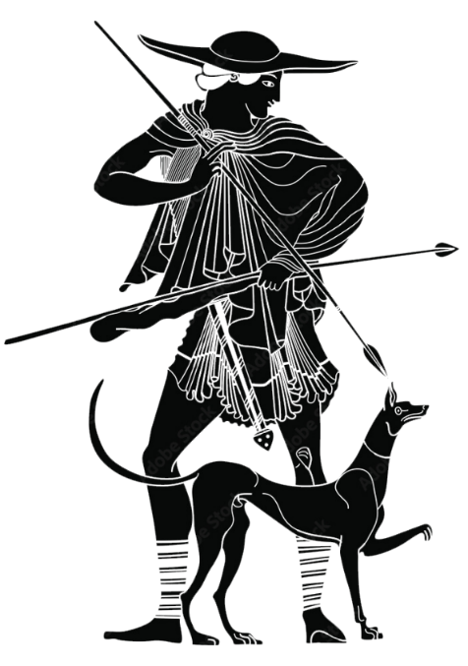
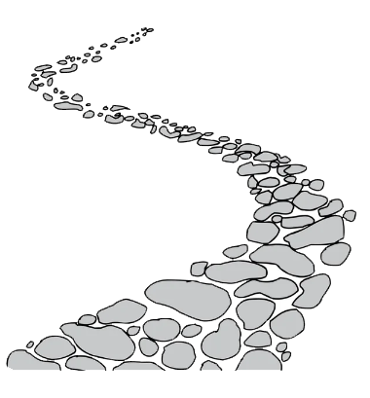
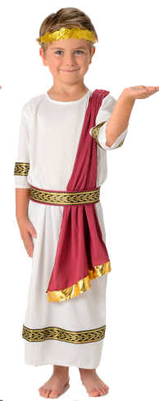
δείκνῡμι “show” (etc., cont’d)
ὁ νεανίας τῷ Φιλίππῳ τὴν ὁδὸν δείκνῡσιν
χθές ὁ νεανίας τῷ Φιλίππῳ τὴν ὁδὸν [was showing]

Slide 5




λαλῶμεν ἑλληνιστί. οἶκος “home”
ΔΙΔΑΣΚΑΛΟΣ ὦ _______, ἐν τίνι πόλει οἰκεῖς;
ΜΑΘΗΤΡΙΣ _______
Δ ὦ μαθητρί, τίνα ἐργασίαν ποιεῖς; πότερον ἐργάζῃ...
ἐν τοῖς ἀγροῖς, ἢ
ἐν οἰνοπωλίῳ τινι, ἢ
σπουδάζεις ἐν τῷ πανεπιστημίῳ;
Μ _______

Slide 6
ἀφίημι, λανθάνω
ἡ μὲν γυνή, “μὴ ἄφες τὸν δοῦλον, ὦ ἄνερ,” ἔφη
ὁ δὲ ἀνὴρ αὐτὸν ἀφεὶς τὴν γυναῖκα ἔλαθε

